Slide 1
From All to Each and Every: Tools and Strategies for Preparing Early Childhood Professionals Who Can Individualize
Master Class
November 14, 2014

Slide 2

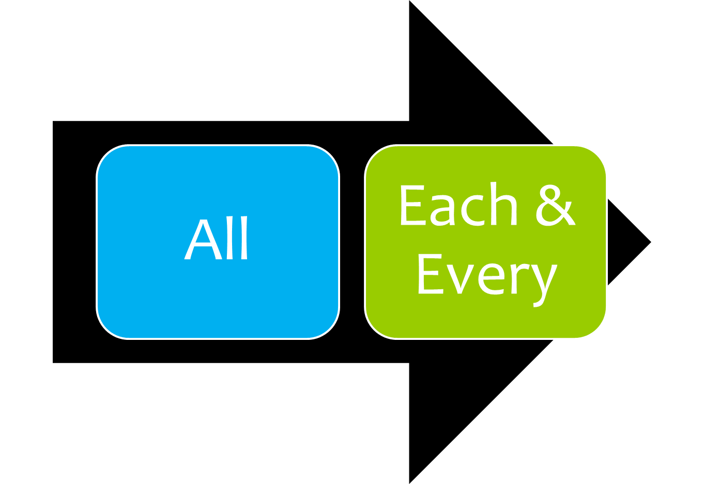

Slide 3

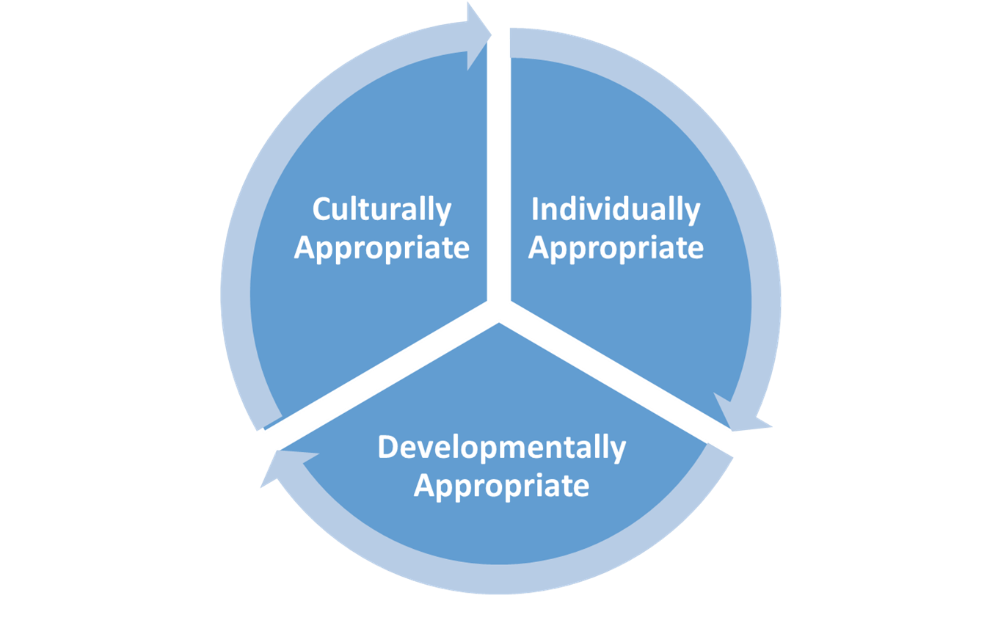
Parts of a Whole
Notes:
Agenda/objectives
What’s in packet

Slide 4
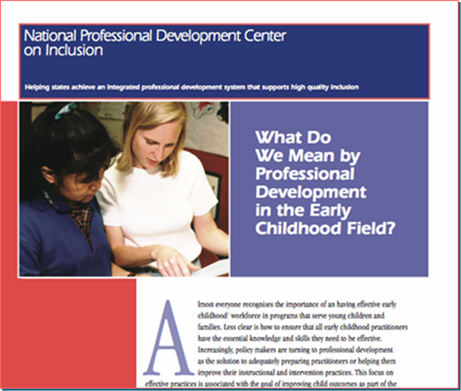
Knowledge
acquisition +
Knowledge application =
Effective professional development

Slide 5
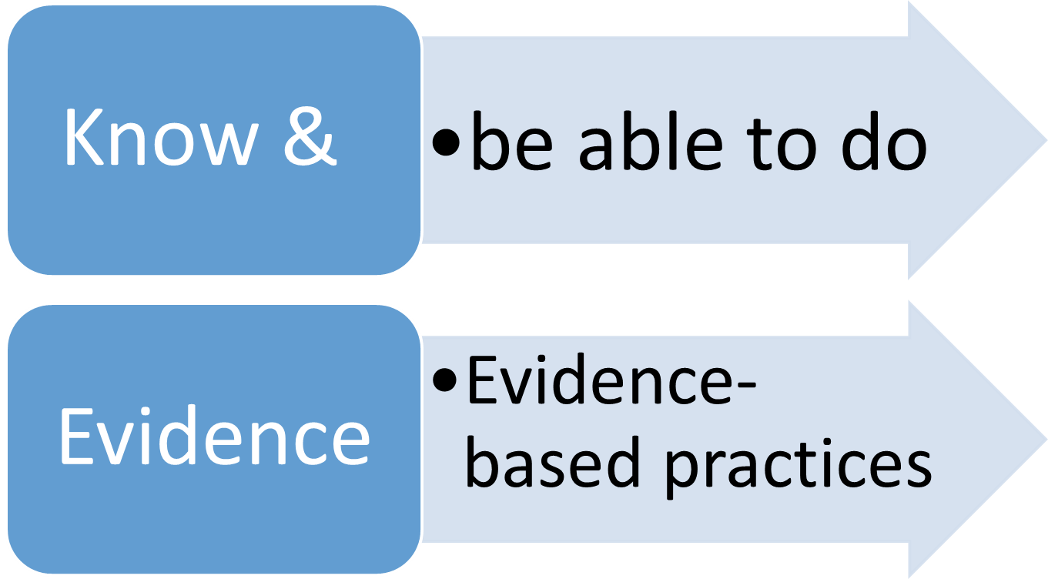

Slide 6
In your group . . . .
Pretend your apple is bright red
Create the longest possible numbered list of descriptors

Slide 7
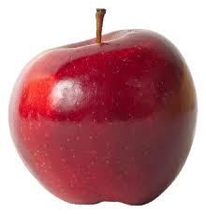

Slide 8
apple

Slide 9
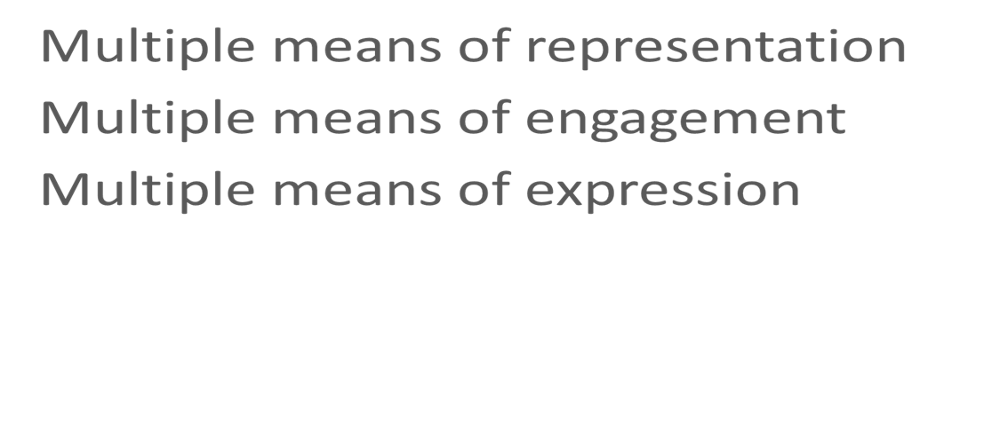

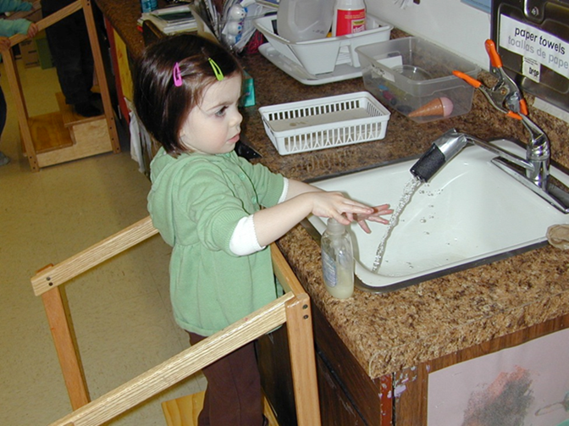
Universal Design for Learning

Slide 10
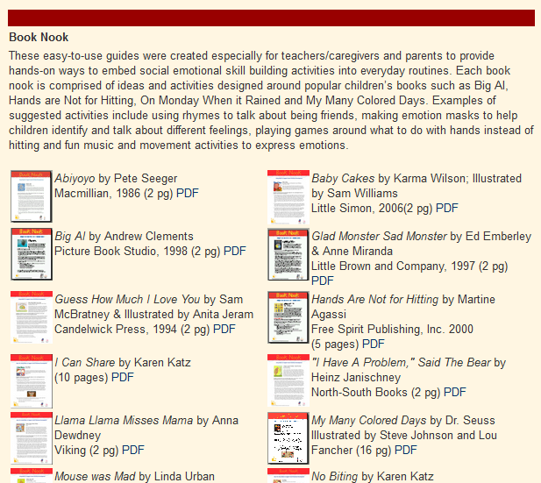
Book Nook Project
Notes:
Agenda/objectives
What’s in packet

Slide 11


Book Nook Project
Circle Art/colors
Sensory Movement
Outdoors
Notes:
Agenda/objectives
What’s in packet

Slide 12


Slide 13
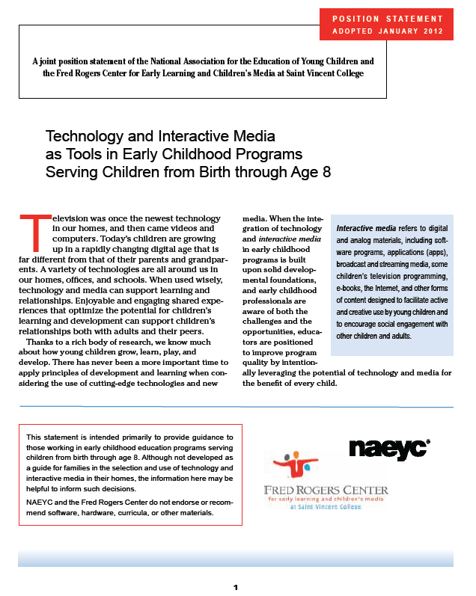

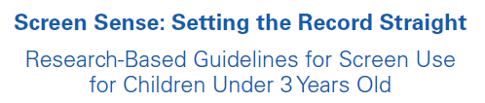

Slide 14
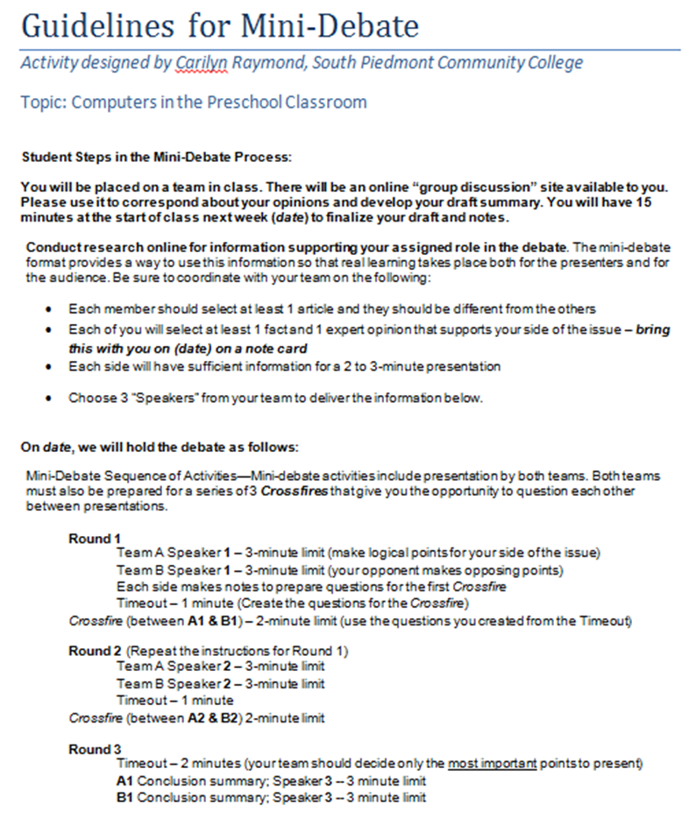


Slide 15
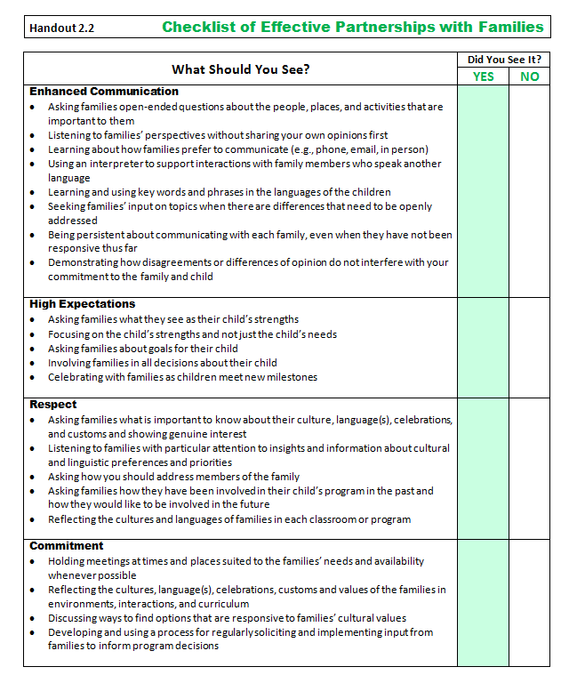
Building Effective Partnerships with Families
Enhanced communication
High expectations
Respect
Commitment

Slide 16
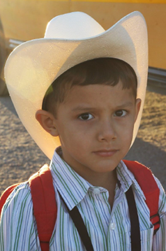
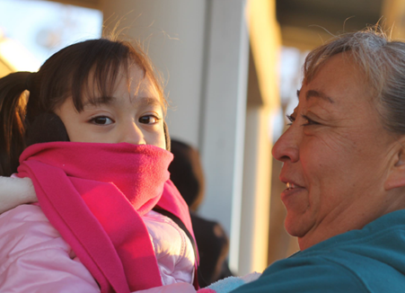
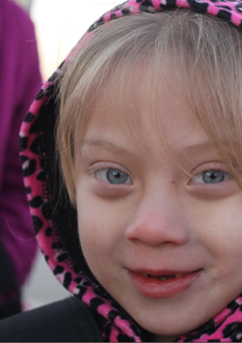
What to do about Mother’s Day?
This child lives with his two fathers
This child lives with her mother and her abuela (grandmother)
This child lives with her older sister

Slide 17
Considerations
Why do we celebrate this holiday?
What developmental concepts do you count on addressing in your celebration of this holiday?
Are there other ways you could address those concepts?

Slide 18
Rethinking holidays
Tradition | Opportunities
Mother’s Day / Father’s Day | Special Family Member Day
Halloween | Harvest
Thanksgiving | Autumn

Slide 19
Remember
6 + 3 = 9
but so does 5 + 4
The way you do things is not always
the only way to do them

Slide 20
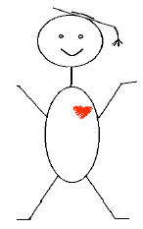
Clarifying a Vision
Identify the qualities of an effective early childhood teacher
Identify the knowledge, skills, and dispositions you want your graduates to have when they leave your program

Slide 21


What’s the connection?

Slide 22
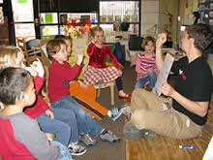
You have a new group of preschool age children to work with.
Several of the children qualify for free/reduced meals.
Several of the children speak Spanish exclusively at home.
Several of the children are from different New Mexico tribes.
To support each child’s full participation, what will you do to. . .
Engage their families?
Reflect each child in your environment and materials?
Build on each child’s strengths?
Maintain high expectations and support each child in achieving them?

Slide 23



Co-sponsored by and
FREE 2015 Webinar Series: Resources, Activities, & Strategies to Support Your Courses
Looking for course-specific resources, activities, & strategies to support student learning around inclusion and diversity? Join us for a series of webinars designed specifically for early childhood community college faculty.
February 3, 2:00 – 3:00 pm EST Introduction to Early Childhood Education | August 4, 2:00- 3:00 pm EST. Health, Safety, and Nutrition
March 3, 2:00 – 3:00 pm EST Child Development (Birth to Age 8) | September 1, 2:00- 3:30 pm EST. Children with Exceptionalities
April 7, 2:00 – 3:00 pm EST Infants, Toddlers, and Twos | October 6, 2:00- 3:30 pm EST. Creative Activities
May 5, 2:00 – 3:00 pm EST Child, Family and Community | November 3, 2:00- 3:00 pm EST. Early Childhood Practicum
June 2, 2:00 – 3:00 pm EST Language and Literacy Experiences | December 1, 2:00- 3:00 pm EST. Educational Technology
July 7, 2:00- 3:00 pm EST. Child Guidance
Presenter: Camille Catlett
FPG Child Development Institute/SCRIPT-NC
Register HERE: https://unc.az1.qualtrics.com/SE/?SID=SV_0vSTmJ89AYJlaNn
Notes:
November 6, 12:00 – 1:00
Topic: Creative Activities

Slide 24
Toolkit
Quality Sections (2)
Foundations of Early Childhood Quality
Foundations of Early Childhood Quality in Delaware
Content Sections (11)
Ability Diversity/Inclusion
Approaches to Learning
Creative Expression
Cultural Diversity
Family Engagement
Health, Safety, Nutrition, and Physical Development
Language and Literacy
Etc.

Slide 25
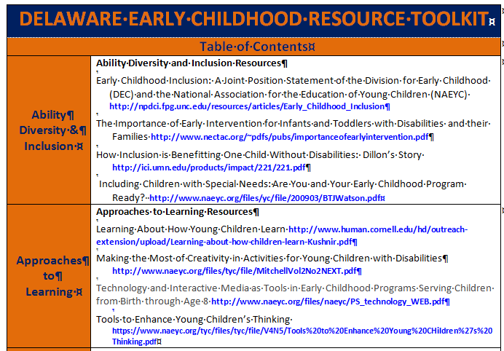
Table of Contents

Slide 26
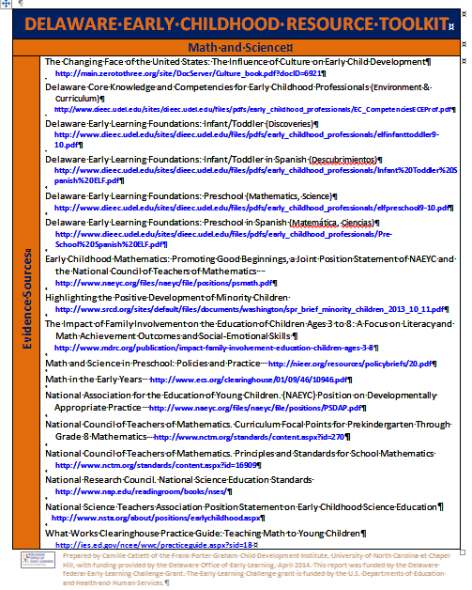
Content Sections
Evidence sources
Books
Articles
Audiovisual Resources
Web Resources

Slide 27
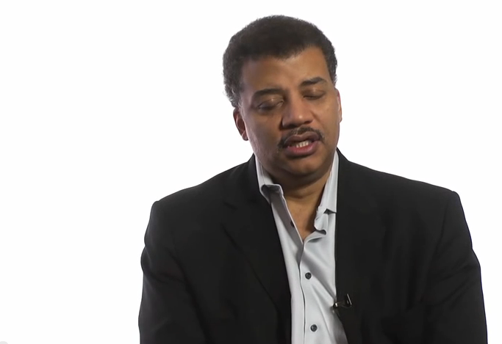
http://www.youtube.com/watch?v=AIEJjpVlZu0

Slide 28


Slide 29


Focusing on assets

Slide 30
Perspective Taking
What are her strengths? | What are his strengths?
What’s important to her? | What’s important to him?
Where could they start?

Slide 31
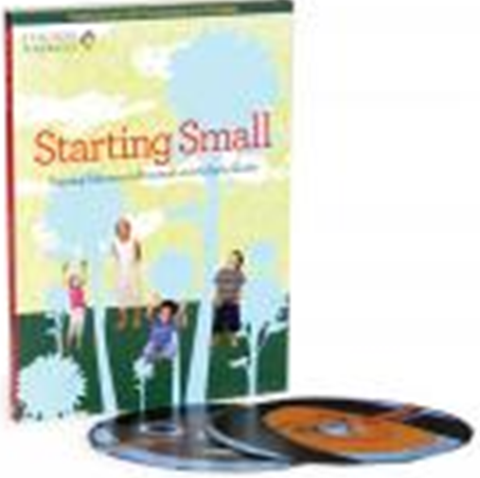

Starting Small
Free DVD + book with examples
of anti-bias practices from six
early childhood classrooms
across the country
Notes:
Source: Teaching Tolerance. (1997). Starting small: Teaching tolerance in preschool and the early grades. Birmingham, AL: Southern Poverty Law Center. http://www.tolerance.org/kit/starting-small

Slide 32
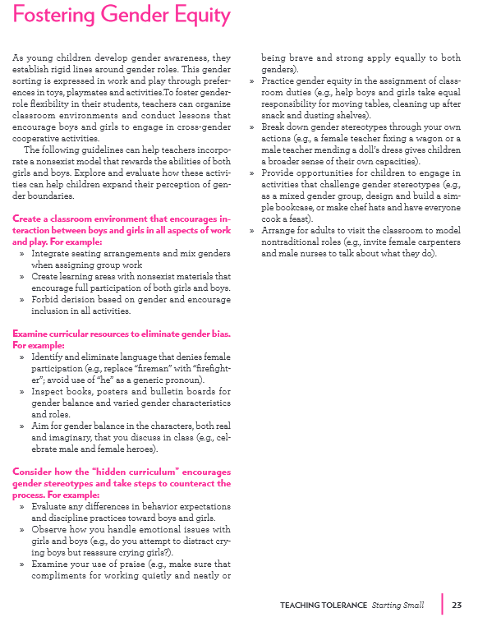
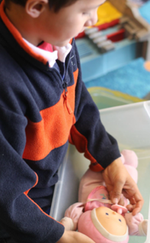

Notes:
Source: Teaching Tolerance. (1997). Starting small: Teaching tolerance in preschool and the early grades. Birmingham, AL: Southern Poverty Law Center. http://www.tolerance.org/kit/starting-small

Slide 33
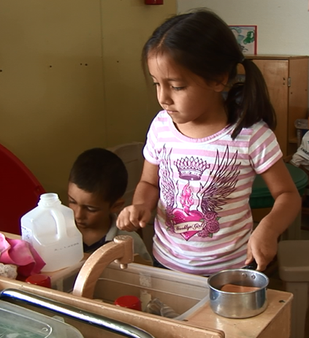
Meet Marta.
She’s four and new to a child care program in her neighborhood.
She is a sequential dual language learner. She has grown up in a home where Spanish is the language spoken. She is now learning English from her teacher.
During her first few days in the program, Marta tried to speak Spanish. She is now silent because no one has responded to her.
She follows simple commands if there are other children to model what to do.
She’s not interested in the books the teacher reads in English, but her family says she loves books and music
Notes:
Source: Strategies for supporting all dual language learners. Retrieved from
http://eclkc.ohs.acf.hhs.gov/hslc/tta-system/cultural-linguistic/docs/dll-strategies.pdf

Slide 34
What would you do to support Marta in the areas of listening and emergent literacy?

Slide 35
Ask Marta’s family to share and tape record some key words to use in the classroom
Use tunes and gestures to help Marta understand new content
Create opportunities for Marta to participate in non-verbal ways while she’s adjusting to the English-speaking environment
Encourage Marta’s peers to model the way for her
Find out what books Marta enjoys at home and make copies available in the classroom
Ask all children, including Marta, to bring in photos of family members so each child can take turns naming their “peeps”
What would you do to support Marta?
Notes:
Source: Strategies for supporting all dual language learners. Retrieved from
http://eclkc.ohs.acf.hhs.gov/hslc/tta-system/cultural-linguistic/docs/dll-strategies.pdf

Slide 36

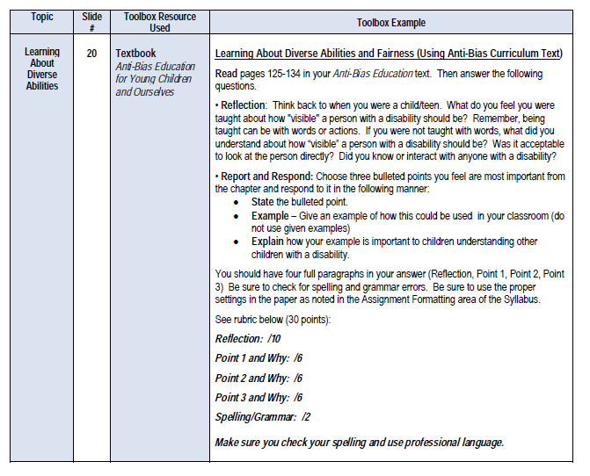

Slide 37


