Slide 1

Welcome to Extending Your Reach: A Master Class
Supported by Bright from the Start: Georgia Department of Early Care and Learning
Camille Catlett Peggy Gallagher
Nichell Moore Cindy Vail

Slide 2
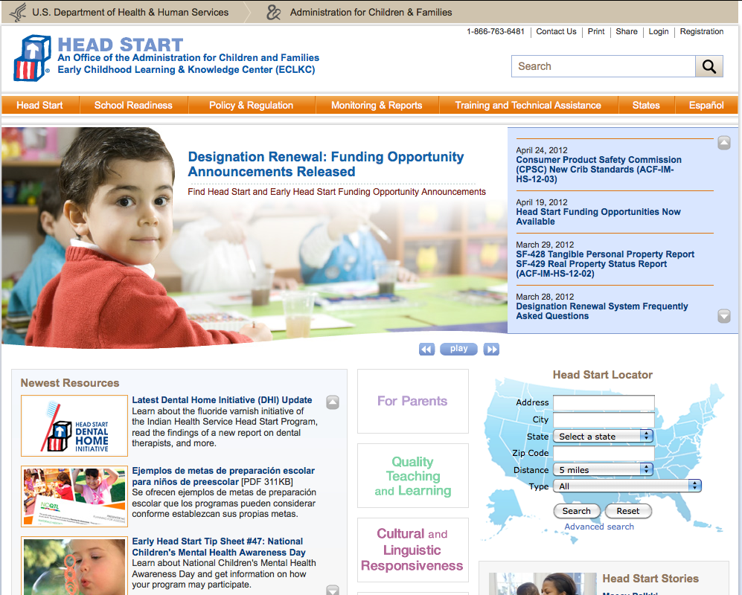
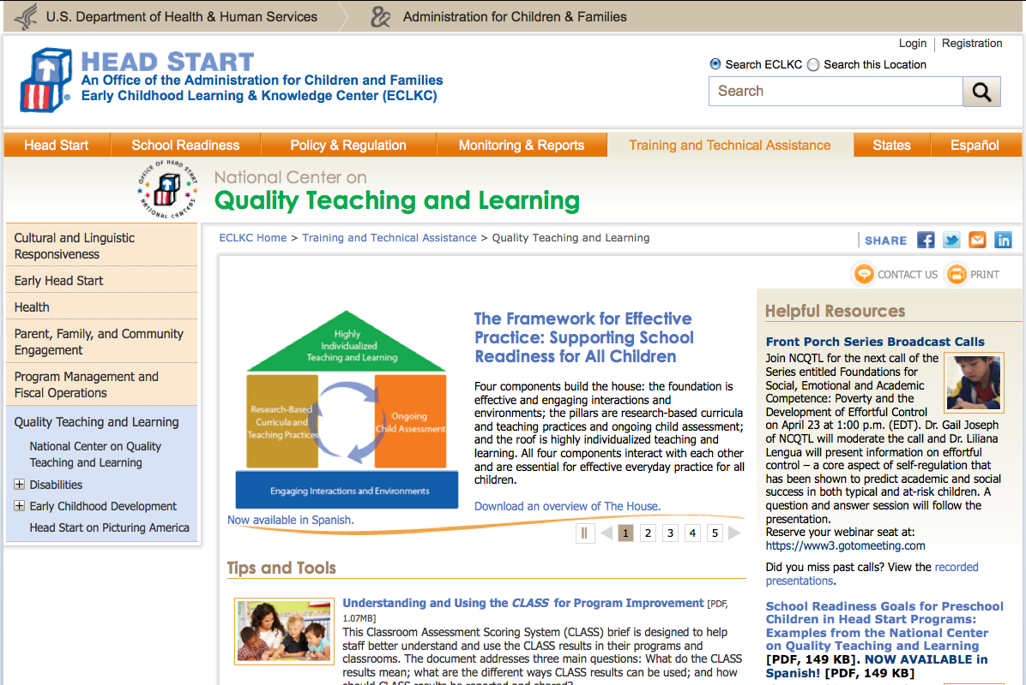
Early Childhood Learning and Knowledge Center

Slide 3

National Center for Quality Teaching and Learning
National Center on Quality
Teaching and Learning
New Web Site
Launch!

Slide 4
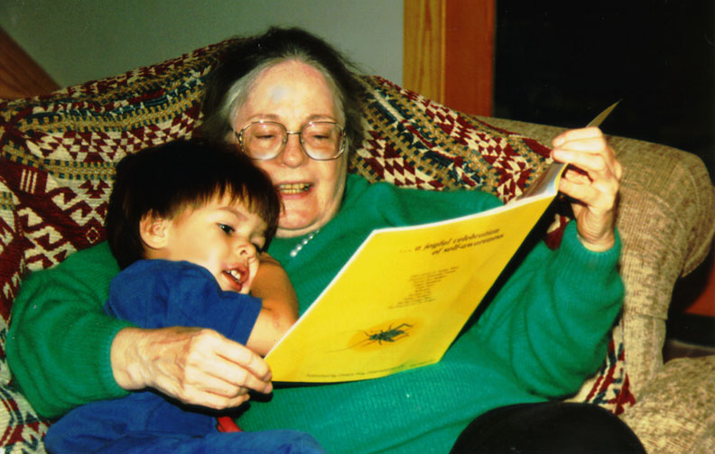
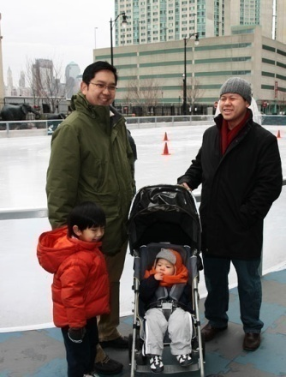
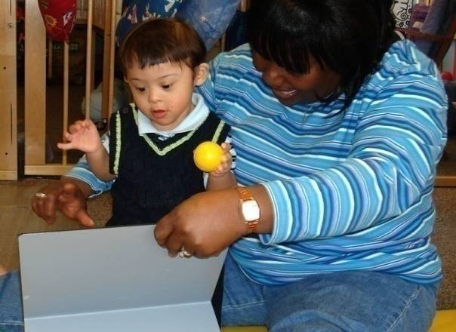
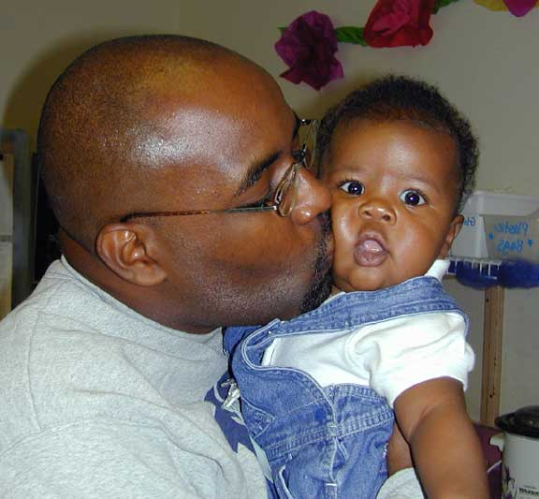
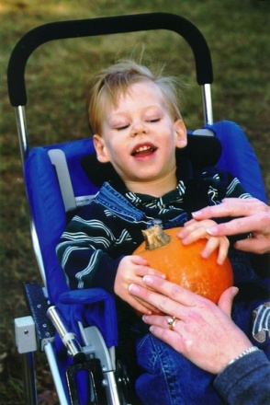
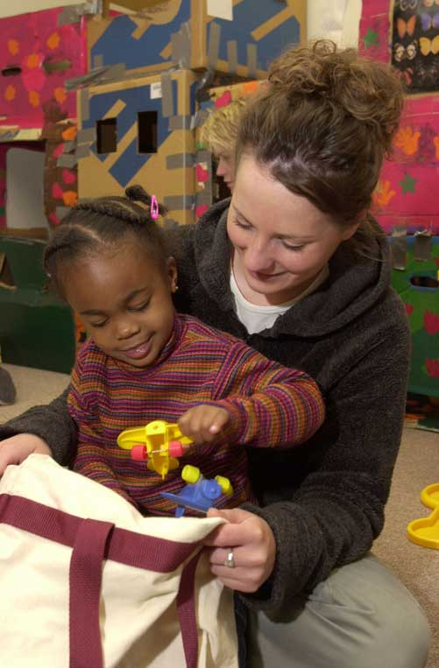
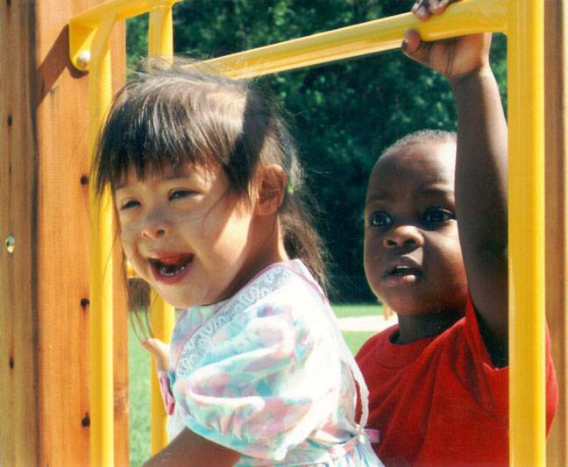
CONNECT
The Center to Mobilize Early Childhood Knowledge
http://connect.fpg.unc.edu/
Notes:
4

Slide 5

Fred Rogers Center Early Learning Environment
Curriculum Toolkit

Slide 6
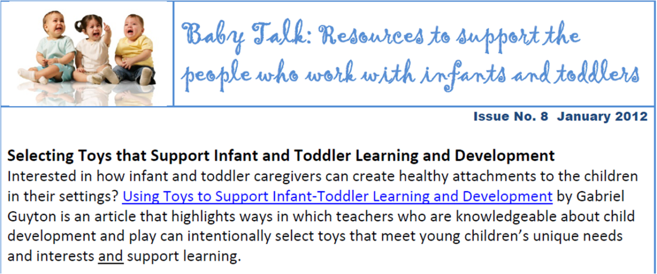
Notes:
6

Slide 7

http://csefel.vanderbilt.edu/

Slide 8


TECHNICAL ASSISTANCE CENTER ON SOCIAL EMOTIONAL INTERVENTION for young children
TACSEI Families Community

Slide 9
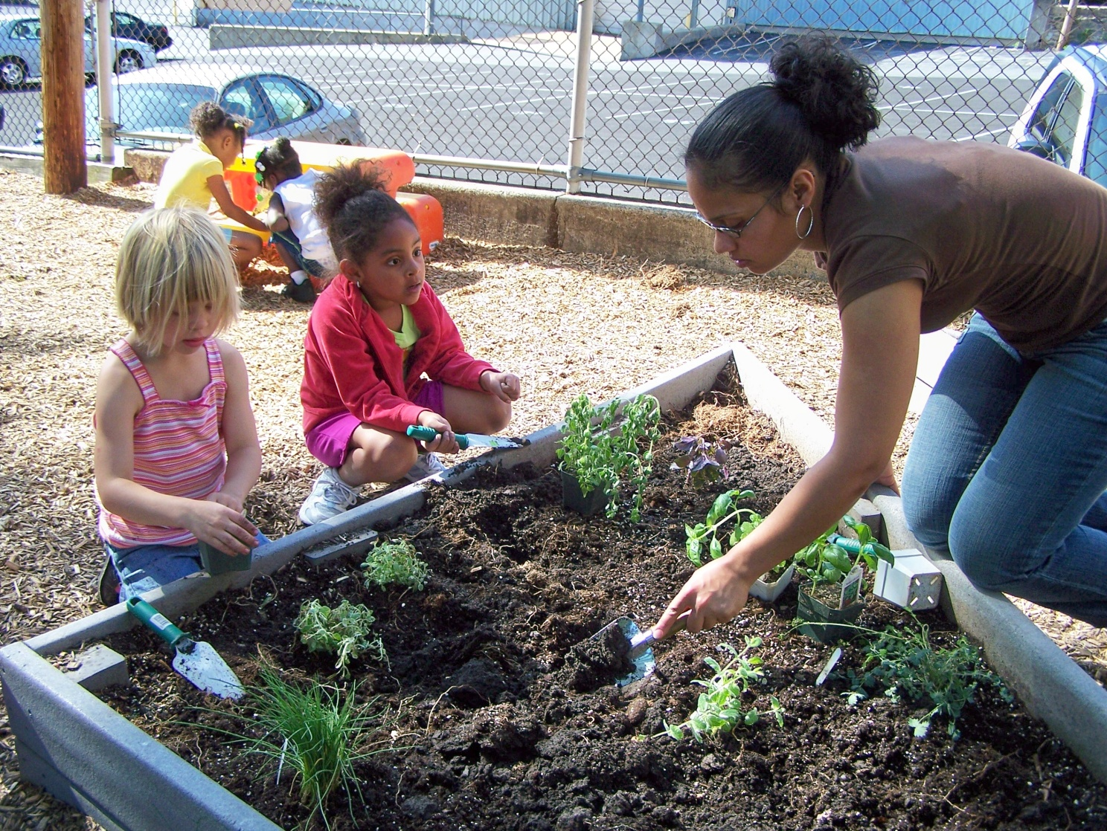
Clips for Practicing Observation

Slide 10

http://www.earlyliteracylearning.org/
General Practice Guides Especially for Parents

Slide 11

¡Colorín colorado!
Meet Tenisha, a pre-K teacher who wants to maximize the benefits of storybook reading for the children in her class. Learn about how to use dialogic reading practices to engage children and help them develop early language and literacy skills.
CONNECT Module 6

Slide 12


READING rockets
For Parents
Videos and Podcasts

Slide 13
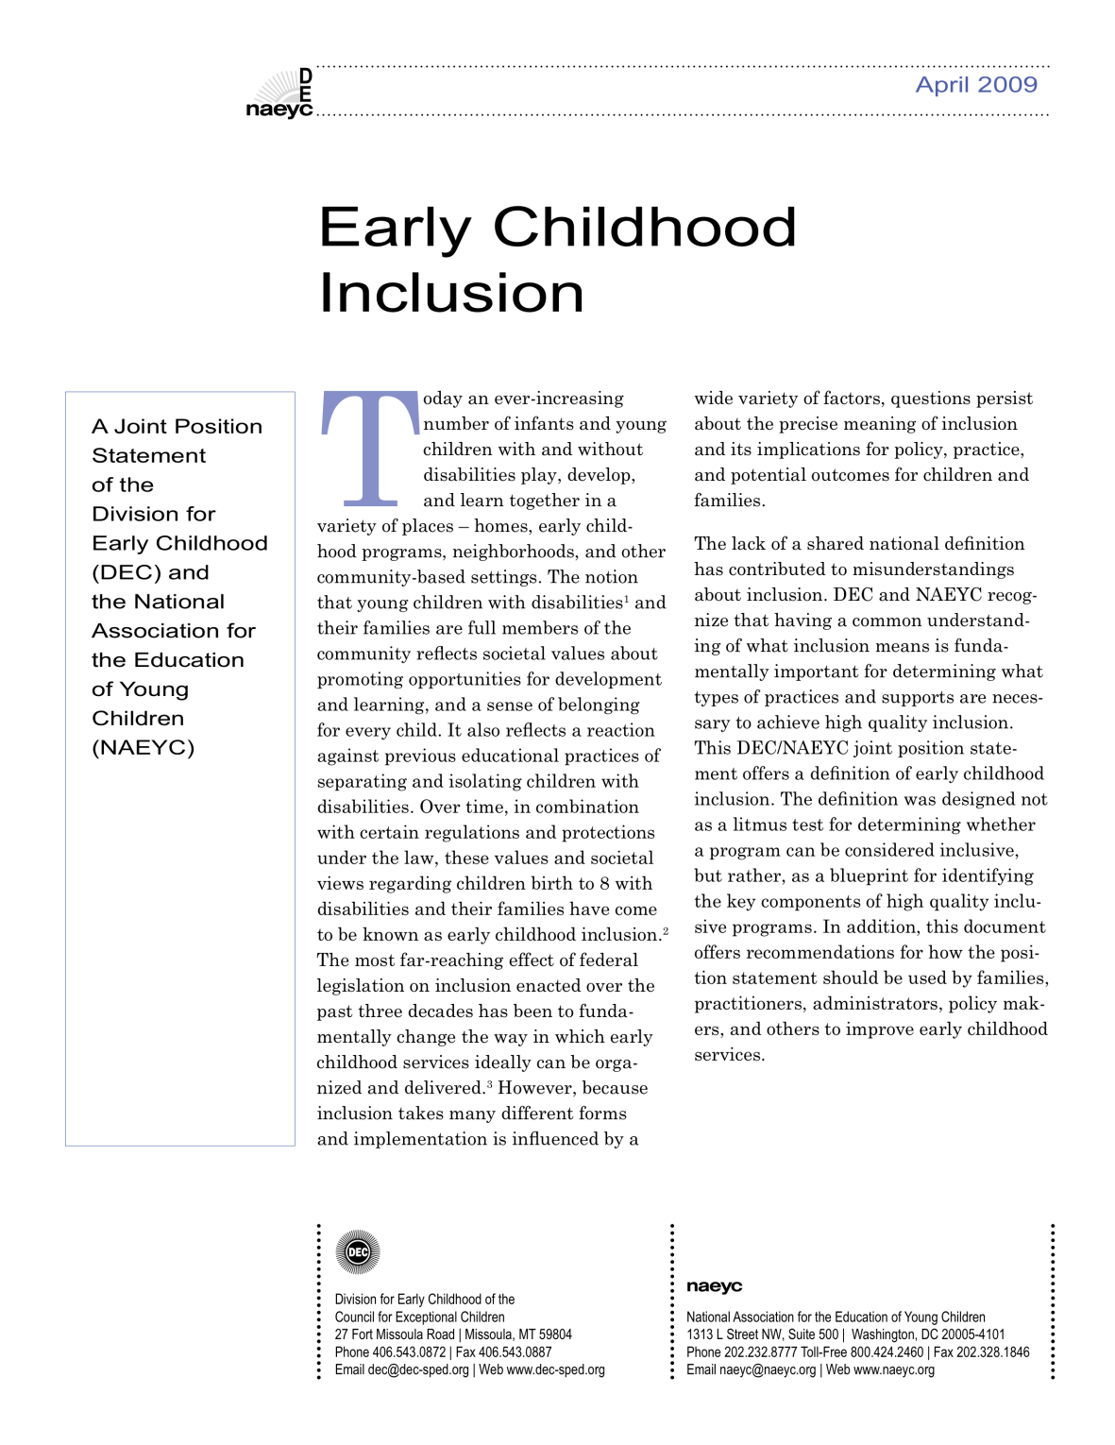
What do we mean by inclusion?
ACCESS
PARTICIPATION
[SYSTEMIC] SUPPORTS
Notes:
13
13

Slide 14

Definition of Inclusion
Early childhood inclusion embodies the values, policies, and practices that support the right of every infant and young child and his or her family, regardless of ability, to participate in a broad range of activities and contexts as full members of families, communities, and society. The desired results of inclusive experiences for children with and without disabilities and their families include a sense of belonging and membership, positive social relationships and friendships, and development and learning to reach their full potential. The defining features of inclusion that can be used to identify high quality early childhood programs and services are access, participation, and supports.

Slide 15
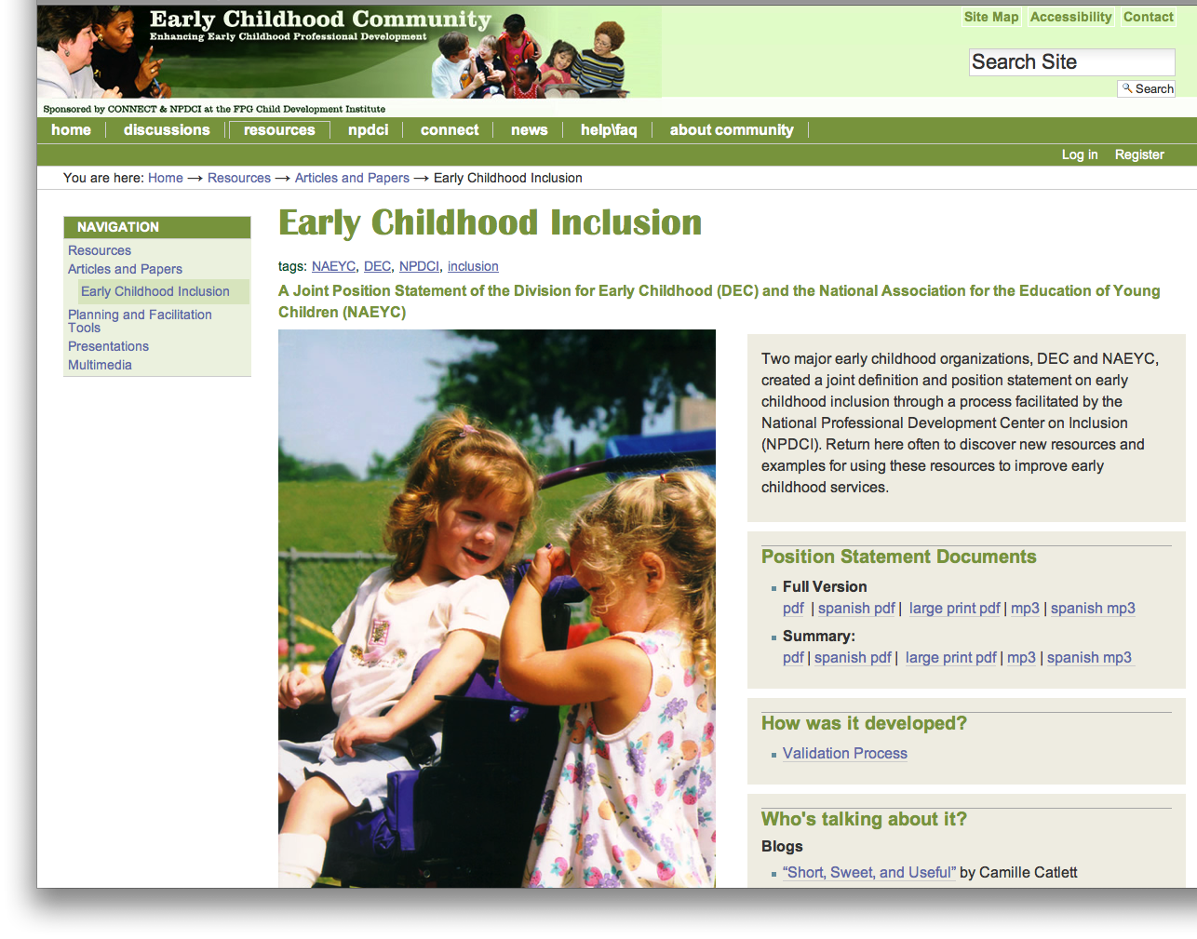
Additional Resources

Slide 16
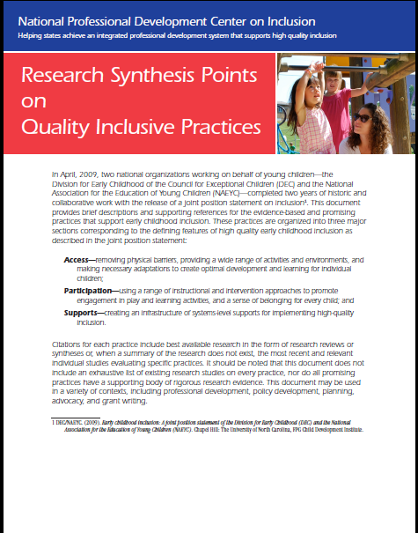
Research Synthesis Points on Quality Inclusive Practices

Slide 17

Adaptations Help All Children
Adaptations allow teachers to do the same things that they would do with all children—facilitate their participation in activities and routines. Adaptations can be used to:
Make situations better
for a particular child.
Improve situations for
the entire group.

Slide 18
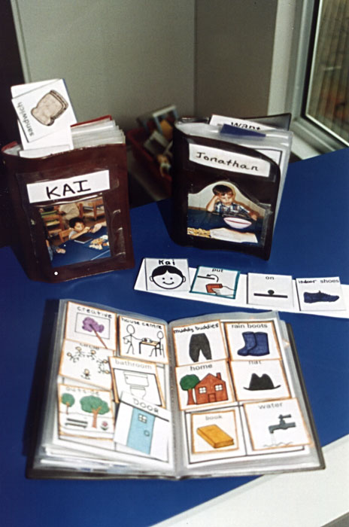
CARA’s Kit
Creating Adaptations for
Routines and Activities -
adaptations to increase
children’s engagement
and participation in
classroom activities
and routines.

Slide 20

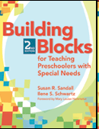
Meet Drew
3 years old
Lives with parents and two brothers, one older and one younger
Diagnosed with autism at 30 months
Cognitive skills are near age-appropriate
Significant delays in social and communication skills
Rarely initiates or engages in social conversation
Favorite toys: trains, Disney figurines, markers
Tendency to tantrum
Difficult time following directions
Reacts strongly when told “no”

Slide 21
Putting It All Together
Drew can find transitions to be very challenging. Use the Adaptation Notes to think about ways in which you can help him be successful during transitions.

Slide 22
Handouts on EBP that Support Inclusion

Slide 23
Read About It

Slide 24

See For Yourself
Notes:
Railings have been attached to a step stool to support the child in reaching the sink. Orange pliers were attached to the handle so she can independently turn the water on and off. A hose was secured to the faucet to direct the water closer to her.

Slide 25

Find It Online
National Center to Improve Practice Early Childhood Guided Tour

Slide 26

Embedded Learning Opportunities videos
Embedded Learning Opportunities resources (PowerPoints, presenter notes, handouts)
Notes:
Video 1.12: Routine in a Program-Rolling with Friends
26

Slide 27
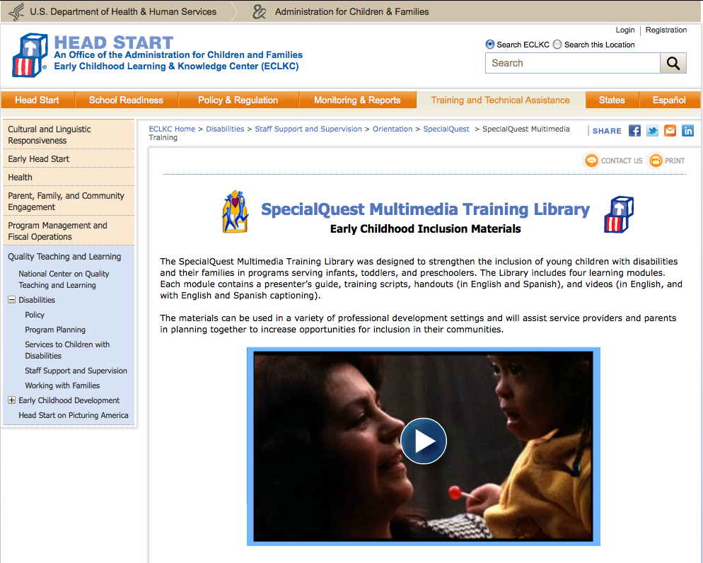
SpecialQuest Multimedia Training Library
SpecialQuest Multimedia Training Library

Slide 28


Slide 29
CULTURAL
COMPETENCY:
WHAT IT IS AND WHY IT MATTERS
http://www.californiatomorrow.org/
media/ccompetecy.pdf

Slide 30

Multicultural Principles for Head Start
Programs Serving Children Ages Birth
To Five
Organized around 10 principles
  Every individual is rooted in culture
  The cultural groups in the communities and families of each program are the primary sources for culturally relevant programming
Questions to support reflection, planning, and policy development

Slide 31
NAEYC Resource
Quality Benchmark for Cultural Competence Tool
  Seven core concepts of cultural competence, ideas for implementing culturally competent approaches in early childhood programs, and ideas for evaluating or measuring levels of cultural competence

