Slide 1

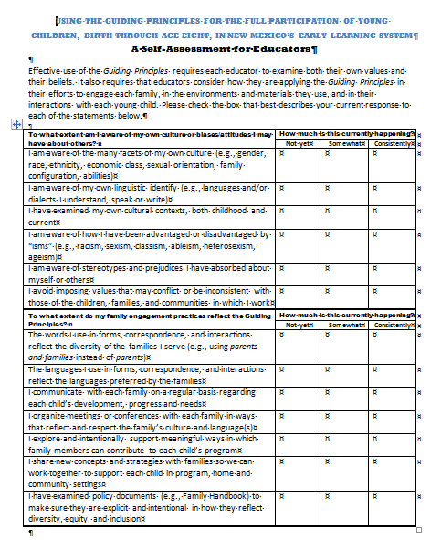
Welcome
Please complete the self-assessment before we get started

Slide 2
The Full Participation of Each Child
The Difference You Can Make
Session 3

Slide 3
Session 3 Objectives
Explain what is meant by full participation and why it is so important in New Mexico
Describe respectful, responsive, and effective practices for supporting each young children and their family
Demonstrate the use of effective approaches for resolving cultural dilemmas that arise in daily interactions with children and families
Use opportunities to reflect on, evaluate, and build their skill at supporting each young child and their family

Slide 4
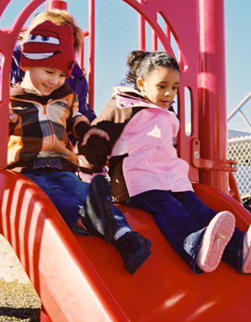
Full Participation
The range of practices that promote engagement in play, learning, development and a sense of belonging for each child
Notes:
Source: New Mexico Children, Youth and Families Department. (2014). FOCUS on young children’s learning: Essential elements of quality for center-based child care programs. Retrieved from https://www.newmexicokids.org/content/caregivers_and_educators/focus/docs/FOCUS_Criteria_Essential_Elements_of_Quality_08212014.pdf

Slide 5
What’s the best way . . .
To comfort a fussy baby?
To discipline a 4-year old?
To respond to a child who doesn’t like the food that is served to them at mealtime?
To respond to a child who is angry with you?

Slide 6
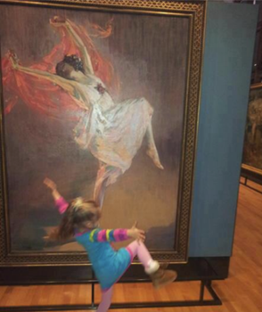
How many of you said “it depends?”
The best way will always be to first think of each child as an individual.

Slide 7
If Session 3 is being held on a different date than Session 2, insert About the Guiding Principles slides here.

Slide 8
Embed or show the Danger of the Single Story Video 1.1 here. Just show the first five minutes, stopping after the words “my roommate had a single story.”

Slide 9
Drop slides 16 – 21 from the original set here

Slide 10
Helping Children Support Full Participation
Insert or show Video 3.2 Starting Small – that sounds funny

Slide 11
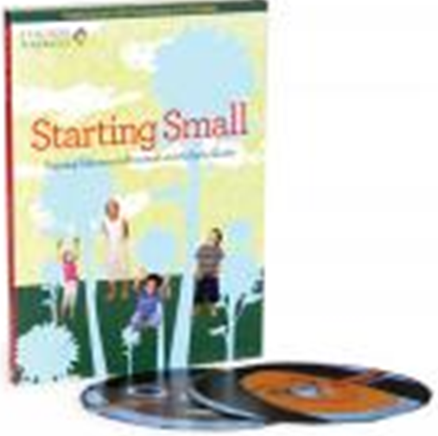

Starting Small
Free DVD + book with examples
of anti-bias practices from six
early childhood classrooms
across the country
Notes:
Source: Teaching Tolerance. (1997). Starting small: Teaching tolerance in preschool and the early grades. Birmingham, AL: Southern Poverty Law Center. http://www.tolerance.org/kit/starting-small

Slide 12
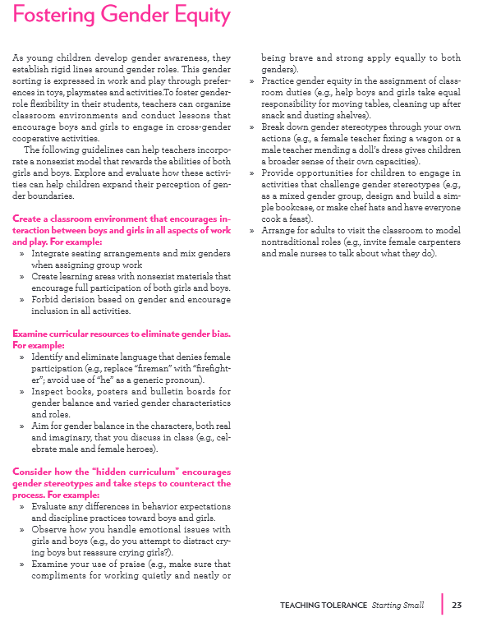
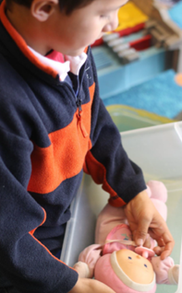

Notes:
Source: Teaching Tolerance. (1997). Starting small: Teaching tolerance in preschool and the early grades. Birmingham, AL: Southern Poverty Law Center. http://www.tolerance.org/kit/starting-small

Slide 13
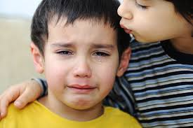
Teachable Moments
Don’t ignore what happened.
Respond in some way.
Ask questions to clarify what was said/what happened if you are not sure.
Answer questions simply and honestly.
Set boundaries if necessary.
Comfort children whose feelings were hurt.
Support the “victim” in taking action if he/she wishes.
Help problem solve the underlying reason for the conflict (if there was one) with the children.
Handout 3.2

Slide 14
Starting Small
Embed or play Video 3.3 – Starting Small I Care Rules
Notes:
Source: Teaching Tolerance. (1997). Starting small: Teaching tolerance in preschool and the early grades. Birmingham, AL: Southern Poverty Law Center. http://www.tolerance.org/kit/starting-small

Slide 15
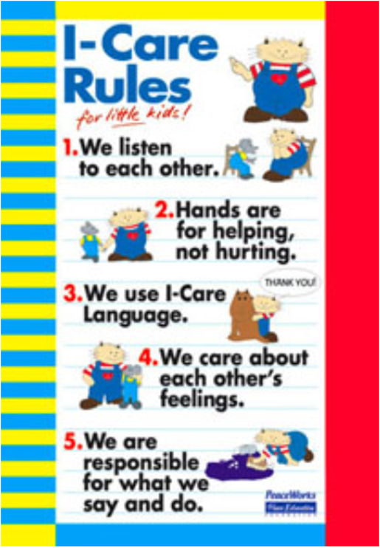
The “I-Care” Rules
We listen to each other.
2. Hands are for helping, not hurting.
3. We use I-Care language.
4. We care about each other’s feelings.
5. We are responsible for what we say and do.
Handout 3.3
Notes:
Source: PreK/K Peacemaking Skills for Little Kids (English and Spanish) http://store.peaceeducation.org/prekkindergartenpeacemakingskillsforlittlekids.aspx

Slide 16

Other resources
Practical strategies
Social stories
Book nooks
Handout 3.3 or
http://csefel.vanderbilt.edu/

Slide 17
Embed or Show Video 3.5 CONNECT Video 4.1
Notes:
Source: CONNECT Module 4: Family-professional partnerships
http://community.fpg.unc.edu/connect-modules/learners/module-4

Slide 18
Embed or show Video 3.5 CONNECT Video 4.2
Notes:
Source: CONNECT Module 4: Family-professional partnerships
http://community.fpg.unc.edu/connect-modules/learners/module-4

Slide 19
Perspective Taking
What are her strengths? | What are his strengths?
What’s important to her? | What’s important to him?
Where could they start?

Slide 20
Embed or play Video 3.4 Diversity and Communication
Notes:
Source: Gonzalez-Mena, J. (1996). Diversity and communication. Crystal Lake, IL: Magna Systems.

Slide 21
It’s not a question of giving up everything we know. It’s a question of balancing what we know and what the family knows, and figuring out together what would be in the best interests of the child.
Louise Derman-Sparks

Slide 22
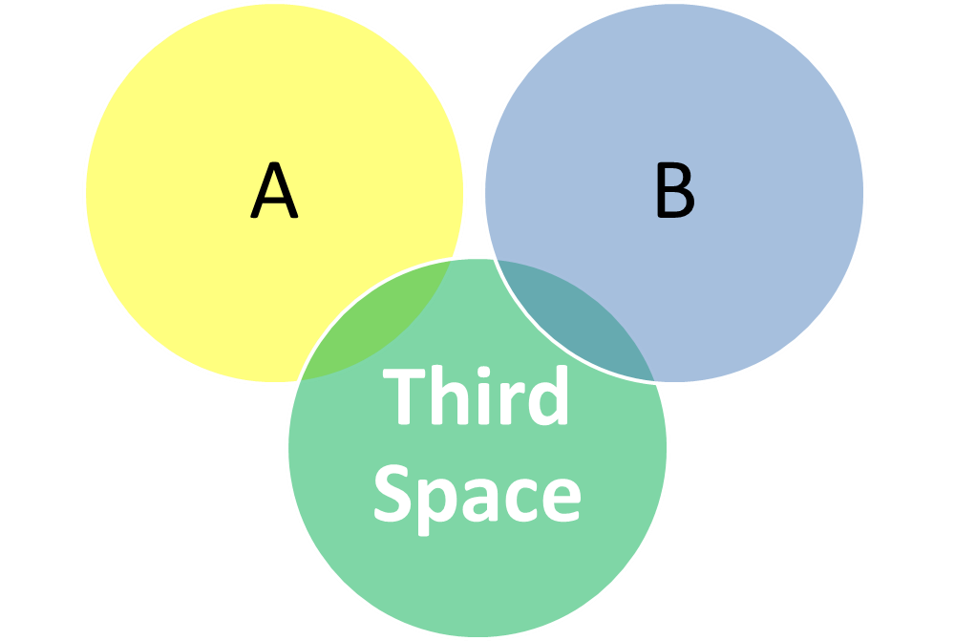
Notes:
Source: Barrera, I., & Corso, R. M. (2003). Skilled dialogue: Strategies for responding to cultural diversity in early childhood. Baltimore, MD: Brookes.

Slide 23
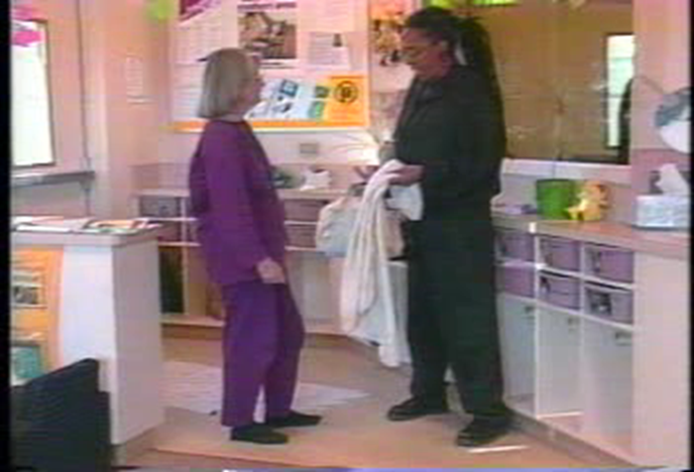
What’s one thing these two might be able to agree upon?
Notes:
Source: Barrera, I., & Corso, R. M. (2003). Skilled dialogue: Strategies for responding to cultural diversity in early childhood. Baltimore, MD: Brookes; Gonzalez-Mena, J. (1996). Diversity and communication. Crystal Lake, IL: Magna Systems.

Slide 24
A third approach
Acknowledge (recognize) the difference between your thoughts and the thoughts of another person
Ask respectfully for clarification or more information to more fully understand and clarify the issue
Adapt
Seek out common ground where possible
Come to a resolution that addresses the real issue
Handout 3.4
Notes:
Program for Infant-Toddler Caregivers. (1993). Essential connections: Ten keys to culturally sensitive child care. Sacramento, CA: Far West Laboratory.

Slide 25
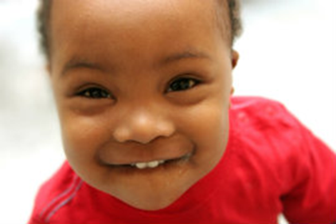
What would you do?
Imagine you are working in a toddler classroom in which the children are diverse (white, Hispanic/Latino, Native American, African American). An African American parent has requested that her daughter not play with dolls of European/white descent? How might you respond?

Slide 26
What would you do?
An African American parent has requested that her daughter not play with dolls of European/white descent? How might you respond?
Acknowledge
That playing with dolls that are in their own image can help promote healthy self-esteem in children
Ask
That the family help you understand why this change is so important to them
Adapt
Commit to acquiring dolls for the children that mirror the heritage of the children

Slide 27
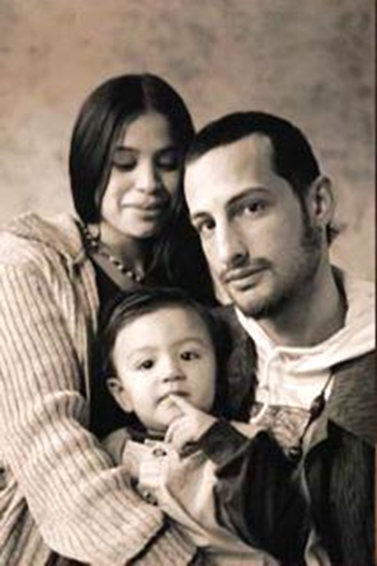
What do you think contributed to the family’s decision to discontinue services?
If the family instead arrived in New Mexico, what are all the things you would have done differently to support the full participation of the child and the engagement of the family?
Notes:
Backwards brainstorming example

Slide 28
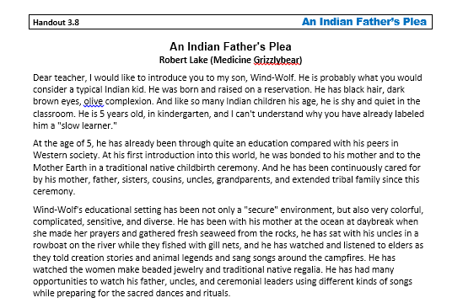
Notes:
Source: Teaching Tolerance – Speak Up At School http://www.tolerance.org/publication/speak-school

Slide 29
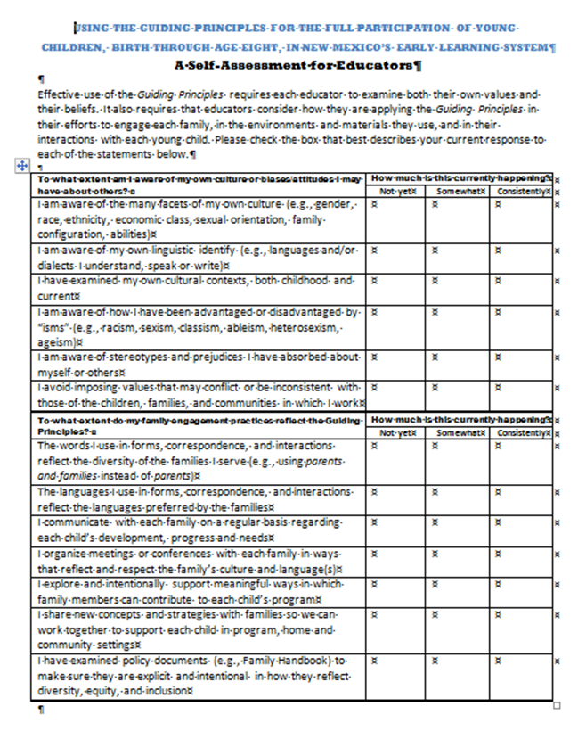
How would you support Wind-Wolf’s full participation?
Self-awareness
Family engagement
Environments and materials
Interactions
Notes:
Source: Teaching Tolerance – Speak Up At School http://www.tolerance.org/publication/speak-school

Slide 30
Whose job is it . . .
To value each child?
To recognize, celebrate, and nurture each child’s gifts and abilities?
To provide each child with access to and participation in opportunities that reflect and respect family experiences, culture, beliefs, abilities and circumstances?
To involve family members and community partners as resources and decision makers?
Notes:
Source: Teaching Tolerance – Speak Up At School http://www.tolerance.org/publication/speak-school

Slide 31
Summary
The more you know about your own culture, the more you will be able to support the full participation of each child and their family
Culturally relevant, respectful and responsive environments, interactions, and practices support the full participation of each young learner
Culturally respectful and responsive teachers can make a tremendous difference for each New Mexico child and their family
We each need more than one story
You have tools, resources, and practices that you can use to support full participation

Slide 32
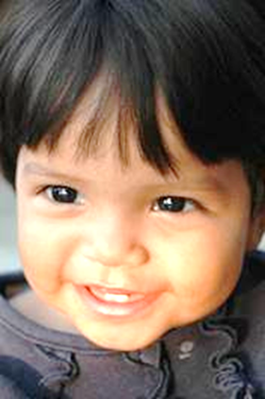
One Resource to Support Your Work

Slide 33
Sometimes change comes not in the first round, but at the second, third, or fourth. Change starts with one person questioning, challenging, speaking up and doing something to make a difference. We can each make a difference.
Paul Kivel

Slide 34
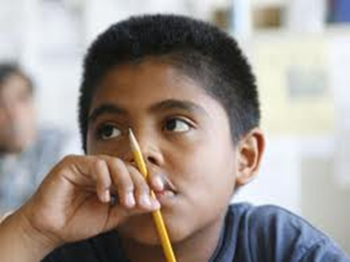
It’s easier to build strong children than to repair broken men [and women]. Frederick Douglass

Slide 35
