Slide 1
Playful Learning: Evidence & Resources for Supporting Social and Emotional Development
Robin Ploof, Champlain College, VT
and
Camille Catlett, Frank Porter Graham Child Development Institute, NC

Slide 2
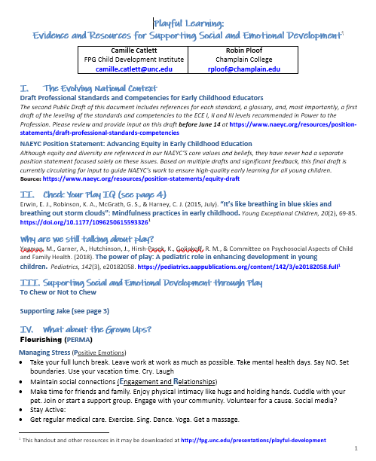
YOUR URL
https://fpg.unc.edu/presentations/playful-learning

Slide 3
Focus on the individual early childhood educator rather than on preparation programs
Address potential missing elements identified in the Transforming the Workforce report, including teaching subject matter specific content, addressing stress and adversity, fostering socioemotional development, working with dual language learners and integrating technology in curricula
Consider competencies from sister organizations (e.g., Council for Exceptional Children, DEC Recommended Practices, Council for Professional Recognition -Child Development Associate (CDA) Competency Standards)
Elevate inclusion, diversity and equity beyond the currently integrated approach to fully capture the depth and breadth of these issues

Slide 4
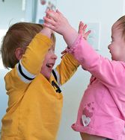
4c: Using a broad repertoire of developmentally appropriate, culturally and linguistically relevant, anti-bias and evidence-based teaching skills and strategies that reflect universal design for learning principles
Early childhood educators make purposeful use of a broad repertoire of developmentally appropriate, culturally and linguistically relevant, anti-bias and evidence-based teaching approaches that reflects universal design for learning principles, reflects understanding of young children from birth through age eight as individuals and as part of a group, and is in alignment with important educational and developmental goals. They understand the importance of both self-directed and guided play in young children’s learning and development across domains and in the academic curriculum. They are familiar with the types and stages of play and with strategies to support and extend play across the full age and grade span of early education. They understand the development of executive function and life skills, including focus and self-control, perspective taking, critical thinking, communicating, making connections, taking on challenges, cooperation, conflict-resolution, problem solving, independence and confidence, planning, and self-directed engaged learning. They know that these skills develop through supportive, scaffolding interactions with adults and are an important part of the early childhood curriculum from birth through the early grades that leads school readiness and success. (page 18)

Slide 5
All children have the right to equitable learning opportunities that help them achieve their full potential as engaged learners and valued members of society. As a result, all early childhood educators have a professional obligation to advance equity. They can do this best when they, the early learning settings in which they work, and their wider communities embrace diversity and inclusivity as strengths, uphold fundamental principles of fairness and justice, and work to eliminate structural inequities that limit equitable learning opportunities.
Notes:
REVISED DRAFT NAEYC Position Statement: Advancing Equity in Early Childhood Education
Although equity and diversity are referenced in our NAEYS’S core values and beliefs, they have never had a separate position statement focused solely on these issues. Based on multiple drafts and significant feedback, this final draft is currently circulating for input to guide NAEYC’s work to ensure high-quality early learning for all young children. Source: https://www.naeyc.org/resources/position-statements/equity-draft

Slide 6
Recommendations for early childhood educators
Actively promote children’s agency. Provide all children with opportunities for rich, engaging play. Use open-ended activities that encourage children to work together and solve problems to support learning across all areas of development and curriculum. (page 5)

Slide 7
Implicit biases also result in differential judgments of children’s play, aggressiveness, compliance, initiative, and abilities. These biases are associated with lower rates of achievement and assignment to “gifted” services and disproportionately higher rates of suspension and expulsions, beginning in preschool, for African American children, especially boys. (page 13)

Slide 8
Check Your Play IQ

Slide 9
A rich imagination improves the ability to use words to express needs, feelings, and ideas.
Notes:
“Research provides more and more evidence of the positive effects that well-developed play has on various areas of child development such as social skills, emerging mathematical ability, mastery of literacy concepts, and self-regulation.” (p. 29)
Leong, D. J., & Bodrova, E. (2012). Assessing and scaffolding make-believe play. Young Children, 29, 28-34. http://www.imagineeducation.com.au/files/CHCECE018022/1.pdf

Slide 10
Children who grow up with greener surroundings have better mental health.
Notes:
Engemann, K., Pedersen, C. B., Arge, L., Tsirogiannis, C., Mortensen, P. B., & Svenning, J-C. (2019, March). Residential green space in childhood is associated with lower risk of psychiatric disorders from adolescence into adulthood. Proceedings of the National Academy of Sciences, 116(11), 5188-5193. https://doi.org/10.1073/pnas.1807504116

Slide 11
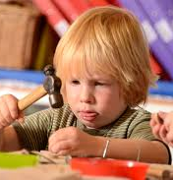
Healthy social and emotional development helps children develop the ability to learn and concentrate.
Notes:
“Research indicates that children who are mentally healthy tend to be happier, show greater motivation to learn, have a more positive attitude toward school, more eagerly participate in class activities, and demonstrate higher academic performance.” (p. 3)
Ho, J. & Funk, S. (2018). Promoting young children’s social and emotional health. Young Children, 73(1). https://www.naeyc.org/resources/pubs/yc/mar2018/promoting-social-and-emotional-health#activities

Slide 12
Creating safe and predictable routines helps children feel safe, secure, and comfortable.
Notes:
“Preschool children flourish in a positive, trusting building environment this environment includes: a daily schedule, an orderly classroom arrangement, respect between both teacher and students, and clear open communication between the student, parent, and teacher.” (p. 8)
DeMeulenaere, M. (2015). Promoting social and emotional learning in preschool. Dimensions of Early Childhood, 43(1), pp 8-10. https://www.southernearlychildhood.org/upload/pdf/DeMeulenaere_43_1.pdf

Slide 13
Support from teachers can make a great difference in whether children with disabilities get to play with peers.
Notes:
Yu, S. Y., Ostrosky, M. M., & Fowler, S. A. (2014, October). The relationship between preschoolers’ attitudes and play behaviors toward classmates with disabilities. Topics in Early Childhood Special Education, 35(1), 40-51. https://doi.org/10.1177/0271121414554432

Slide 14
Play allows for real-world experiences to reinforce positive social skills
Notes:
Play is a natural way for children to connect and relate to each other. As they engage in various types of play and through the social stages of play children from infancy work to develop social skills as they play. https://www.encourageplay.com/open-ended-play

Slide 15
Creating an environment that helps children explore their physical body and take risks supports emotional development
Notes:
The inclusion of rough and tumble play and risk as elements of play for young children support social and emotional development children learn to assess risks, learn the limits of their bodies, and learn how to respond to others in the play.
Tannock, M. T. (2008). Rough and tumble play: An investigation of the perceptions of educators and young children. Early Childhood Education Journal, 35(4), 357-361. https://search.proquest.com/docview/228485799?pq-origsite=gscholar

Slide 16
“I came to the counterintuitive conclusion that engaging in risk is actually very important in preventing injuries,” a researcher says.
Notes:
Making Playgrounds a Little More Dangerous https://www.nytimes.com/2019/05/10/well/family/adventure-playgrounds-junk-playgrounds.html?fbclid=IwAR1VSZgbVhgHPeVBXvgRGE75KlK7MsZsNVxCMJMUQPrdqUqVlO1n6-X_6D4

Slide 17
Mindfulness refers to repetitive, prescriptive breathing and movements.
Notes:
Erwin, E. J., Robinson, K. A., McGrath, G. S., & Harney, C. J. (2015, July). “Its like breathing in blue skies and breathing out storm clouds”: Mindfulness practices in early childhood. Young Exceptional Children, 20(2), 69-85. https://doi.org/10.1177/1096250615593326

Slide 18
Notes:
Yogman, M., Garner, A., Hutchinson, J., Hirsh-Pasek, K., Golinkoff, R. M., & Committee on Psychosocial Aspects of Child and Family Health. (2018). The power of play: A pediatric role in enhancing development in young children. Pediatrics, 142(3), e20182058. https://pediatrics.aappublications.org/content/142/3/e20182058.full

Slide 19
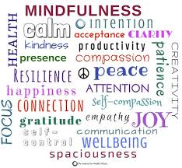
Notes:
To chew or not to chew

Slide 20
MOVING TOWARD FLOURISHING AND WELL-BEING

Slide 21
When you are in the Zone!
Healthy: in the zone
Reactive stress: common reversible distress
Burn out- ask for help
Normal mood fluctuations. Taking things in stride. Consistent performance, Normal sleep patterns. Physically and socially active. Usual self-confidence. Comfortable with others.
Irritable/impatient. Nervousness, sadness, increased worrying. Procrastination, forgetfulness. Trouble sleeping (more in falling asleep). Lowered energy. Difficulty in relaxing. Intrusive thoughts. Decreased social activity.
Anger, high level of anxiety (panic attacks), lingering sadness (depression), fearfulness, tearfulness, hopelessness, worthlessness. Difficulty with emotions. Preoccupation, Decreased performance, feeling overwhelmed. Constant fatigue, disturbed sleep (falling asleep and staying asleep). Avoidance of social situations, withdrawal, disturbances in thinking. Suicidal thoughts/intent/behavior.

Slide 22
Positive Psychology and PERMA
Positive Emotion – Taking all things together, how happy would you say you are?
Engagement/Interest – I love learning new things.
Relationships (positive ones) – There are people in my life who really care about me.
Meaning /Purpose – I generally feel that what I do in my life is valuable and worthwhile.
Accomplishment – I pursue things for their own sake for the internal reward I give myself. Not for the reward others may (or may not) bestow upon me.

Slide 23
http://www.easternct.edu/cece/
Notes:
The Center of Early Childhood Education at Eastern Connecticut University (website) https://www.youtube.com/watch?v=CKUfraBmjy8
http://www.easternct.edu/cece/

Slide 24
Nurturing Preschool Children’s Emotional Health Through Active Play https://www.youtube.com/watch?v=CKUfraBmjy8

Slide 25
http://www.child-encyclopedia.com/
Notes:
Encyclopedia on Early Childhood Development http://www.child-encyclopedia.com/
http://www.child-encyclopedia.com/peer-relations/introduction/playing-others-important

Slide 26
http://www.child-encyclopedia.com/peer-relations/introduction/playing-others-important

Slide 27
Notes:
The Australian Parenting Website https://raisingchildren.net.au/
A website with amazing parenting resources supported by the Australian Government.

Slide 28
https://raisingchildren.net.au/toddlers/connecting-communicating/communicating/talking-play-toddlers
Notes:
https://raisingchildren.net.au/toddlers/connecting-communicating/communicating/talking-play-toddlers

Slide 29
Notes:
The Power of Play
Comprehensive research summary on play and learning from the Minnesota Children’s Museum with a really nice section on the social and emotional benefits of play.
White, R. E. (2012). The power of play: A research summary on play and learning. Rochester: Minnesota Children's Museum. https://www.childrensmuseums.org/images/MCMResearchSummary.pdf

Slide 31
Culturally Responsive Teaching
A 50-State Survey of Teaching Standards
Jenny Muniz New America
Understanding culturally responsive teaching
8 teacher competencies that promote culturally responsive teaching
Using professional teaching standards to promote culturally responsive teaching
Excerpts from excellent teaching standards documents
https://d1y8sb8igg2f8e.cloudfront.net/documents/Culturally_Responsive_Teaching_2019-03-28_130012.pdf
Notes:
31
Culturally Responsive Teaching https://d1y8sb8igg2f8e.cloudfront.net/documents/Culturally_Responsive_Teaching_2019-03-28_130012.pdf

Slide 32
Culturally Responsive Teaching
Just over half (28%) of state teacher standards address self-knowledge
Analyze their cultural backgrounds and worldviews
Recognize biases they may hold and their effect on relationships with students and families
Recognize how common societal "isms" (e.g., racism, sexism, and classism) can influence on their own attitudes
CONSIDER
Asking students to reflect on or examine their attitudes about families before interacting with them as part of an assignment
Consider requiring an assignment to define culturally responsive teaching at the very beginning of the semester (e.g., as a quick write). Ask students to revise that definition at the end of the semester.
Notes:
32
Culturally Responsive Teaching https://d1y8sb8igg2f8e.cloudfront.net/documents/Culturally_Responsive_Teaching_2019-03-28_130012.pdf

Slide 33
Want more resources???
Play
Social and
Emotional
Development
At YOUR URL
https://fpg.unc.edu/ presentations/playful-learning

Slide 34
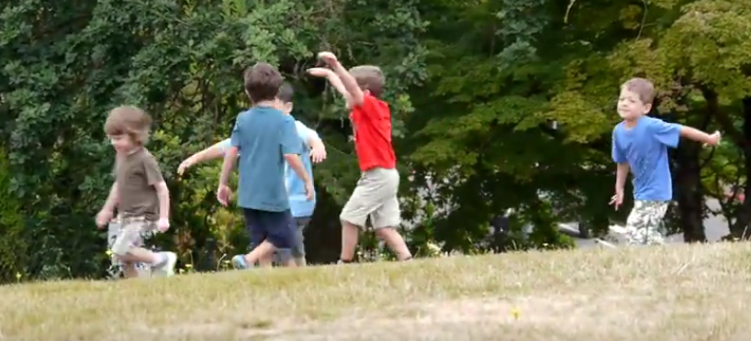
Notes:
Opal School Children on Play and Learning https://www.youtube.com/watch?v=V0mCy9asVk0&list=PLJdq3OzEoR1gL79_6UoiMrleB1_jwzQaw&index=1

