Slide 1
From All to Each and Every: Building a Consistent, Statewide Emphasis on Full Participation and Equity
Camille Catlett (NC) Amy Bolger & Melissa Riegel-Garrett (VT)

Slide 2
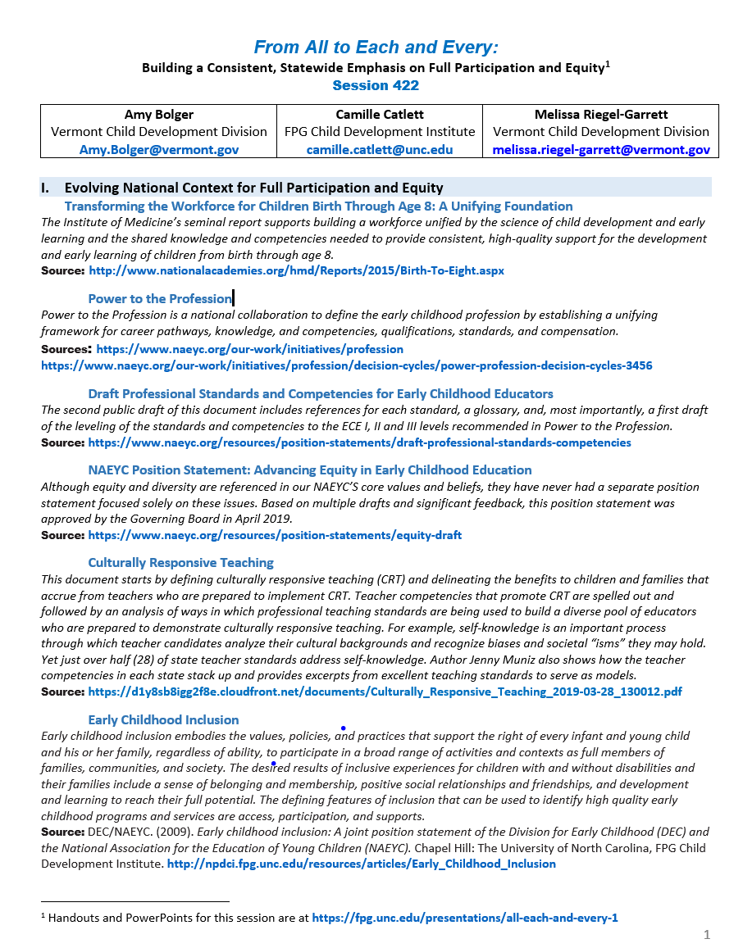
YOUR URL
https://fpg.unc.edu/presentations/all-each-and-every-1

Slide 3
To strengthen higher education, the report calls for high-quality training programs . . . that foster a shared fundamental knowledge base and competencies to support child development for professionals in all sectors who work with young children

Slide 4
Power to the Profession

Slide 5
Focus on the individual early childhood educator rather than on preparation programs
Address potential missing elements identified in the Transforming the Workforce report, including teaching subject matter specific content, addressing stress and adversity, fostering socioemotional development, working with dual language learners and integrating technology in curricula
Consider competencies from sister organizations (e.g., Council for Exceptional Children, DEC Recommended Practices, Council for Professional Recognition -Child Development Associate (CDA) Competency Standards)
Elevate inclusion, diversity and equity beyond the currently integrated approach to fully capture the depth and breadth of these issues

Slide 6
All children have the right to equitable learning opportunities that help them achieve their full potential as engaged learners and valued members of society. As a result, all early childhood educators have a professional obligation to advance equity. They can do this best when they, the early learning settings in which they work, and their wider communities embrace diversity and inclusivity as strengths, uphold fundamental principles of fairness and justice, and work to eliminate structural inequities that limit equitable learning opportunities.
Notes:
REVISED DRAFT NAEYC Position Statement: Advancing Equity in Early Childhood Education
Although equity and diversity are referenced in our NAEYS’S core values and beliefs, they have never had a separate position statement focused solely on these issues. Based on multiple drafts and significant feedback, this final draft is currently circulating for input to guide NAEYC’s work to ensure high-quality early learning for all young children. Source: https://www.naeyc.org/resources/position-statements/equity-draft

Slide 7
Culturally Responsive Teaching
A 50-State Survey of Teaching Standards
Jenny Muniz New America
Understanding culturally responsive teaching
8 teacher competencies that promote culturally responsive teaching
Using professional teaching standards to promote culturally responsive teaching
Excerpts from excellent teaching standards documents
https://d1y8sb8igg2f8e.cloudfront.net/documents/Culturally_Responsive_Teaching_2019-03-28_130012.pdf
Notes:
7
Culturally Responsive Teaching https://d1y8sb8igg2f8e.cloudfront.net/documents/Culturally_Responsive_Teaching_2019-03-28_130012.pdf

Slide 8
Culturally Responsive Teaching
Just over half (28%) of state teacher standards address self-knowledge
Analyze their cultural backgrounds and worldviews
Recognize biases they may hold and their effect on relationships with students and families
Recognize how common societal "isms" (e.g., racism, sexism, and classism) can influence on their own attitudes
CONSIDER
Asking students to reflect on or examine their attitudes about families before interacting with them as part of an assignment
Consider requiring an assignment to define culturally responsive teaching at the very beginning of the semester (e.g., as a quick write). Ask students to revise that definition at the end of the semester.
Notes:
8
Culturally Responsive Teaching https://d1y8sb8igg2f8e.cloudfront.net/documents/Culturally_Responsive_Teaching_2019-03-28_130012.pdf

Slide 9
Supporting Each and Every Young Child and Family’s Full and Equitable Participation:
The Vermont Guiding Principles

Slide 10
Child Care Providers
Teachers
Administrators
Families
Foundations, Funders,
Organizations,
Colleges & Universities
Critical Conversation among Vermont early childhood partners
May 2016
Notes:
For the past year, a very diverse group representing these and other perspectives has been meeting to discuss the need for, and develop drafts of, a set of guiding principles. Now it’s time for your input.
A website has been created to gather input from as many as possible. The goal is to guarantee that the content of Vermont’s Guiding Principles reflects the thoughts and words of families, teachers, therapists, clinicians, leaders, faculty, and other representatives of early childhood programs, agencies and organizations. On the site, a draft of the Guiding Principles will be available in March and April 2017 for input from all of us.
So if you do just one thing, please provide your feedback.

Slide 11
“[I hope] that he will discover new interests, make good friends and have positive social experiences that challenge him and help him grow, and that his intellect will be fostered in many ways and appropriate for his developmental stage.”
Family member

Slide 12
Do you endorse the principles?
Do you endorse Vermont Guiding Principles for the Full Participation of Each and Every Young Child and Their Family?
YES
91.74%
8.26%
NO

Slide 13
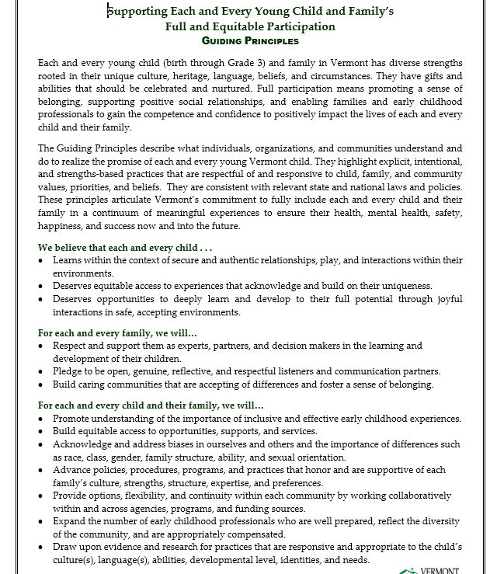
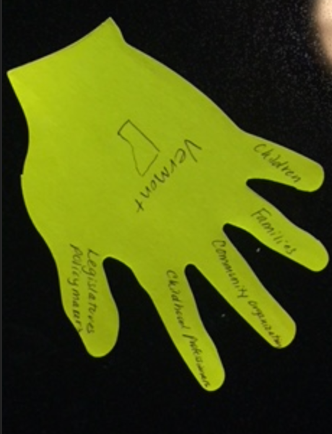

Slide 14
Bank Street Center on Culture, Race and Equity Change Model

Slide 15
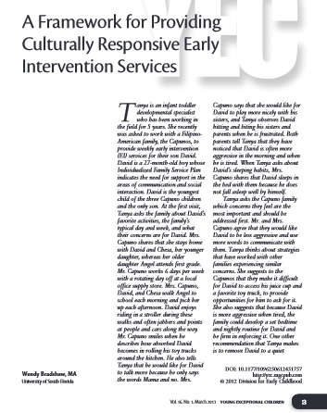
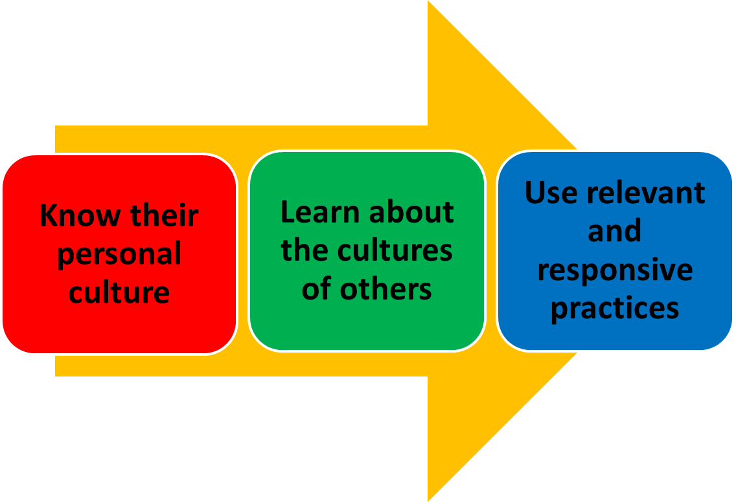
Bradshaw article

Slide 18
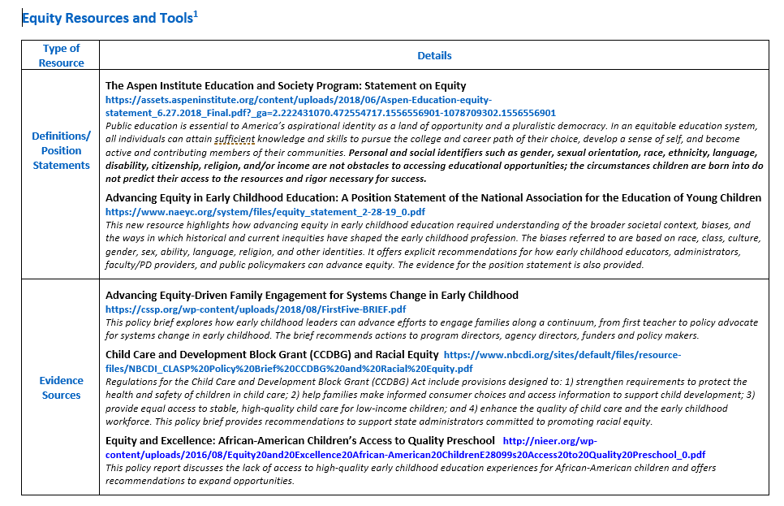

Slide 19
All → each and every

Slide 20
Parents → families or Parents & families
Notes:
Guiding Principles are for families. They outline the components of quality that families should see and expect. For families with different home languages, they articulate the commitment to supporting dual language learners. For families whose children learn differently they detail the importance of each child’s inclusion, membership and belonging. For families who are racially and ethnically diverse, the Guiding Principles underscore the commitment to equitable and responsive practices. For each and every family, they underscore the importance of family members as partners and decision makers.

Slide 21
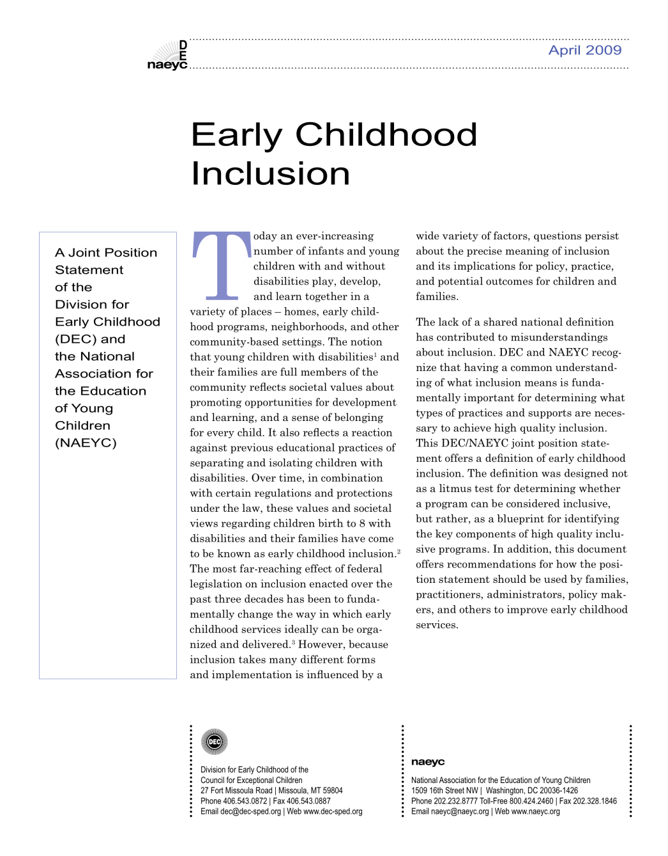
Early Childhood Inclusion: A Joint Position Statement of DEC and NAEYC
Notes:
21
Source: DEC/NAEYC. (2009). Early childhood inclusion: A joint position statement of the Division for Early Childhood (DEC) and the National Association for the Education of Young Children (NAEYC). Chapel Hill: The University of North Carolina, FPG Child Development Institute. http://npdci.fpg.unc.edu/resources/articles/Early_Childhood_Inclusion
21

Slide 22
Definition
Early childhood inclusion embodies the values, policies, and practices that support the right of every infant and young child and his or her family, regardless of ability, to participate in a broad range of activities and contexts as full members of families, communities, and society. The desired results of inclusive experiences for children with and without disabilities and their families include a sense of belonging and membership, positive social relationships and friendships, and development and learning to reach their full potential. The defining features of inclusion that can be used to identify high quality early childhood programs and services are access, participation, and supports.
Notes:
Source: DEC/NAEYC. (2009). Early childhood inclusion: A joint position statement of the Division for Early Childhood (DEC) and the National Association for the Education of Young Children (NAEYC). Chapel Hill: The University of North Carolina, FPG Child Development Institute. http://npdci.fpg.unc.edu/resources/articles/Early_Childhood_Inclusion

Slide 23
National Black Child Development Institute -
Delivering on the Promise of Effective Early Childhood Education for Black Children: Eliminating Exclusionary Discipline and Concentrating on Inclusion

Slide 26
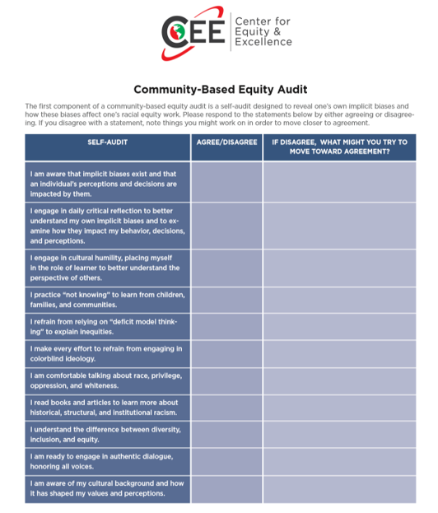
Read the prompts and consider how you would respond.
2. Consider and discuss who might use a self-reflection like this and how.

Slide 27
New Student Learning Outcome in a Preschool Language and Literacy Course
Examine personal bias and apply insights gained to effectively select and use children’s books that reflect issues of race, culture, language, ability, gender, and diverse life circumstances

Slide 28
Professional efforts to use the Vermont Guiding Principles

Slide 29
Research and evidence
The Right Stuff
Annotated collections of free resources
Personas
Guiding Principles in Action

Slide 35
Creating systems level change to reflect the Vermont Guiding Principles

Slide 36
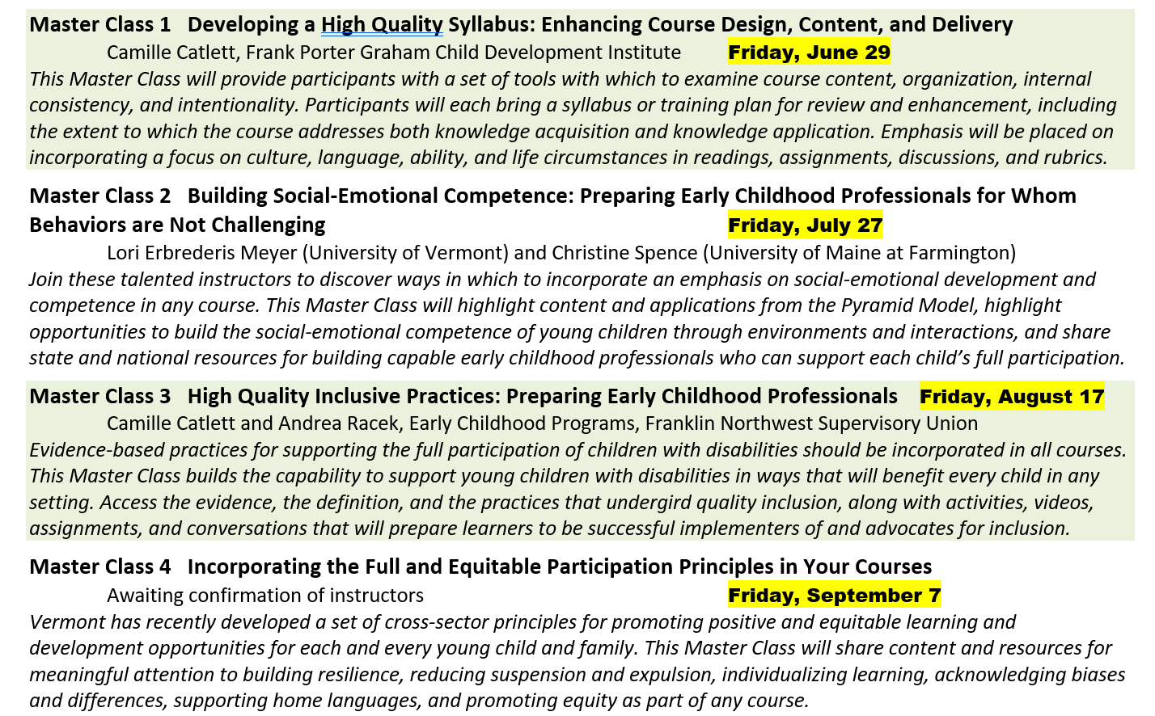
Master Classes

Slide 39
Have the principles on the table at every meeting and refer to them as decisions are discussed and made

Slide 40
Encourage agencies and entities to endorse the principles as explicit concepts that guide their work

Slide 41
Incorporate the Guiding Principles into applications like the recent PDG proposal

Slide 42
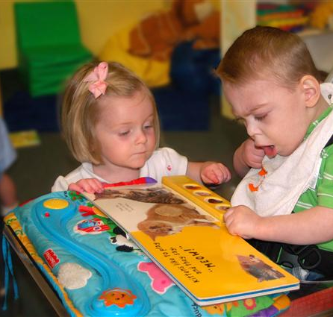
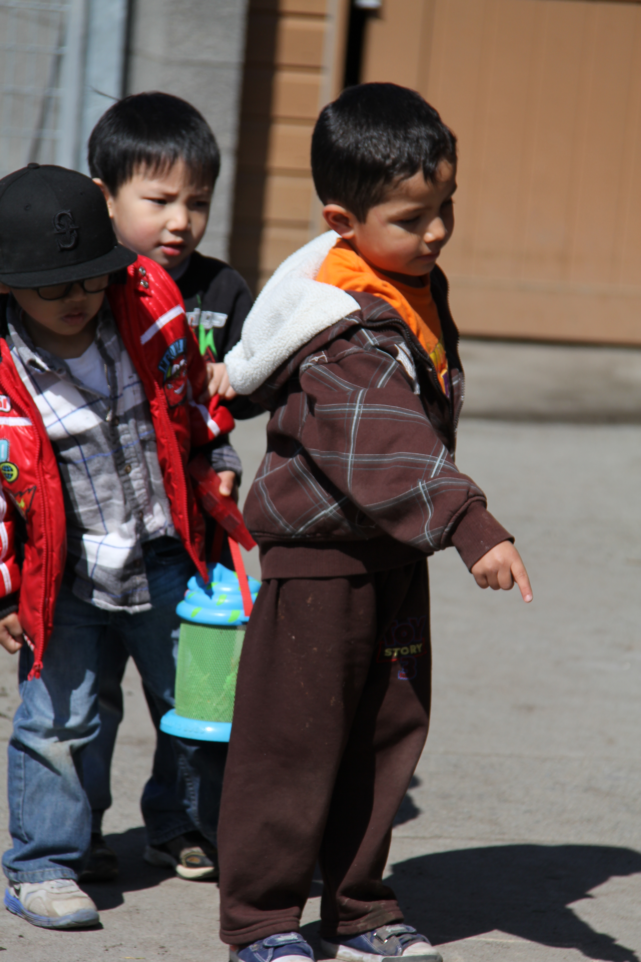
How can Vermont construct a QRIS system that advances equity for each and every child and family?

Slide 43
Every child is worth it!

Slide 44
Notes:
Thank you for your commitment to quality for each and every young child and their family. We look forward to getting your input on the draft of the guiding principles and to sharing what we learn.

Slide 45
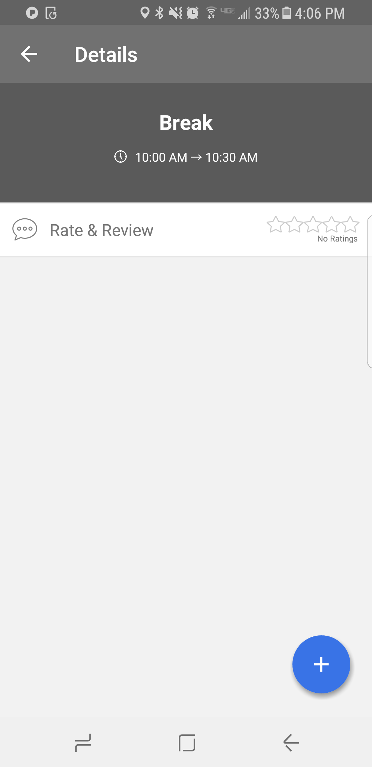
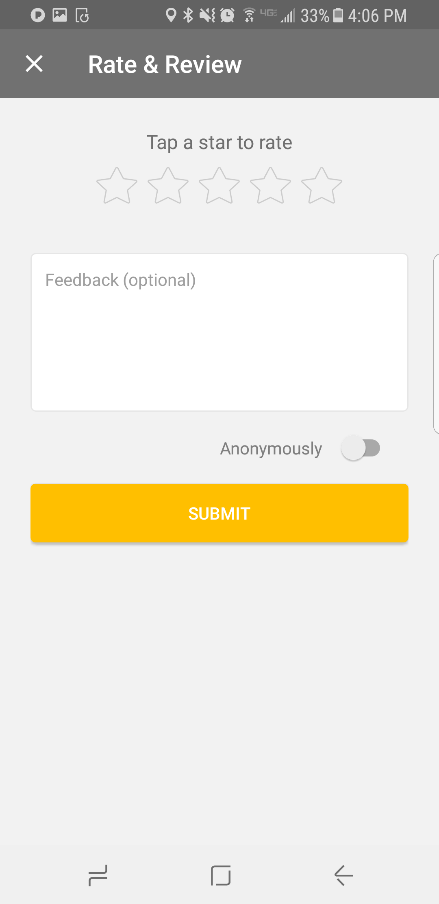
Please take a moment to rate & review this session.
Find this session in the app and click to view details.
Select a Star rating.
Enter additional feedback – What did you love? What could have been better?
Click the Submit button.
We take your feedback very seriously and will use it to inform improvements for QRIS 2020!

