Slide 1
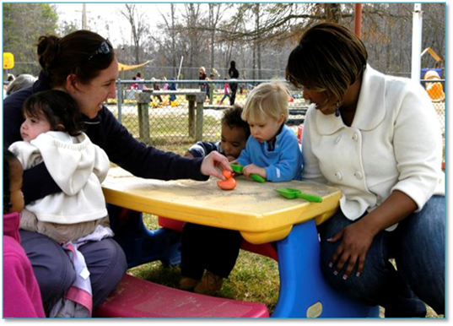
Fabulous and Free: Resources to Support High Quality Inclusion
Presenter: Camille Catlett, Frank Porter Graham Child Development Institute

Slide 2
Logistics
Questions? Comments?
USE THE CHAT BOX

Slide 3
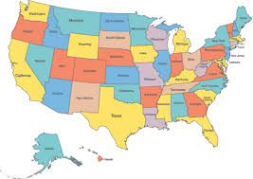
Quick Poll
What state or territory are you joining us from today?

Slide 4
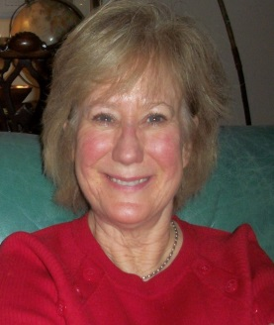
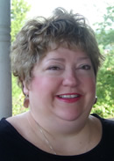
This webinar is sponsored by the Division for Early Childhood Professional Development Special Interest Group (DEC PD SIG)
Harriet Able University of North Carolina, Chapel Hill Co-Chair, DEC PD SIG hable@email.unc.edu | Cori Hill Integrated Training Collaborative (VA) Co-Chair, DEC PD SIG cfhill@vcu.edu
For more information about the DEC PD SIG visit:
http://www.dec-sped.org/sigprofessionaldevelop
Like our Facebook page at: https://www.facebook.com/DivisionofEarlyChildhoodProfessionalDevelopmentSIG/

Slide 5
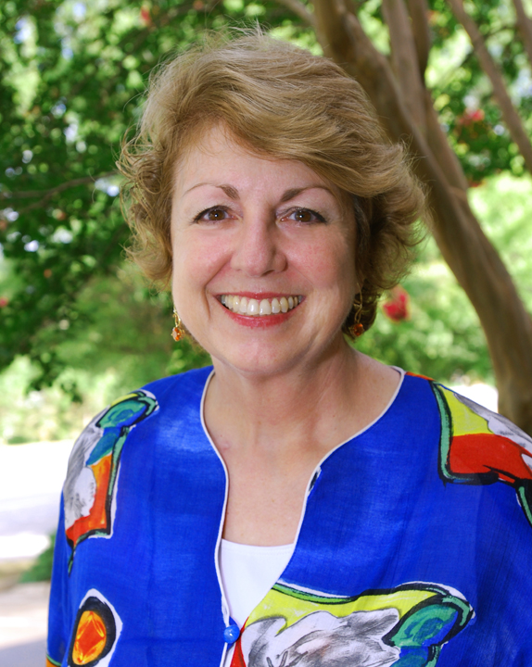
Camille Catlett
Frank Porter Graham Child Development Institute
University of North Carolina, Chapel Hill
Chapel Hill, NC

Slide 6
Resources . . .
. . to define inclusion
. . to support attitudes, knowledge, skills,
and dispositions that will support each
young child’s full participation
. . to support evidence-based and
recommended practices
. . to support professional development
with diverse audiences in diverse
settings for diverse purposes
. . to support attitudes, knowledge, skills,
and dispositions that will support each
young child’s full participation
. . For FREE
Topics for Today

Slide 7
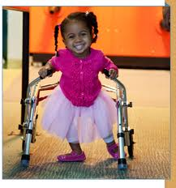
The handouts and PowerPoints for this session are available
online at
http://fpg.unc.edu/presentations/dec-pd-sig-webinar

Slide 8
WHO
WHAT
HOW
ACQUISITION AND APPLICATION OF KNOWLEDGE, SKILLS AND DISPOSITIONS
Professional Development Definition

Slide 9
Inclusion Basics

Slide 10
Person First Language
22 Respectful Ways to Respond
Additional resources on pages 5 & 9

Slide 11
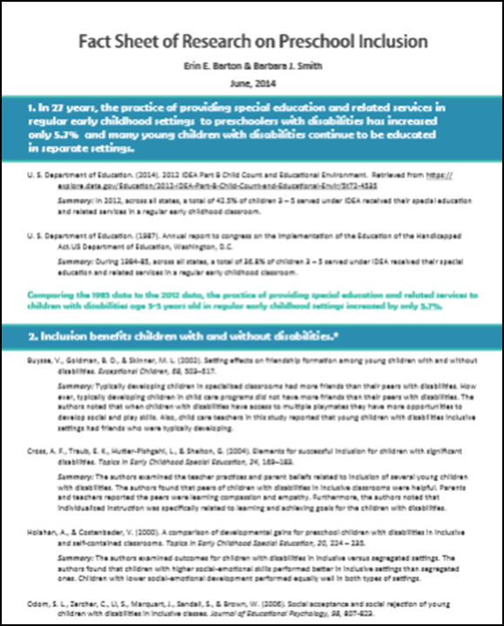
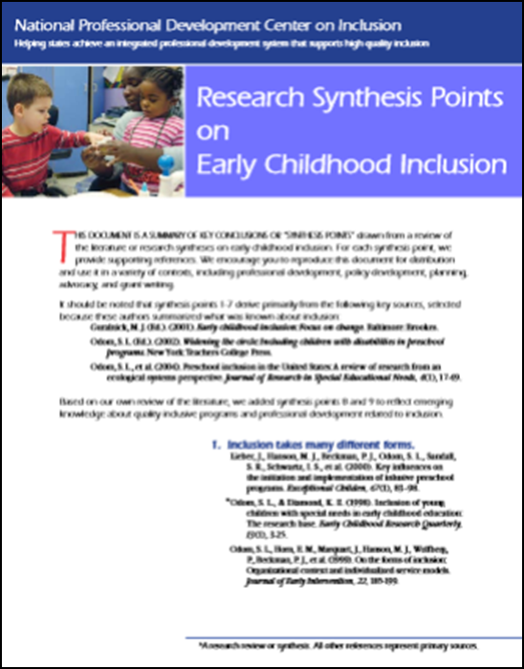
Know the Facts

Slide 12
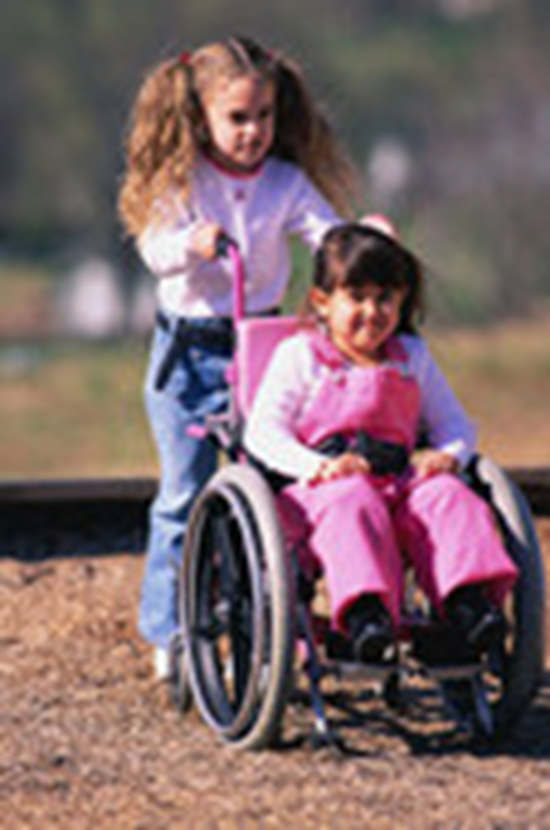
Does inclusion benefit children with and without disabilities?

Slide 13
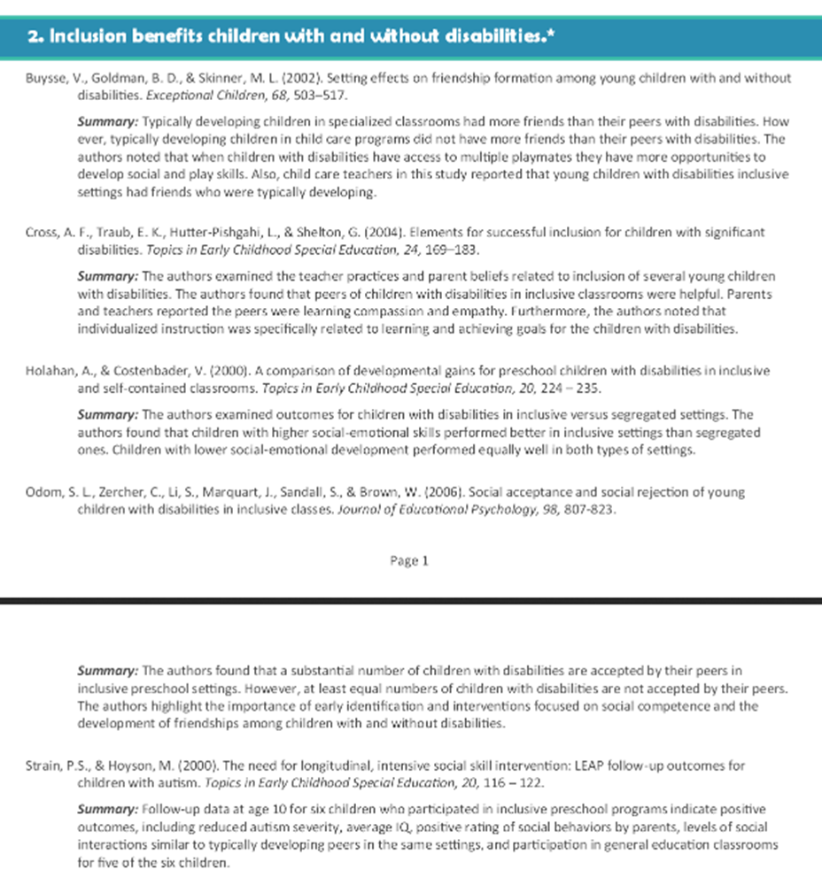

Slide 14
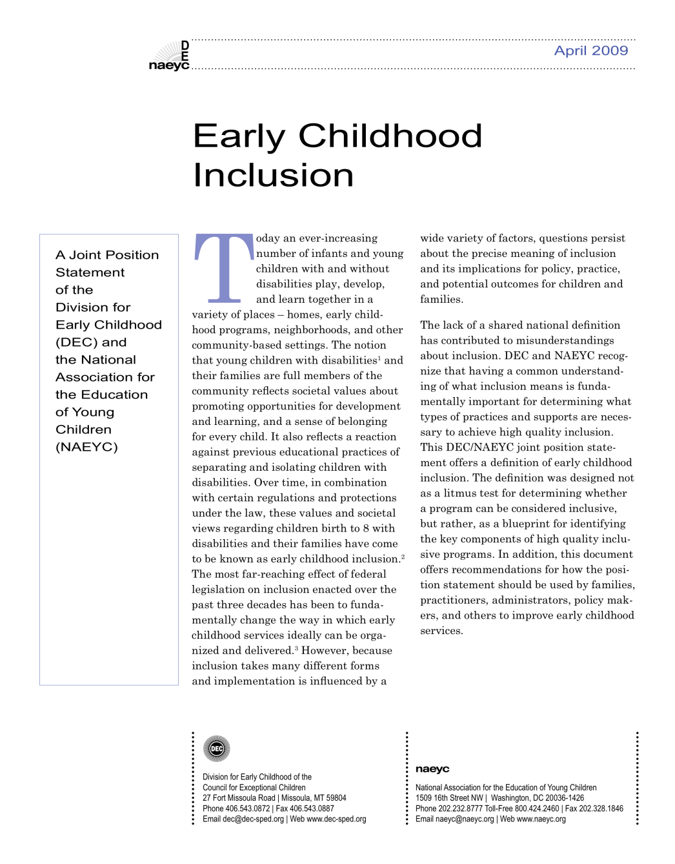
Early Childhood Inclusion: A Joint Position Statement of DEC and NAEYC

Slide 15
Early childhood inclusion embodies the values, policies, and practices that support the right of every infant and young child and his or her family, regardless of ability, to participate in a broad range of activities and contexts as full members of families, communities, and society. The desired results of inclusive experiences for children with and without disabilities and their families include a sense of belonging and membership, positive social relationships and friendships, and development and learning to reach their full potential. The defining features of inclusion that can be used to identify high quality early childhood programs and services are access, participation, and supports.

Slide 17
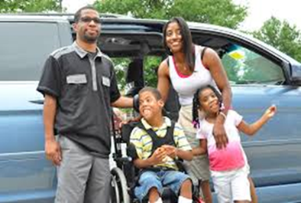
Inclusion in early childhood programs refers to including children with disabilities in early childhood programs, together with their peers without disabilities; holding high expectations and intentionally promoting participation in all learning and social activities, facilitated by individualized accommodations; and using evidence-based services and supports to foster their development (cognitive, language, communication, physical, behavioral, and social-emotional), friendships with peers, and sense of belonging. This applies to all young children with disabilities, from those with the mildest disabilities, to those with the most significant disabilities.

Slide 18
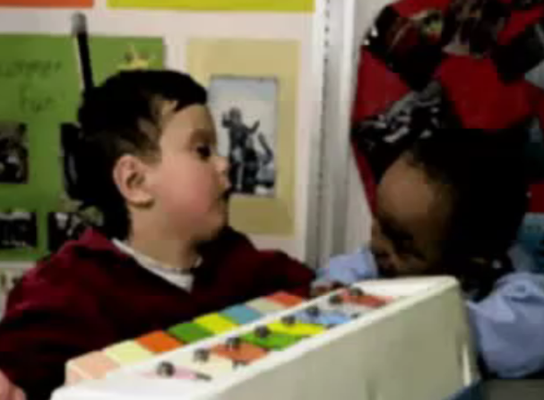
What did you notice about Jake’s access to the learning?
Describe the ways in which Jake and his peers were supported to fully participate.
What [systemic] supports were implemented prior to this interaction?
What would Jake have missed if his physical therapist had pulled him out for PT? What would the other children have missed?

Slide 19
Developmentally Appropriate Practice
Individually Appropriate
Developmentally Appropriate
Culturally/
Linguistically
Appropriate

Slide 20
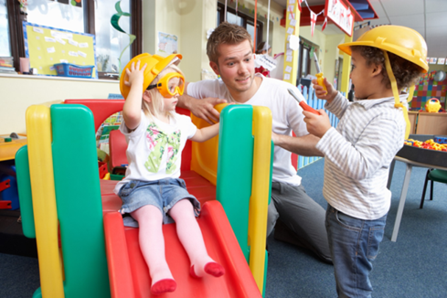
F | FAMILY
A | ASSESSMENT
C | COLLABORATION
I | INSTRUCTION
L | LEADERSHIP
I | INTERACTION
T | TEAMING
A | AND
T | TRANSITION
E | ENVIRONMENT

Slide 21
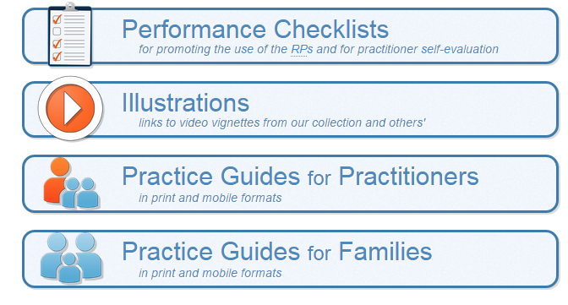
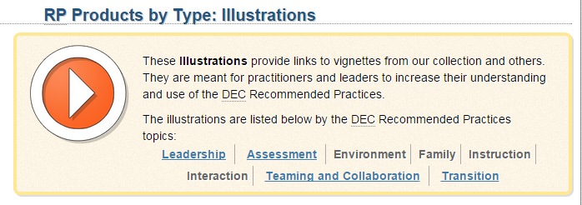

Slide 23
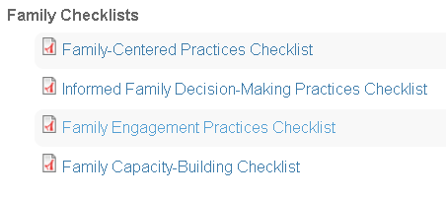
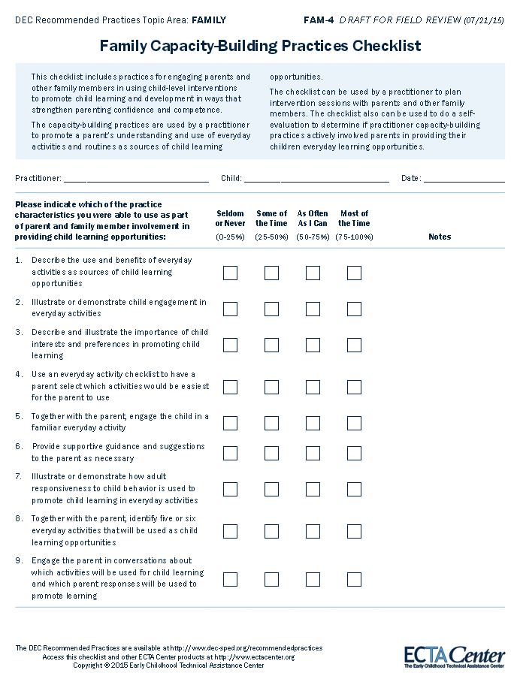

Slide 24
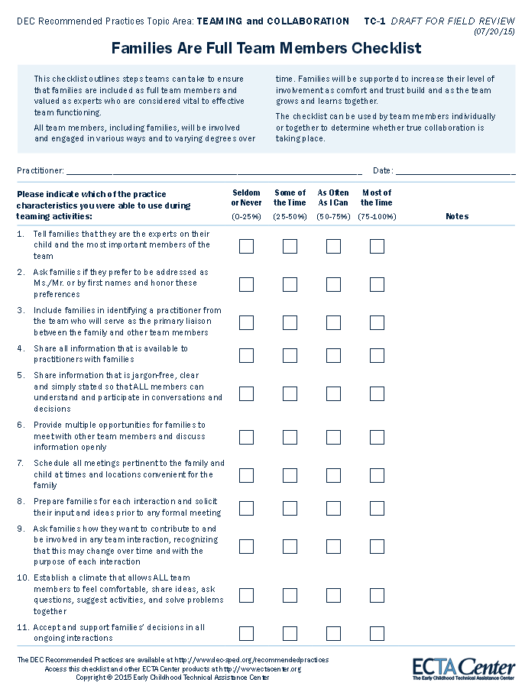

Slide 25
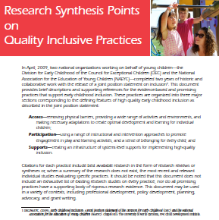
ACCESS
Universal Design for Learning (UDL)
Assistive Technology
PARTICIPATION
Peer Supports
Scaffolding
Embedded Learning
Tiered Models
[SYSTEMIC] SUPPORTS
Professional Development
Collaboration
Family-Professional Partnerships

Slide 26
A sampling of evidence and resources, related to each practice, to support your learning and professional development needs
Find them online at http://npdci.fpg.unc.edu/resources/quality-inclusive-practices-resources-and-landing-pads

Slide 27
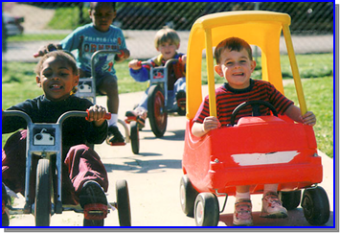

Slide 28
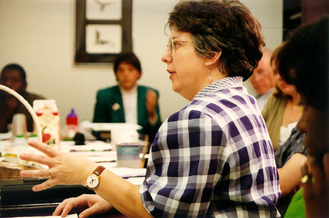
Resources to Support Professional Development

Slide 29
SCRIPT-NC
Supporting Change and Reform in Preservice Teaching in North Carolina
Landing
Pads
Handouts
PowerPoints
Recording
http://scriptnc.fpg.unc.edu/resource-search
SCRIPT-NC
Supporting Change and Reform in Preservice Teaching in North Carolina

Slide 33
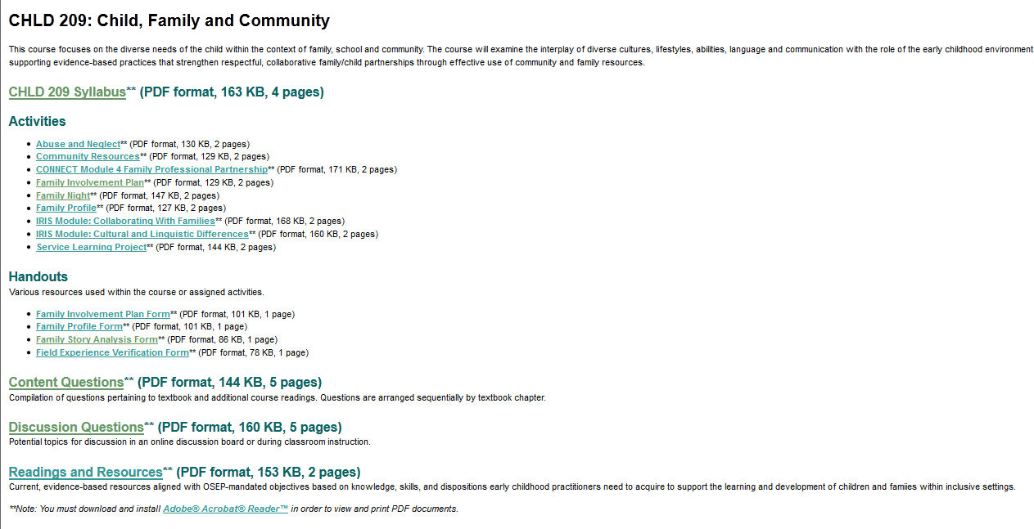
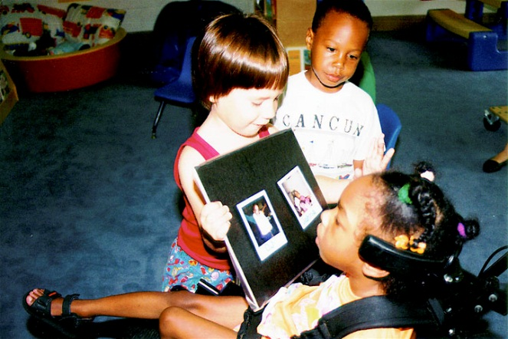

Slide 34
Curriculum maps on
● assistive technology
● cultural diversity
● linguistic diversity
● ability diversity
● CARA’s Kit

Slide 35
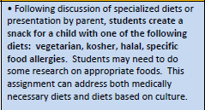
Curriculum Maps

Slide 36
What’s the most powerful resource in your repertoire for helping people to understand the importance of inclusion?

Slide 37
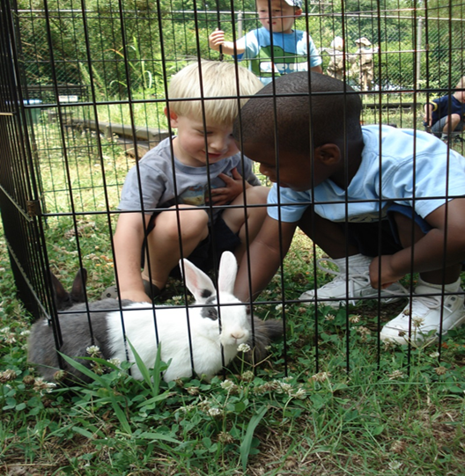
Resources to Support Inclusion

Slide 38
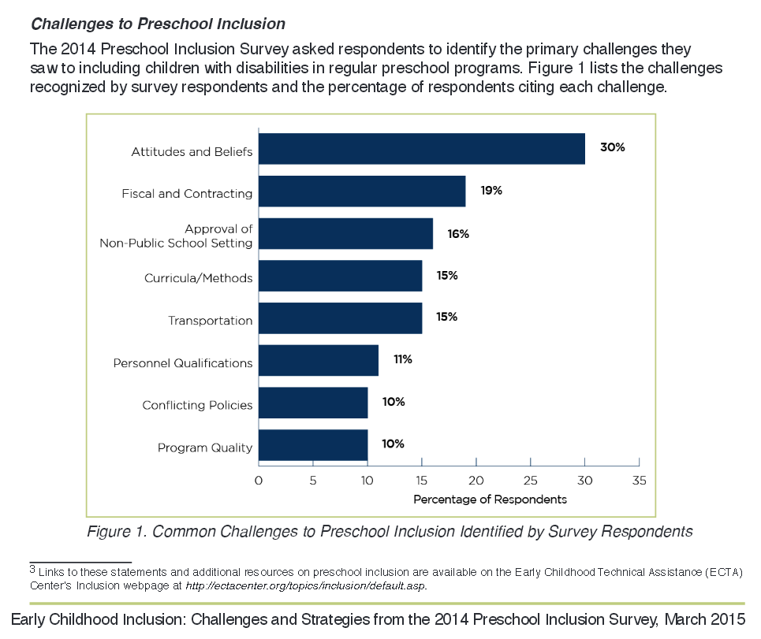
Early Childhood Inclusion: Challenges and Strategies pg. 4

Slide 39
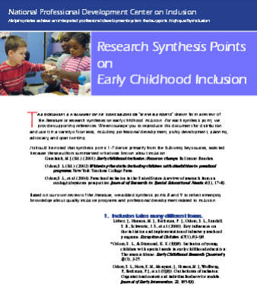
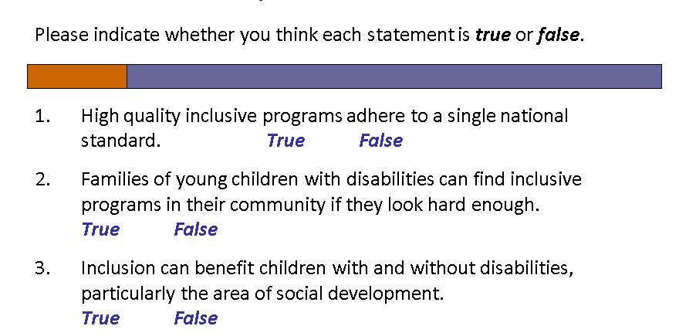
Just the Facts, Ma’am
Page 5

Slide 40
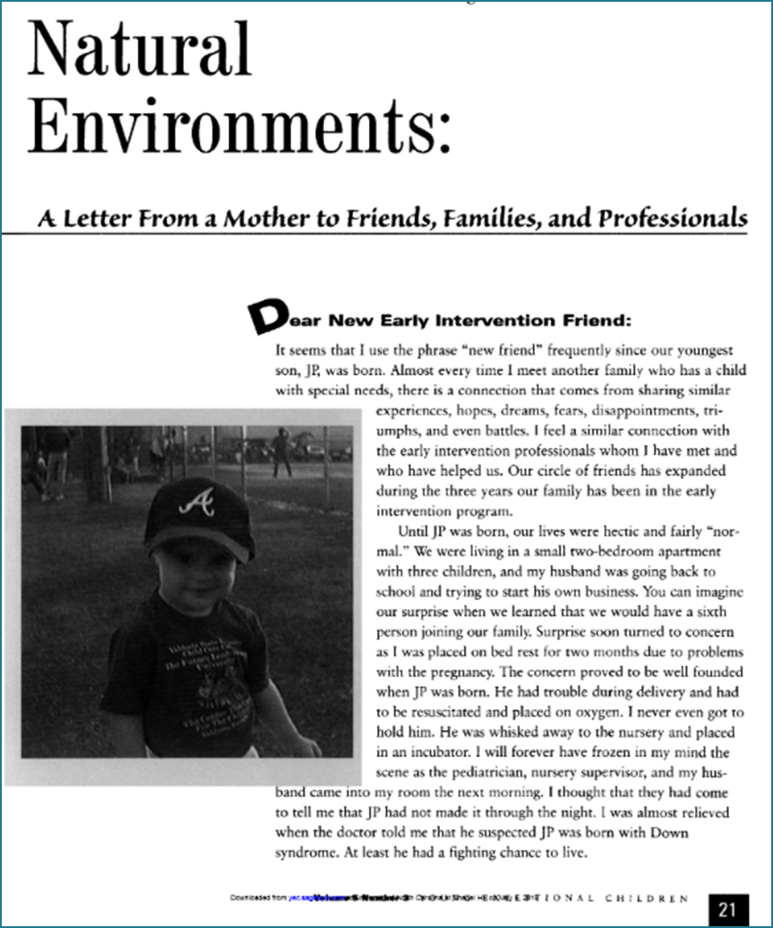
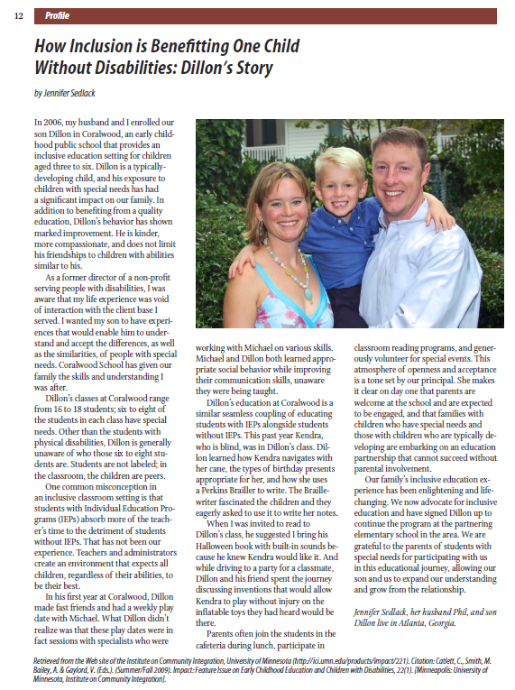
Page 5
Page 6

Slide 41
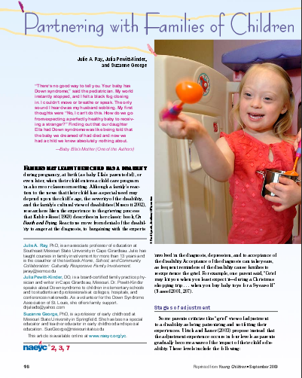
Read All About It
Page 6
Page 5

Slide 42
Multifaceted Resources
Page 6
Page 9

Slide 43
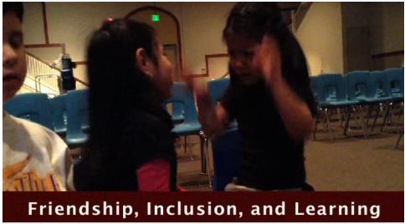
Page 7
Page 8

Slide 44
Page 7

Slide 45
Audiovisual
Page 7
Page 8

Slide 46
Page 8

Slide 47
Page 8
Liam’s Story: A Mother’s Voice

Slide 48
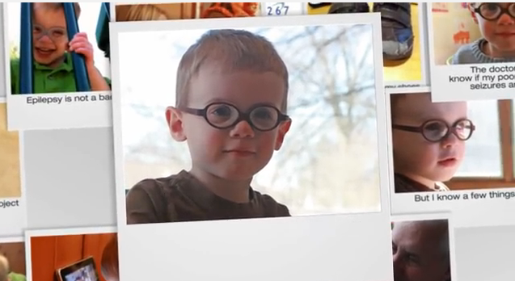
Page 8
My Name is Jude

Slide 49
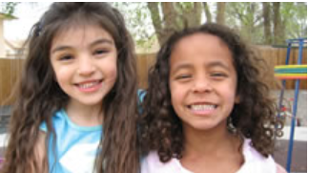
Page 9
http://www.cde.shttp://www.cde.state.co.us/resultsmatter/rmvideoseries
Notes:
http://www.cde.state.co.us/resultsmatter/rmvideoseries

Slide 50
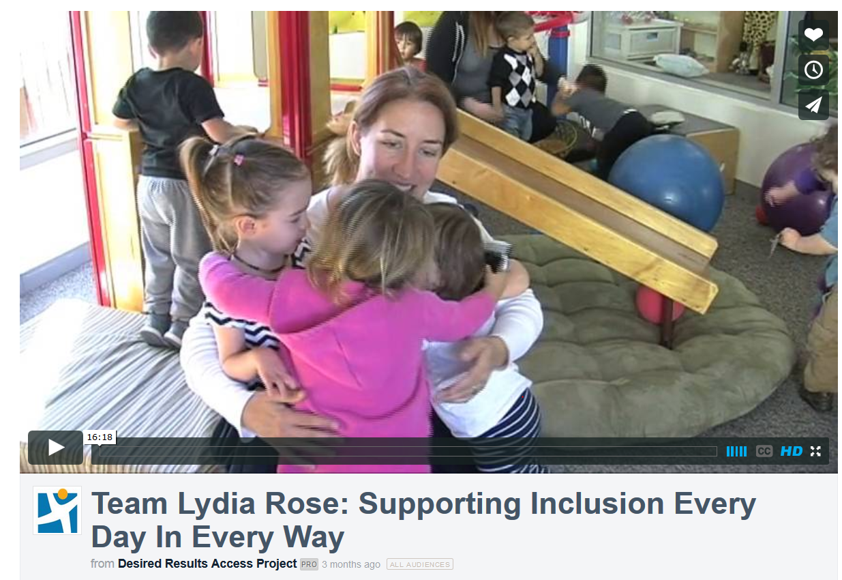
Page 9
https://vimeo.com/118072510

Slide 51
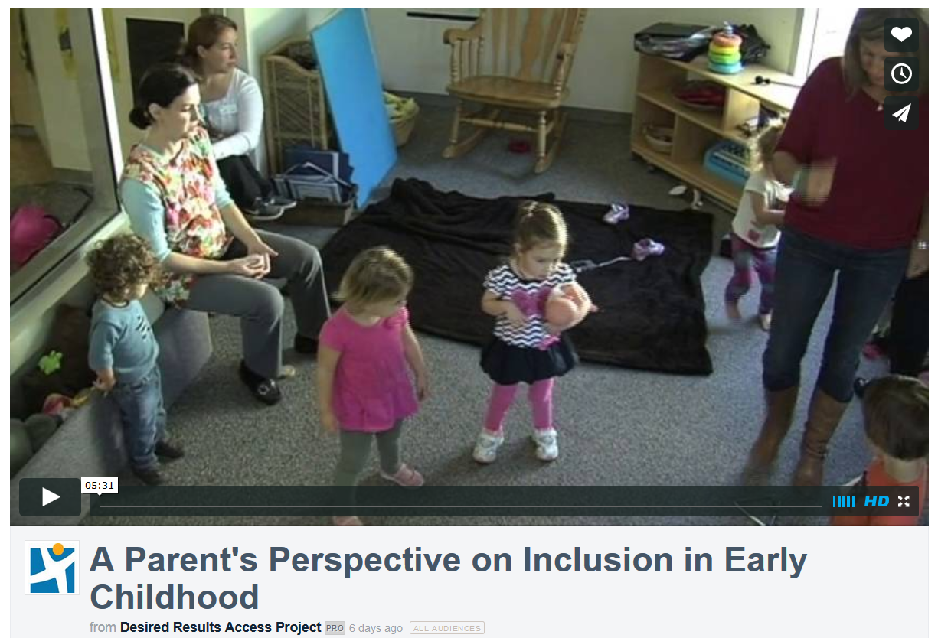
Page 8
https://vimeo.com/126299752

Slide 52
We All Belong
page 9
https://www.youtube.com/watch?v=AFoLsYDQzzY

Slide 53
http://www.earlyliteracylearning.org/
General Practice Guides Especially for Parents

Slide 54
http://csefel.vanderbilt.edu/
Research syntheses
Training modules
Practical strategies
What Works briefs
Videos
Family tools
Decision making guides

Slide 55
Notes:
http://eclkc.ohs.acf.hhs.gov/hslc/tta-system/family

Slide 56
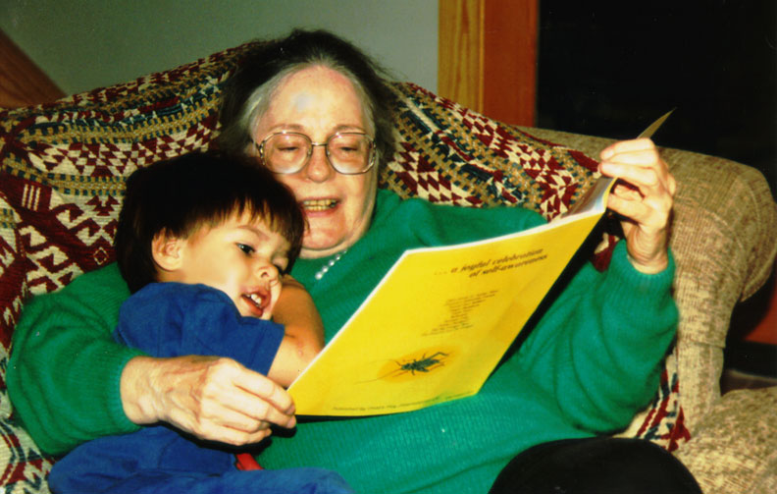
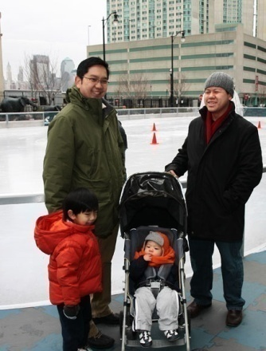
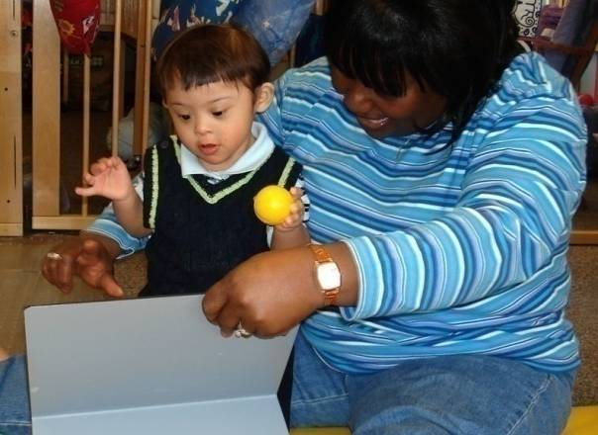
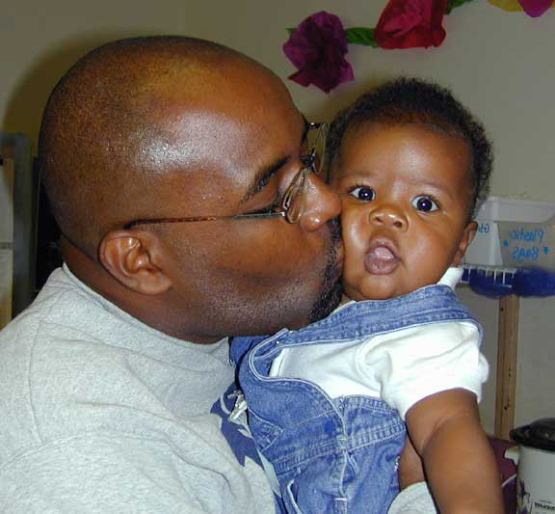
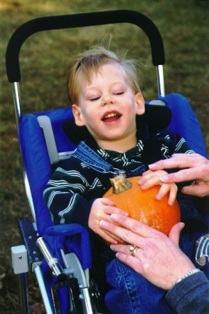
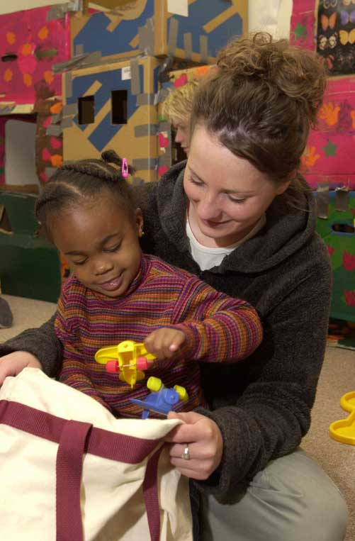
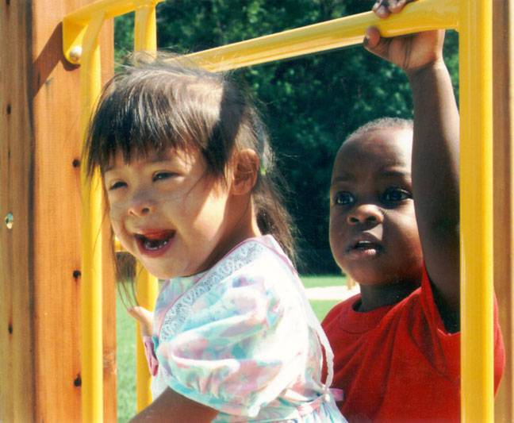
CONNECT
The Center to Mobilize Early Childhood Knowledge
Page 10
http://connect.fpg.unc.edu/
Notes:
56

Slide 57
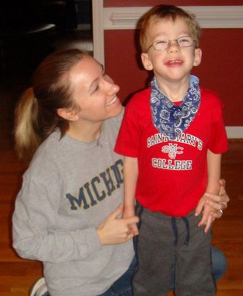
CONNECT Modules
Page 3
Module 3: Communication for Collaboration
Module 4: Family-Professional Partnerships
Module 1: Embedded Interventions
Module 2: Transition
Module 7: Tiered Instruction (Social emotional development & Academic learning)
Module 5: Assistive Technology Interventions
Module 6: Dialogic Reading

Slide 58
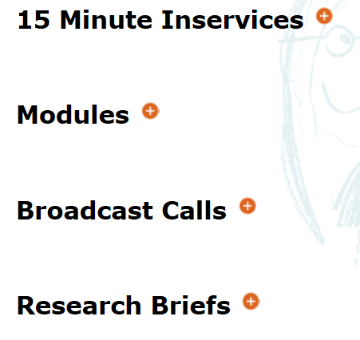
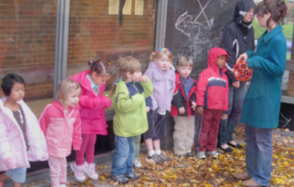
Exceptional Children’s Assistance Center (ECAC)
Page 8
SCRIPT-NC
Supporting Change and Reform in Preservice Teaching in North Carolina

Slide 59
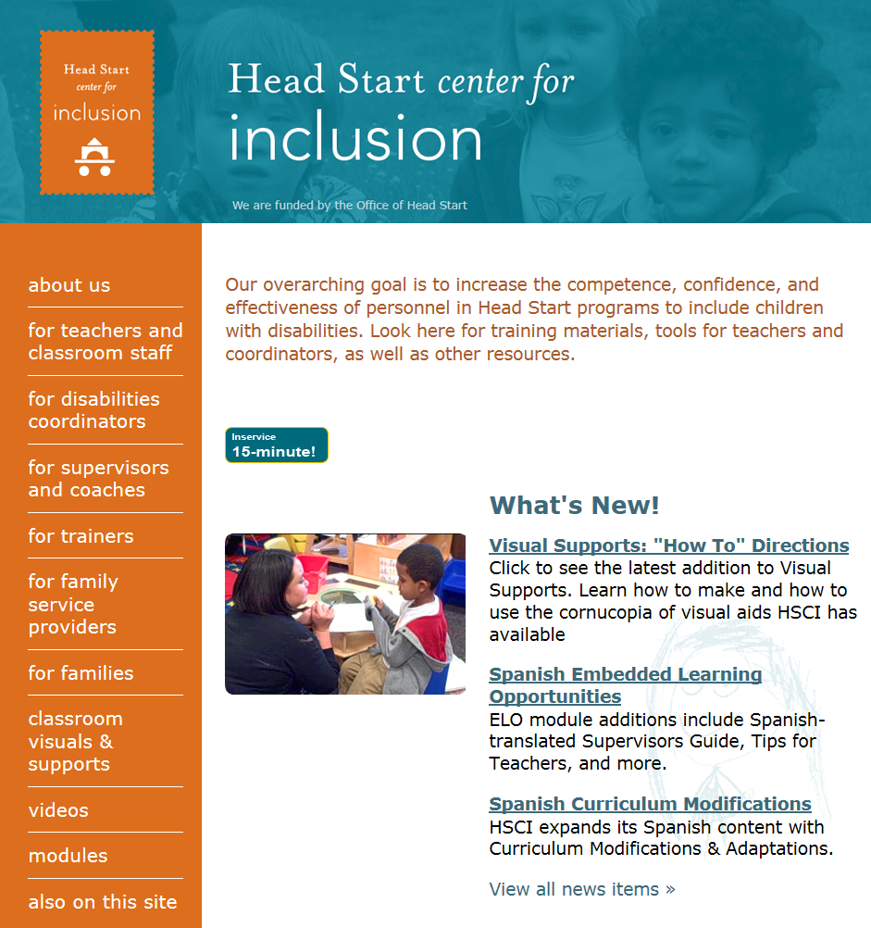

Slide 60
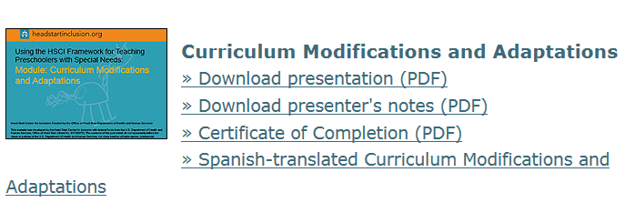
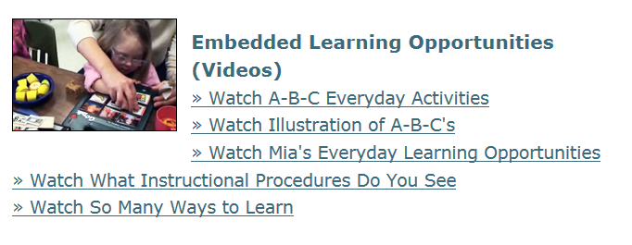

Slide 61
TACSEI
TECHNICAL ASSISTANCE CENTER ON SOCIAL EMOTIONAL INTERVENTION for young children

Slide 62
The possibilities continue . . .
What are you taking away from this webinar that you can share with others and/or use in your work?

Slide 63
The handouts and PowerPoints for this session are available
online at
http://fpg.unc.edu/presentations/dec-pd-sig-webinar

Slide 65
Fabulous and Free: Resources to Support High Quality Inclusion
Presenter: Camille Catlett, Frank Porter Graham Child Development Institute
This webinar will be offered again on Monday, March 7, 2016 at 2:00 PM EST.
Invite colleagues to register at
tinyurl.com/PDSIG372016

