Slide 1

Full Participation: Strategies for Supporting Authentic Family Engagement
DVAEYC Friday, April 12, 2013
Camille Catlett
Frank Porter Graham Child Development Institute
camille.catlett@unc.edu

Slide 2
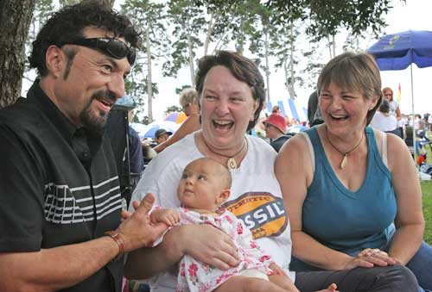
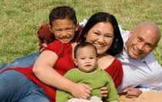
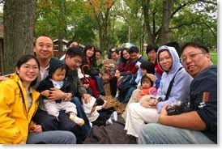
Why involve families?

Slide 3

The family is the constant in a child’s life, while the service systems and support personnel within those systems fluctuate.
Notes:
3
3

Slide 4
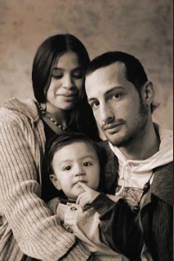
Family Engagement Helps Children to Succeed
Higher preschool performance and promotion to next grade
More positive engagement with peers, adults, and learning
Buffers negative impact of poverty on academic and behavioral outcomes
(Harvard Family Research Project, 2006; Izzo, Weissberg, Kasprow, & Fendrich, 1999; Mantizicoupoulos, 2003; McWayne, Hampton, Fantuzzo, Cohen, & Sekino, 2004)

Slide 5
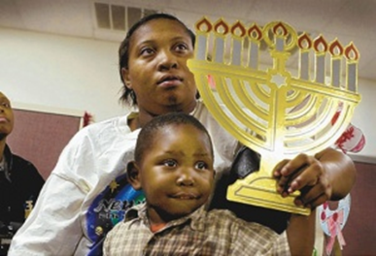
Families can become lifelong partners or lifelong bystanders based on how you engage them in the process of supporting their child.

Slide 6

Traditional Models of Parent Education or Family Involvement
Have not been tremendously effective at engaging families, especially those that are culturally, linguistically, and ability diverse
Often convey the attitude that the professionals have all the answers
Often disregard the knowledge-base and strengths of the family (Halgunseth, 2009)

Slide 7
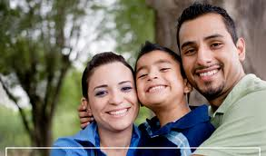
Effective Models of Family Engagement
View families as “involved” and “invested” in their children’s learning
View family members as having unique skills and interests
Ask the question “how are we engaging family interests and skills in our program?”

Slide 8
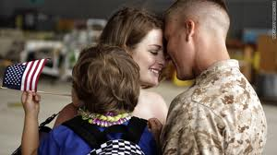
Effective Models of Family Engagement
  Emphasize a reciprocal relationship (not one-sided)
  Takes a partnership approach to children’s learning, in which both programs and families collaborate
  Emphasize respect for families and a value for their expertise
  Promote two-way communication and co-planning

Slide 9
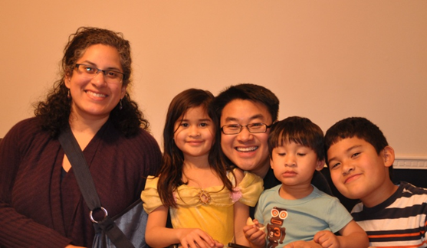
Commitments that Support Family Empowerment
Clarify your values and terms, together
Communicate, communicate, communicate
Acknowledge and respect diversity
Use relevant curricula and instructional practices
(First School, n.d.; Keyser, 2006)

Slide 10
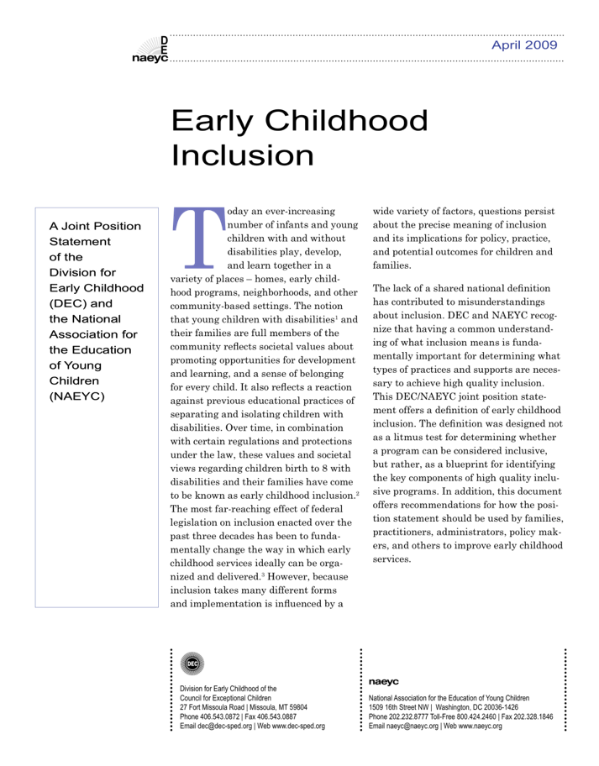
Early
Childhood Inclusion:
A Joint Position Statement of
DEC and NAEYC
Clarify your values
Notes:
10
10

Slide 11
Definition
Early childhood inclusion embodies the values, policies, and practices that support the right of every infant and young child and his or her family, regardless of ability, to participate in a broad range of activities and contexts as full members of families, communities, and society.
Notes:
Have participants read the section in black ink.

Slide 12
… desired results of inclusion
The desired results of inclusive experiences for children with and without disabilities and their families include
  a sense of belonging and membership,
  positive social relationships and friendships,
  development and learning to reach their full potential.

Slide 13
Our Philosophy (FPG)
We believe that...
Appropriate behavior is fostered by helping children learn to control their behavior and work out their conflicts with others rather than relying solely on adults to manage their behavior and intervene in disputes. Positive discipline places emphasis on preventing problems by attending to the room arrangement, having age-appropriate expectations, providing interactive activities for play and learning, and active adult monitoring and supervision.
Learning about and respecting differences among people is promoted when children have many opportunities to play and interact with classmates of different racial and cultural backgrounds and varying abilities.
The advocacy efforts of staff and families are important for improving the lives of all children.

Slide 14

Ask yourself. . .
Do you have agreed upon definitions of key terms to use in your work (e.g., cultural competence, inclusion)?
Do you have guiding principles to underscore your shared commitment to family engagement in all aspects of your work?
Have they been developed collaboratively with families?

Slide 15

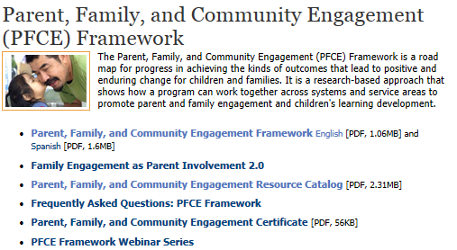

Slide 16
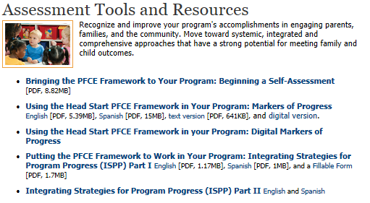

Slide 17
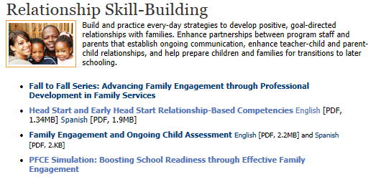

Slide 18
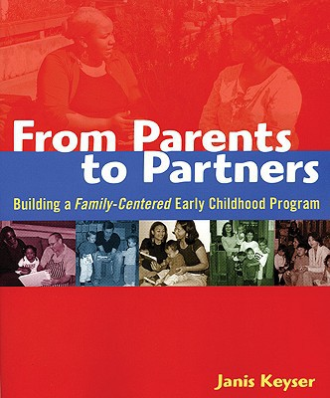
Add from parents to partners here
Partnerships
Communication
Classroom environments
Curriculum

Slide 19

Communicate, communicate, communicate
The Chinese characters that make up the verb “to listen” tell us something significant about communication.
Notes:
19
19

Slide 20
Open House Activity
Why didn’t they come?

Slide 21


Slide 22
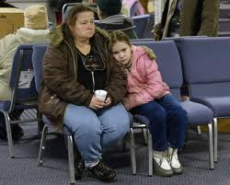

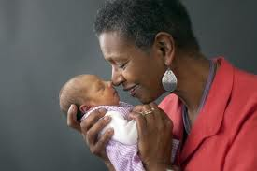
The words we use make a big difference

Slide 23
Ask yourself. . .
Is communication with family members shaping the quality of your work? Are you building the capacity of diverse families to support the capability and success of their children?
Do we engage in honest dialogue with families about their expectations and staff/program objectives?
Are family members helping you to intentionally and effectively support practices that connect home cultures and experiences to their learning?

Slide 24
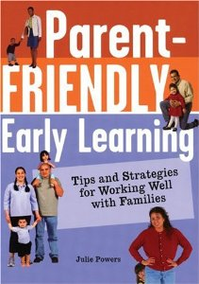
Parent-Friendly Early Learning: Tips and Strategies for Working Well with Families
Dilemmas of daily practice
Possible strategies

Slide 25
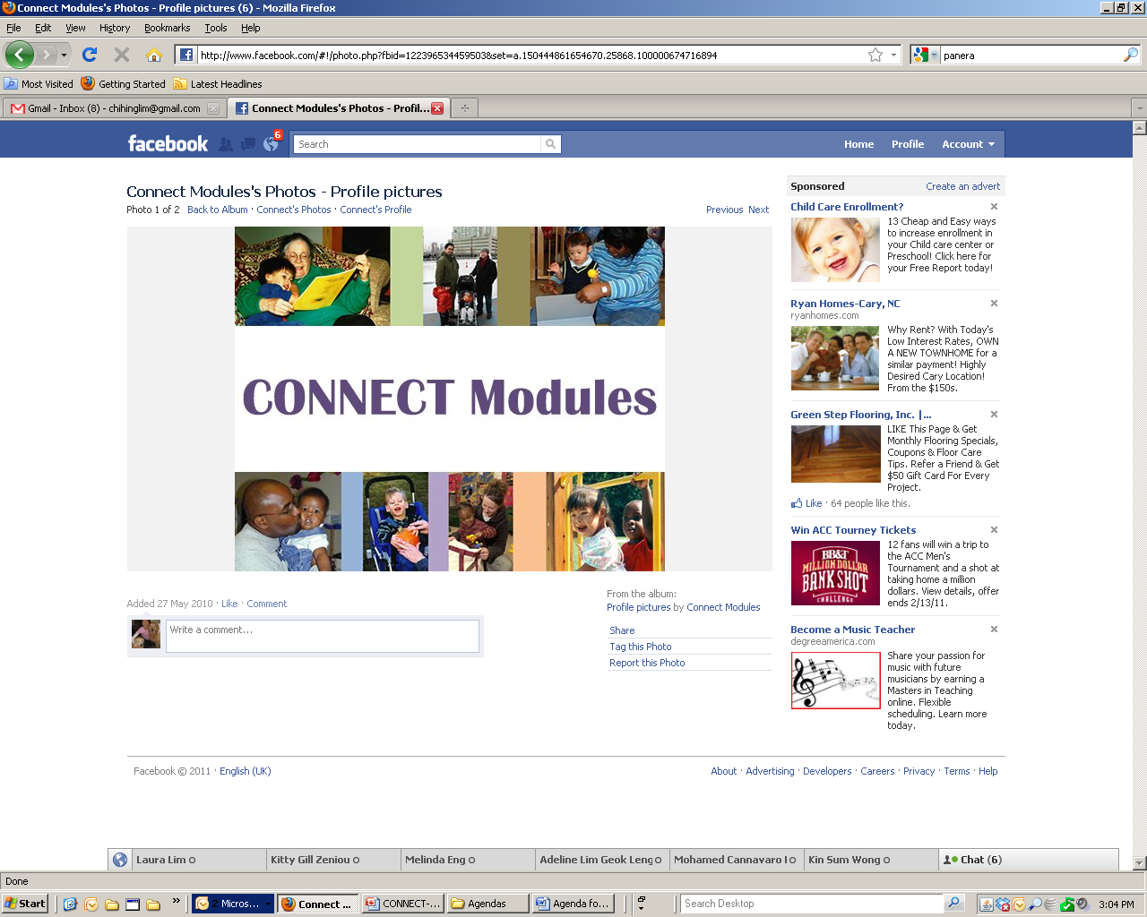

CONNECT Modules
Professional Development focused on Inclusion Practices
Evidence-Based Inclusion Practices

Slide 26
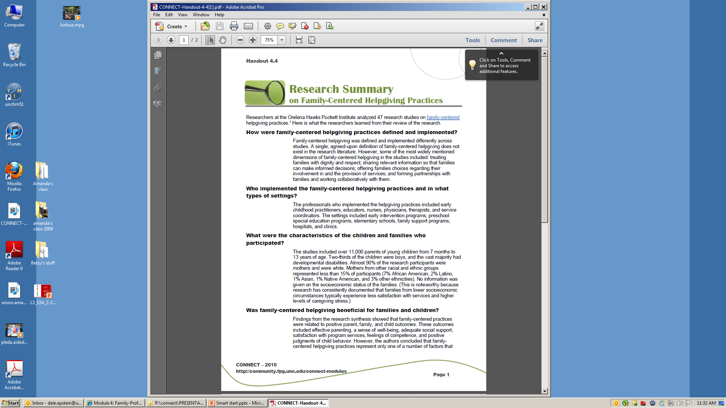
Research

Slide 27
Ask yourself. . .
Do you welcome all families and all family structures, sizes, and arrangements?
Is communication with family members shaping the quality of your work? Are you building the capacity of diverse families to support the capability and success of their children?
Are family members helping you to intentionally and effectively support practices that connect home cultures and experiences to their learning?

Slide 28

Anti-bias Education for Young Children and Ourselves
Louise Derman-Sparks and Julie Olson Edwards
Chapter 4: Creating an Anti-Bias Learning Community
Positive interactions with children
Positive interactions with and among families
The visual and material environment
Curriculum planning

Slide 29
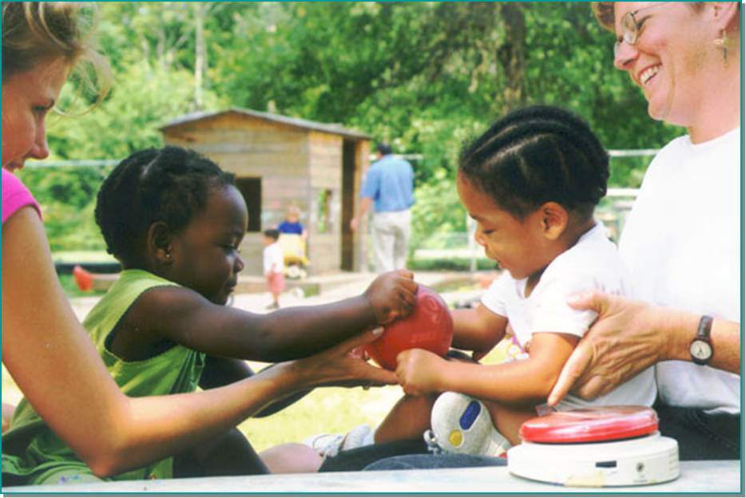
What does quality inclusion look like to families?
Most Valued Characteristic
Program personnel ensure that children with disabilities are active participants in all classroom routines and activities
(Hurley & Horn, 2010)
Notes:
29
29

Slide 30

Multicultural Principles for Head Start Programs Serving Children Ages Birth To Five
Organized around 10 principles
  Every individual is rooted in culture
  The cultural groups in the communities and families of each program are the primary sources for culturally relevant programming
Questions to support reflection, planning, and policy development

