Slide 1
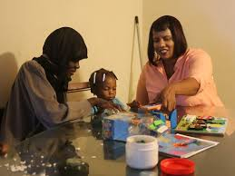
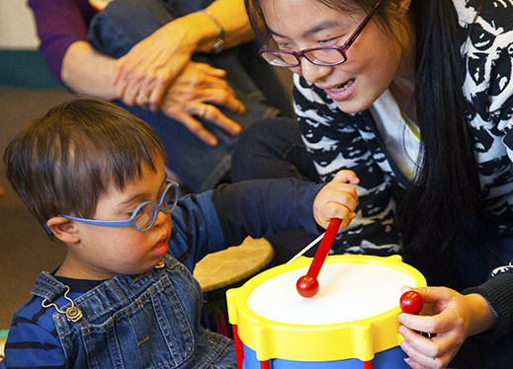
Giving Power to the Family’s Voice: Implications for Policy and Practice
DEC Conference 2018
Kimberly Hile, Camille Catlett & Lori Meyer

Slide 2
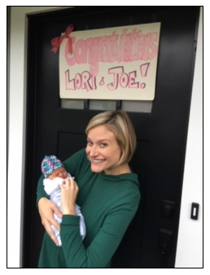
Lori Erbrederis Meyer
and
Lillian Erbrederis Meyer

Slide 3
Notes:
Find out who is in the audience.

Slide 4
Objectives
Participants will identify how family voices can be used to positively impact policy and practice for young children with disabilities and their families.
Participants will understand the challenges and benefits of collecting family voices including identifying diverse families willing to share their stories, establishing rapport with families so they are willing to share their stories, identifying strategies for sharing family stories with key stakeholders, etc.
Participants will learn about several authentic approaches for capturing and using family stories to promote quality.
Participants will learn about high-quality, readily available resources to support the use of family voices in their work.

Slide 5
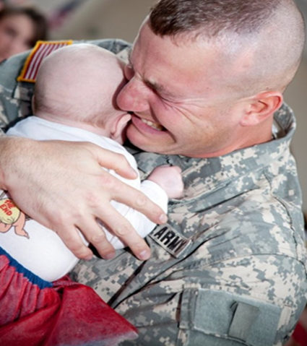

Slide 6
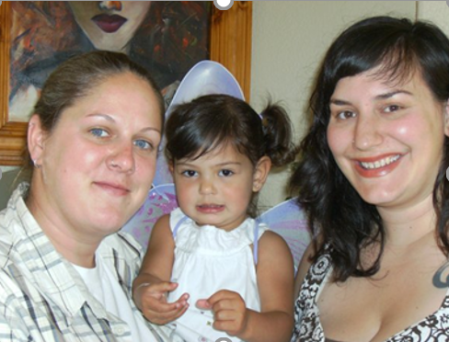
How does the policy statement define family?
The term “family” as used in this statement is inclusive of all adults who interact with early childhood systems in support of their child, to include biological, adoptive, and foster parents; grandparents; legal and informal guardians; and adult siblings.
Notes:
Point this out because I think we often only think of the mom and dad when we talk about family engagement.

Slide 7
Why is it important to give power to the family’s voice?
Notes:
Ask participants to share why they think it’s important.

Slide 8
Almost half of parents feel judged
almost all the time.
90% of moms and 85% of dads feel judged.
46% of moms and 45% of dads say they feel judged all the time or nearly all the time.

Slide 10
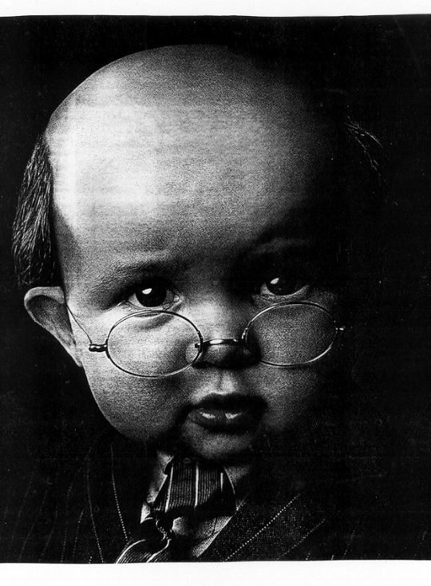
Nearly half of parents think that reading to children starts to benefit long-term language development about a year and a half later than it actually does: 45% say the benefits start at 2 years or older. In reality, benefits begin at about 6 months.
34% of parents believe that talking to children starts to benefit their language skills at a year old or later, when in fact it begins at birth. 63% of parents say the benefits of talking begin at 3 months or older.
There is a missing first year
Notes:
10
We need to know where parents are coming from in order to support their ability to have developmentally appropriate expectations, to feel as though they have something to contribute (i.e., parents as experts), and to engage in meaningful interactions with their children.
10

Slide 11
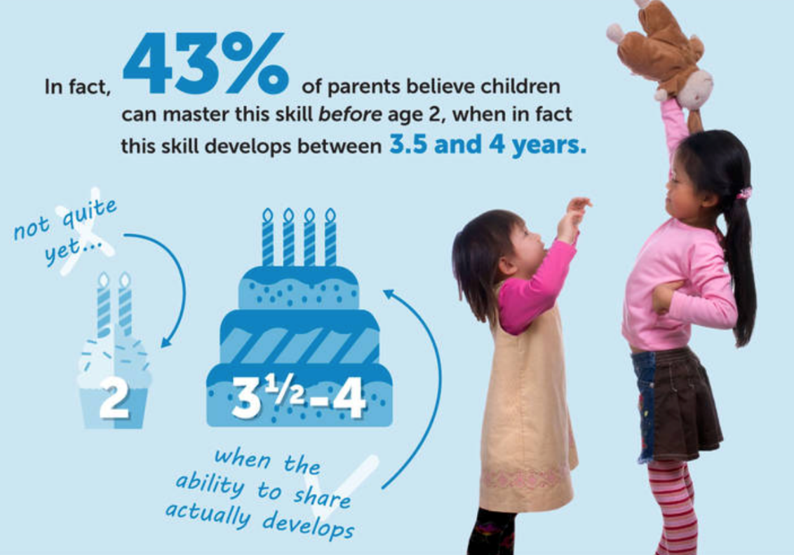
At what age, on average, do you think a child is capable of having this experience: Sharing and taking turns with other children?
Notes:
LEM
Tuning In, ZERO TO THREE’s national Parent Survey, revealed that a majority of parents believe children start developing self-control early in life – much earlier than brain science indicates is possible.
https://www.zerotothree.org/resources/series/the-expectation-gap

Slide 12
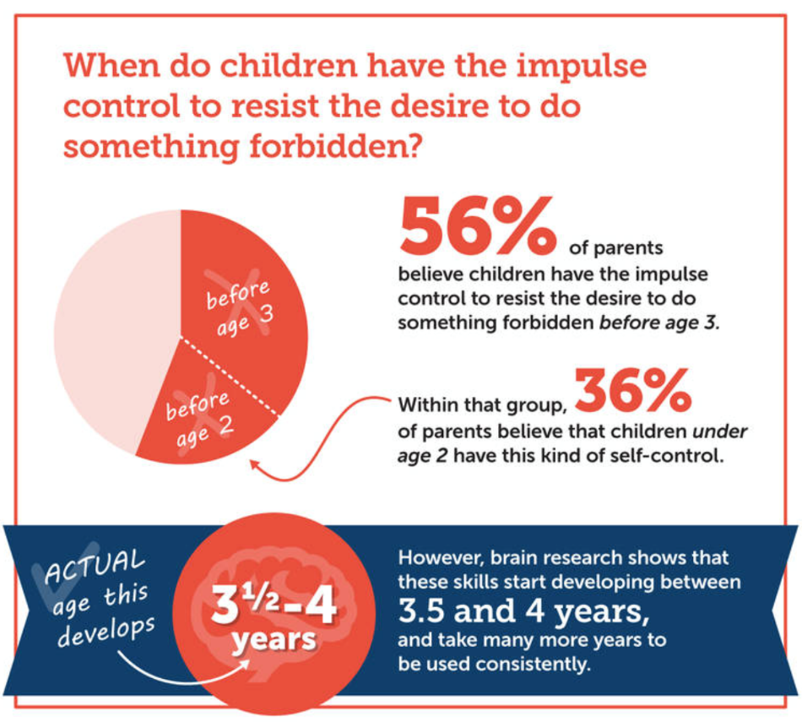
At what age, on average, do you think a child is capable of having this experience: Resisting the desire to do something that parents have forbidden?
Notes:
The next few questions are about how young children grow and develop. Please read the following list of actions and behaviors. For each item, choose at what age on average you think a child is capable of having this experience.

Slide 13
While many parents turn to the internet for parenting advice and information, they sometimes feel overwhelmed by the amount of information available online and its inconsistent quality.

Slide 14
Supporting Each and Every Young Child and Family’s Full and Equitable Participation: Vermont Guiding Principles

Slide 15
All → Each and every

Slide 16
What can people do to help you feel respected?
What does a program/school need to do to support your family’s priorities, values, and culture?

Slide 17
What is your greatest worry for your children when they are in the care of someone else?
What is your greatest hope for your children when they are in the care of someone else?

Slide 18
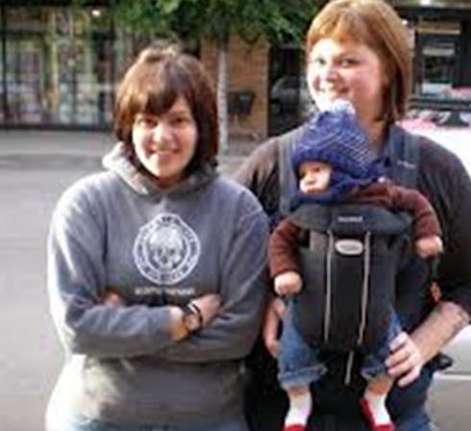
Imagine the best program/ school that supports your children and includes your family. What does it look like?

Slide 19
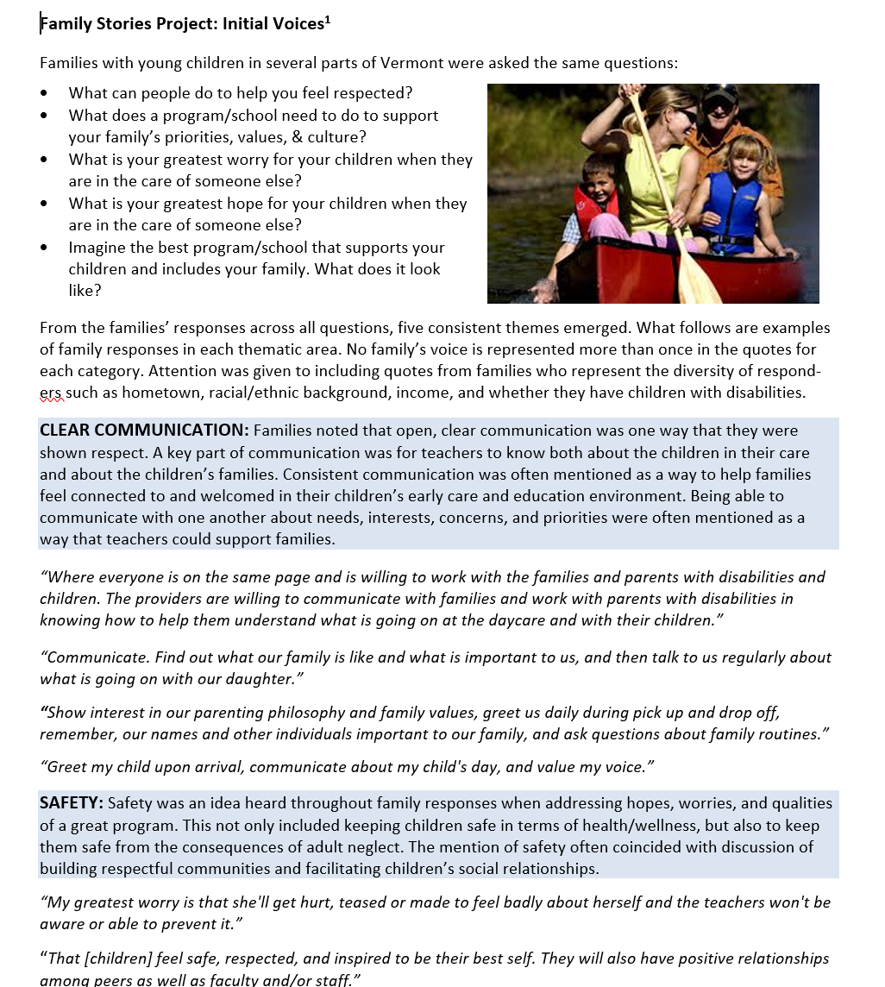
Clear Communication Safety Creating Community Respecting Diversity

Slide 20
Sample responses from families
“Teachers who love teaching, who are flexible thinkers, who inspire creativity and scaffold learning for every child. Placing great emphasis on social emotional wellbeing of everyone children and adults and prioritizing that above academics and test scores.”
“That she will have joy and be enjoyed and that there will be balance between her needs and the needs of the larger group. Through this balance she will learn to be part of a community. That she will learn to love learning and be full of curiosity.”

Slide 21
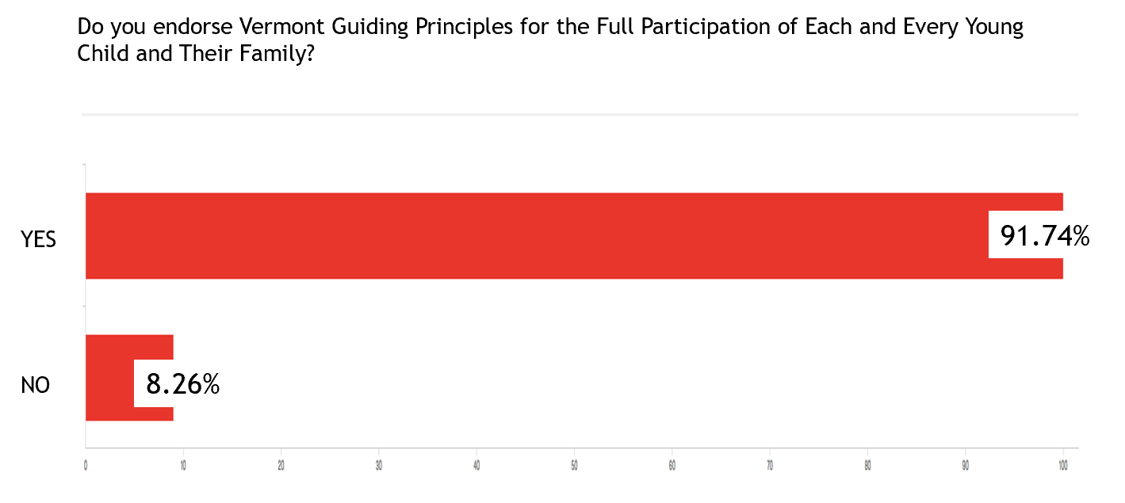
Statewide endorsement process

Slide 22
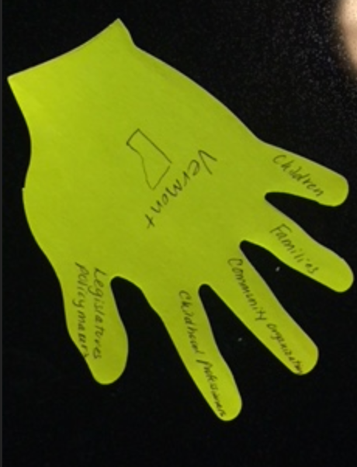

Slide 23
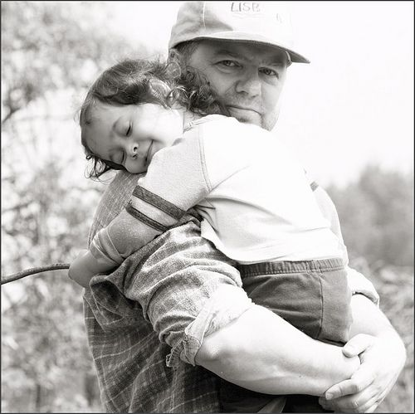
“For each and every family, we will respect and support them as experts, partners, and decision makers in the learning ad development of their children.”

Slide 24
“For each and every family, we will pledge to be open, genuine, reflective, and respectful listeners and communication partners.”

Slide 25
“For each and every family, we will build caring communities that are accepting of differences and foster a sense of beloging.”

Slide 26
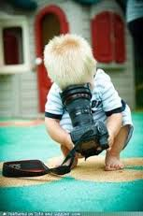
Photo-elicitation Interviews
Interviews that utilize photographs to support or enhance conversations.
Provides opportunities to examine participants’ experiences that are not readily observable such as feelings, thoughts, or intentions.
Assists with establishing rapport, extends conversations, shifts “power” from the interviewer to the participant, and facilitates personal reflection.

Slide 27
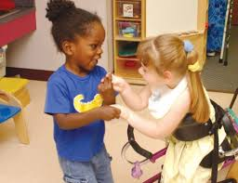
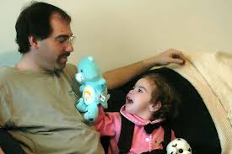
“It is important to appreciate that the photographs themselves are not the focus of the photo elicitation interview method; rather, it is the meaning and significance attributed to the image by the participant that is of research interest.”
(Smith, Gidlow, & Steel, 2012, p. 375)

Slide 28
“Words are how we think. Stories are how we link.”
Christina Baldwin

Slide 29
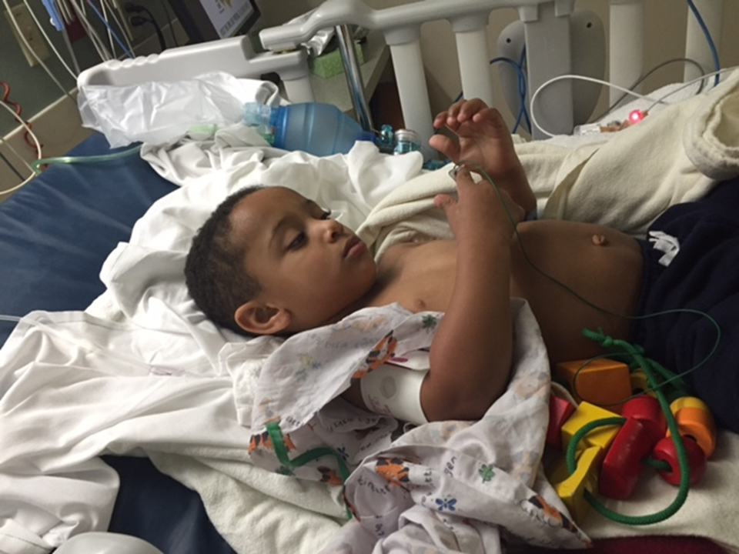
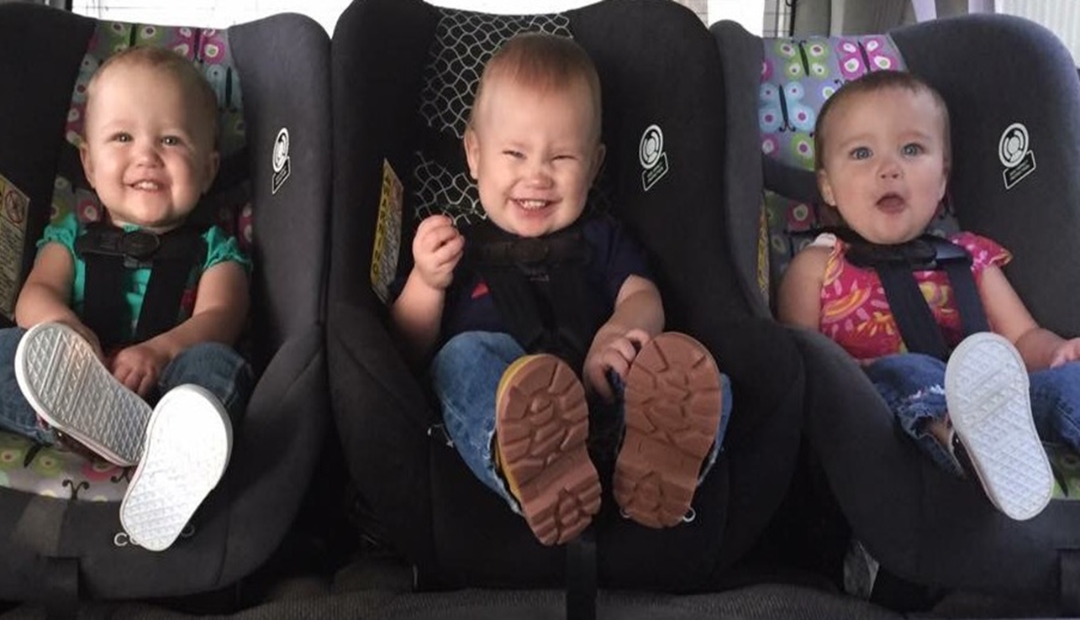
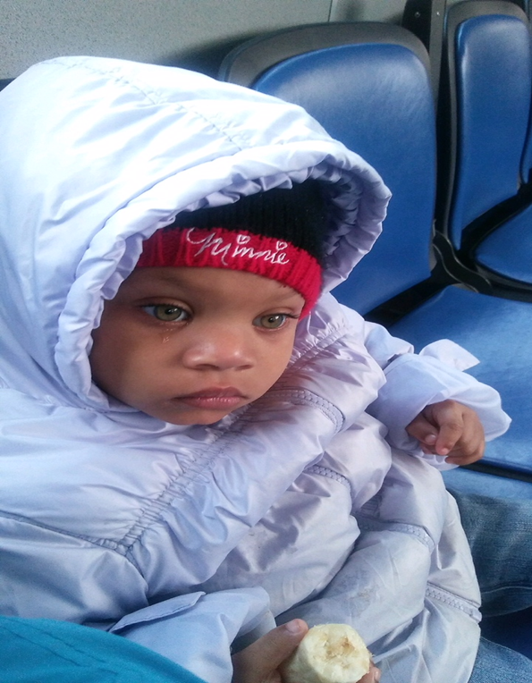

Slide 30
What strategies have you tried? Share both positive results and challenges.

Slide 32
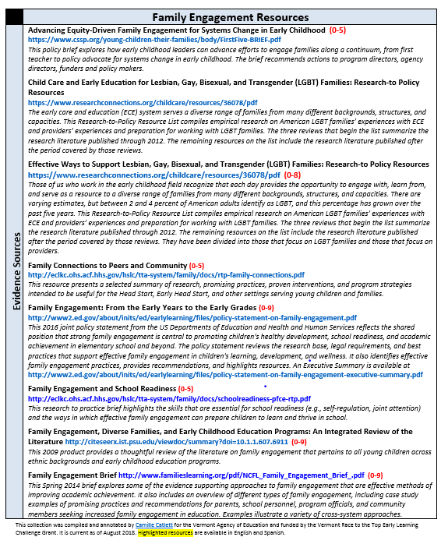
Family engagement resources

Slide 35
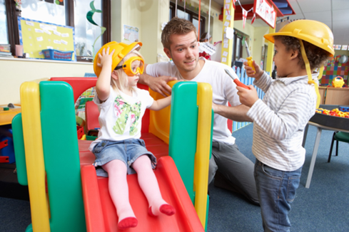
F | FAMILY
A | ASSESSMENT
C | COLLABORATION
I | INSTRUCTION
L | LEADERSHIP
I | INTERACTION
T | TEAMING
A | AND
T | TRANSITION
E | ENVIRONMENT

Slide 36
http://www.dec-sped.org/dec-recommended-practices

Slide 37
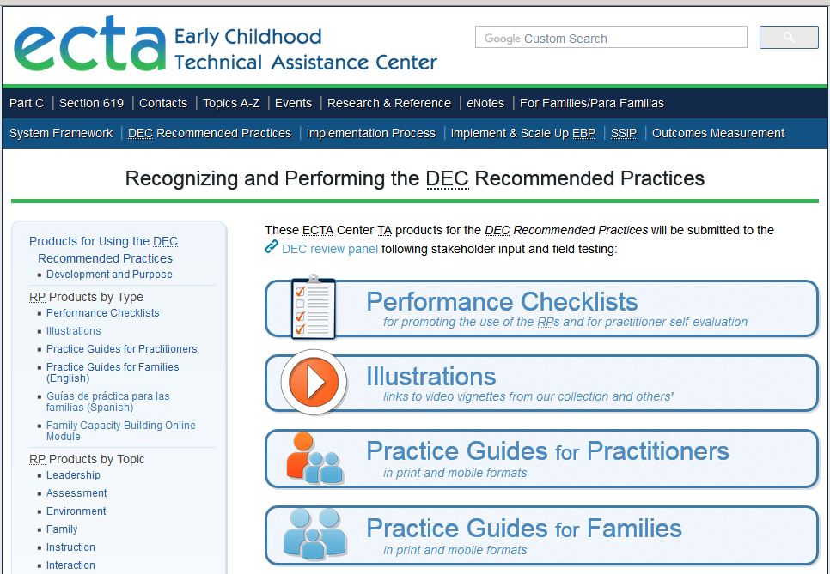
http://ectacenter.org/decrp/

Slide 40
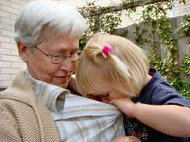

Slide 42
Supporting Family Leaders

Slide 43
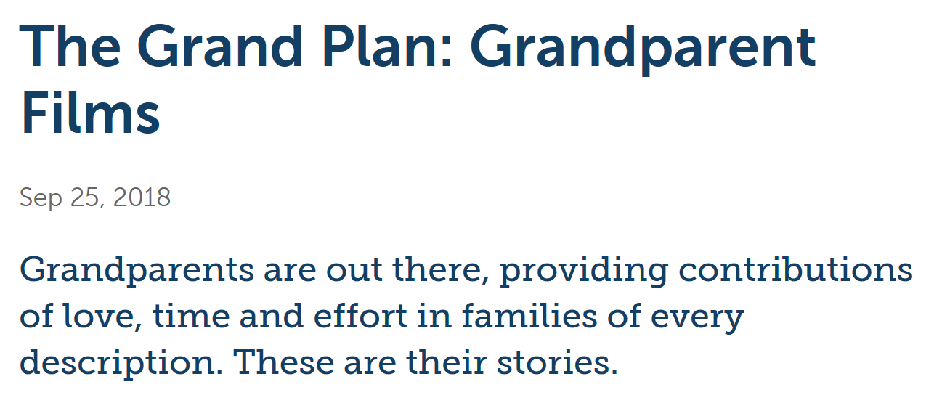
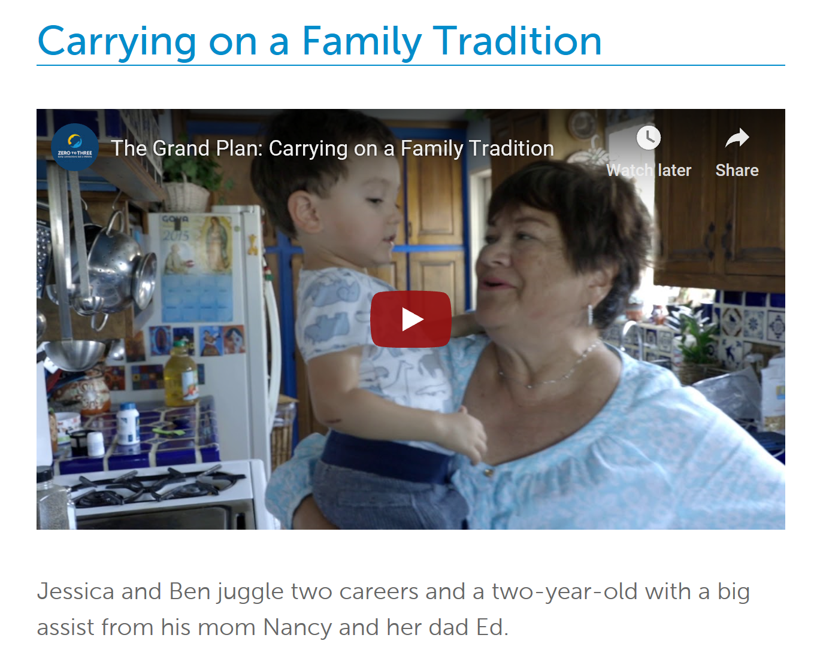
Plus additional resources

Slide 44
Kimberly Hile kimberly.hile@uah.edu
Camille Catlett camille.catlett@unc.edu
Lori Meyer Lori.Meyer@uvm.edu

Slide 45
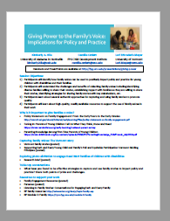
https://fpg.unc.edu/presentations/giving-power

