Slide 1
Incorporating Vermont Quality Tools and Frameworks in Your Teaching/Professional Development
Camille Catlett
Janet Kilburn
Beth Peloquin
Andrea Racek
Lauren Smith
5/31/2019

Slide 2
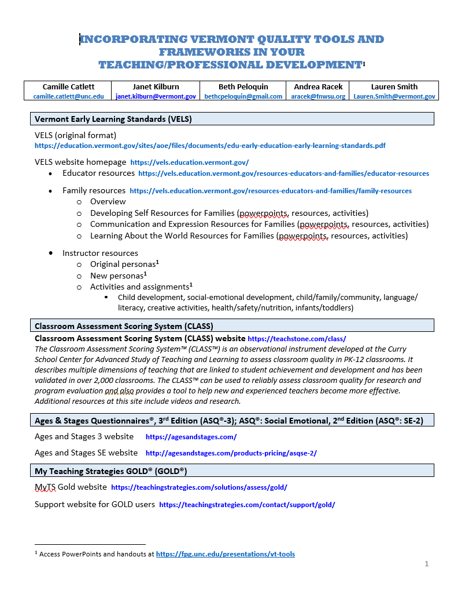
https://fpg.unc.edu/presentations/ vt-tools

Slide 3
Areas of Lowest Current Knowledge: Faculty and Instructors
Newer Vermont assessment tools (CLASS, TPOT, TPITOS, ICP)

Slide 4
Review of Vermont Early Childhood and Early Childhood Special Education Course Syllabi (2/2018)
Four tools (ASQ, CLASS, ERS, TS GOLD) that are part of Vermont’s systems for measuring program quality were rarely mentioned in any of the syllabi. One syllabus (out of 52) explicitly incorporated the ASQ, one incorporated the CLASS, two incorporated one of the ERSs, and none incorporated TS GOLD.
Notes:
A total of 52 syllabi were reviewed

Slide 5
https://www.youtube.com/watch?v=0pNFBXFUSaE
Notes:
https://www.youtube.com/watch?v=0pNFBXFUSaE

Slide 6
What can 2-year-olds do? https://www.youtube.com/watch?v=sJkmnIQIYZg&feature=youtu.be

Slide 7
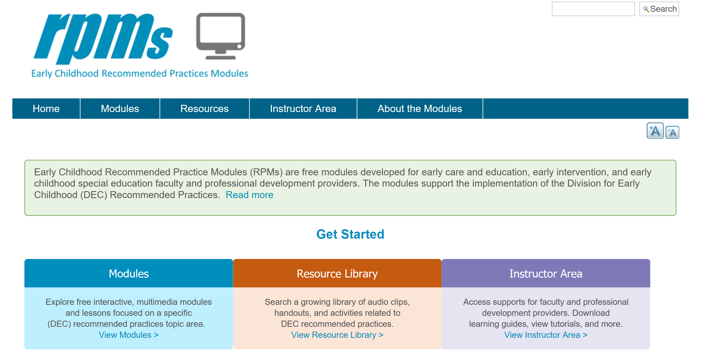
https://rpm.fpg.unc.edu/

Slide 8
http://ectacenter.org/decrp/topic-assessment.asp

Slide 10
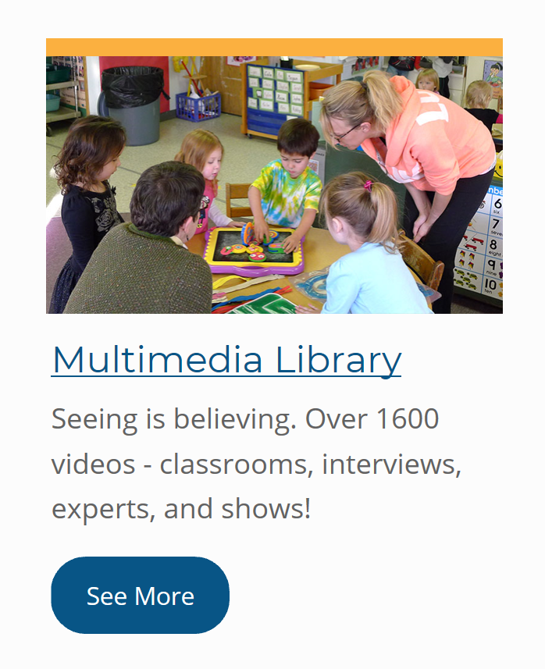
https://members. earlyedualliance. org/content/

Slide 11
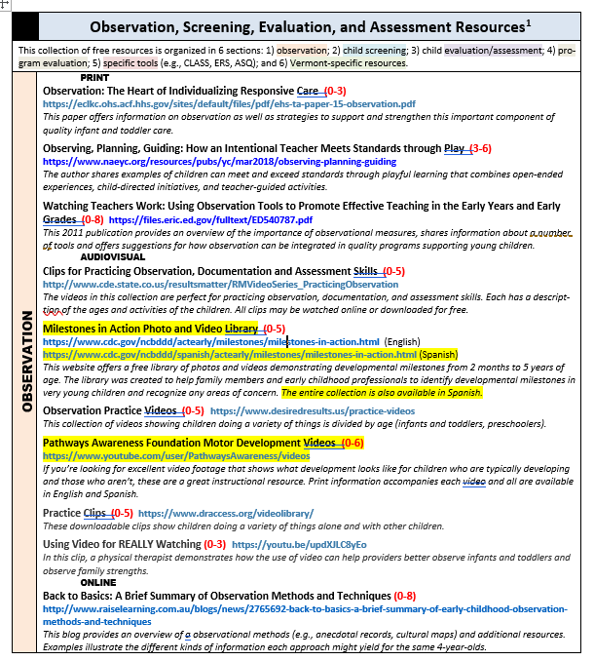

Slide 12
Clips for Practicing Observation

Slide 13
Assessment resources https://www.cdc.gov/ncbddd/actearly/milestones/milestones-in-action.html

Slide 14
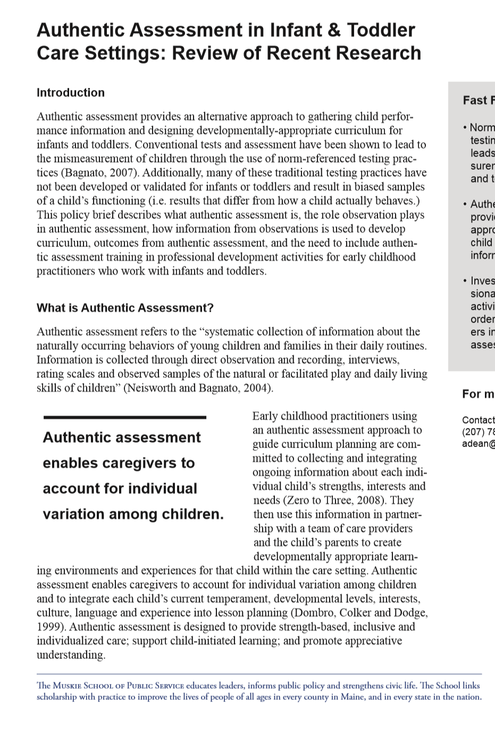

Slide 15
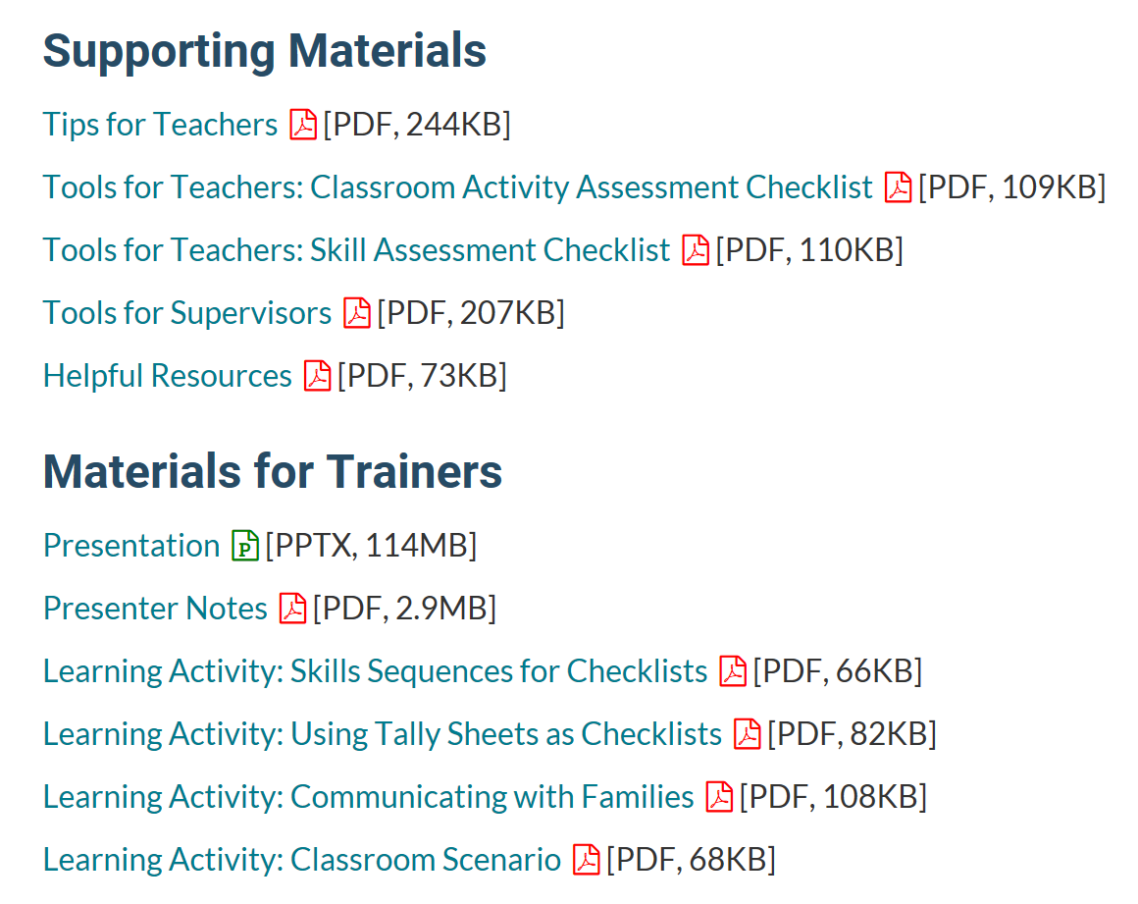

Slide 16
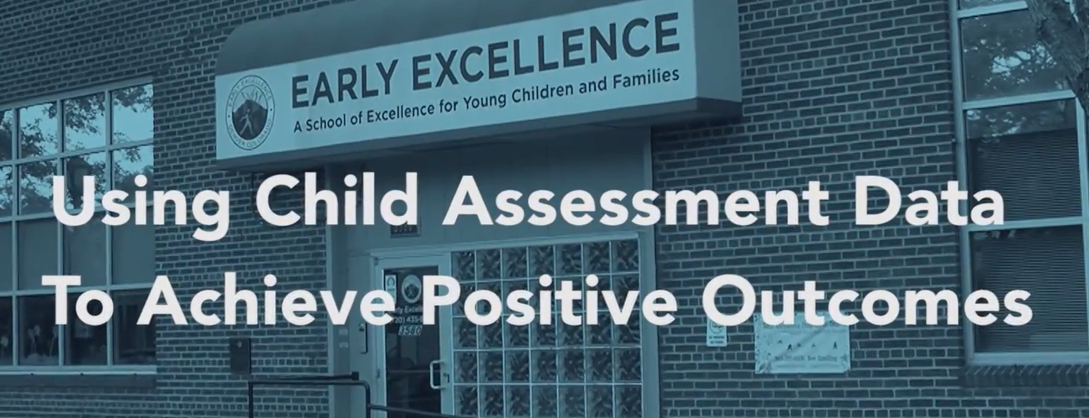
Administrators and teachers illustrate how they use authentic child assessment data to: 1) inform funders, 2) inform classroom level instruction, 3) support teachers, and 4) meet the needs of individual children and their families.

Slide 17
How do you monitor reading progress?

