Slide 1
LEADING FROM THE MIDDLE Influencing Up, Down, and Sideways
Camille Catlett
Frank Porter Graham Child Development Institute

Slide 3
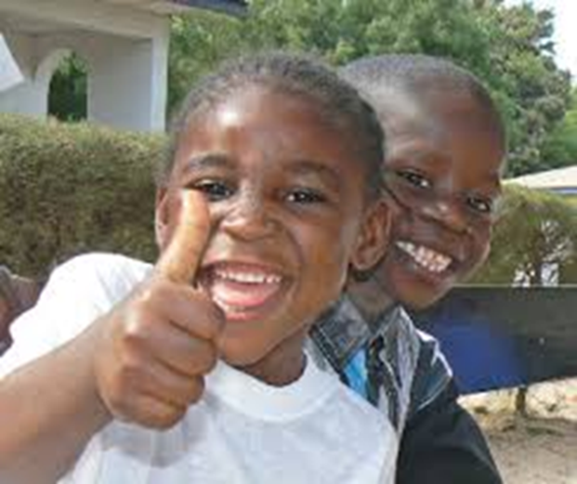
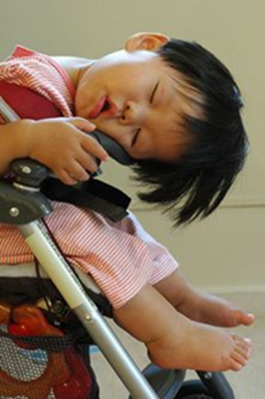
My Goal
This
Not this

Slide 4
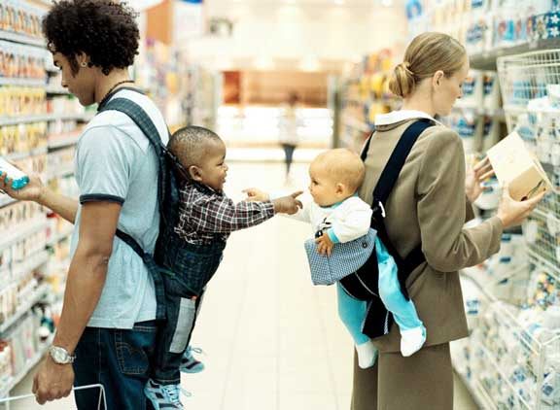
Acknowledge one another as equals
Notes:
Source: Wheatley, M. J. (2009). Turning to one another: Simple conversations to restore hope to the future. San Francisco: Berrett-Koehler Publishers, Inc.

Slide 5
Share generously

Slide 6
Stay curious

Slide 7
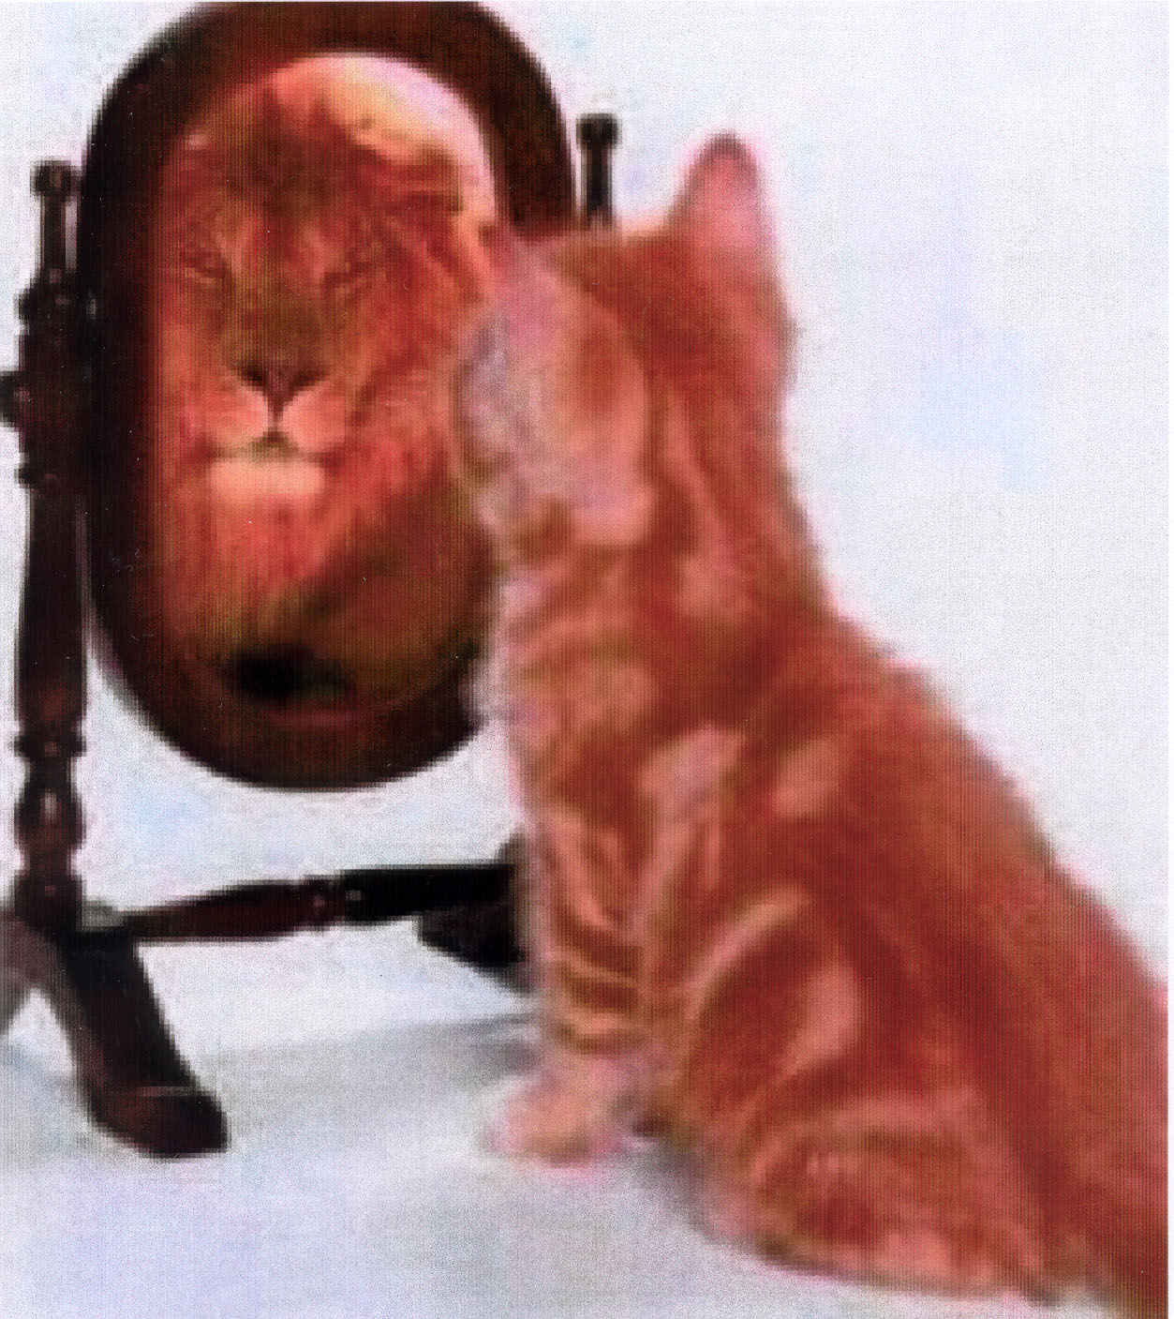
Slow down so we have time to think and reflect

Slide 8
Expect it to be messy at times

Slide 9
There is no power greater than a community discovering what it cares about.
Ask “what’s possible?” not “what’s wrong?” Keep asking.
Trust that meaningful conversations can change your world.

Slide 10
A New Context of Leadership

Slide 11
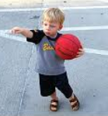
Types of Leadership
Situational Leadership
Transformational Leadership
Servant Leadership
Directive Leadership

Slide 12
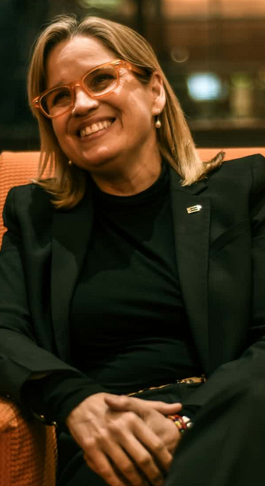
Situational Leaders
Able to lead based on
time, place and/or
circumstance
Strong ability to
influence and
inspire others
Carmen Yulín Cruz
Mayor, San Juan Puerto Rico
Notes:
Hurricane Maria lifted a “veil from our eyes”, said Carmen Yulín Cruz, her broad smile and warm manner belying the steely edge to her voice. “We are awake to our inequity – and our inequality,”

Slide 13
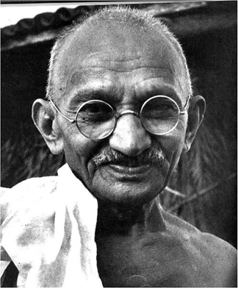
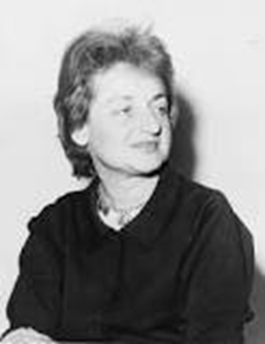
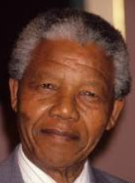
Transformational Leaders
Influence and inspire
others
Create change and
inspire vision
Work effectively
with complexity,
ambiguity and uncertainty
Mahatma Gandhi
Betty Friedan
Nelson Mandela

Slide 14
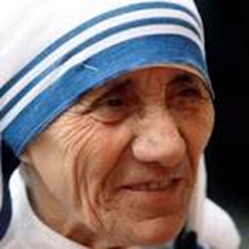
Servant Leaders
Focus on the needs and
goals of others
Determine what actions
and behaviors are most
likely to benefit those
being served
Mother Teresa

Slide 15
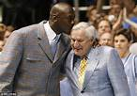
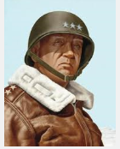
Directive Leaders
Monitor, guide, coach,
direct, and evaluate the
work of others
Influenced by values
and beliefs about how
people grow, change,
and develop
Dean Smith
General Patton

Slide 16
What can leadership look like?
Observe the types of
leadership practiced
by Sister Mary Clarence
(Whoopi Goldberg)

Slide 17
. . . the words “leading from the middle” and you’ll get over 37 million results

Slide 18
Leading from the Middle
A different way of thinking about leadership
Leading as a peer, not a superior
Modeling behaviors you want others to display
Exercising influence to reach shared goals

Slide 19
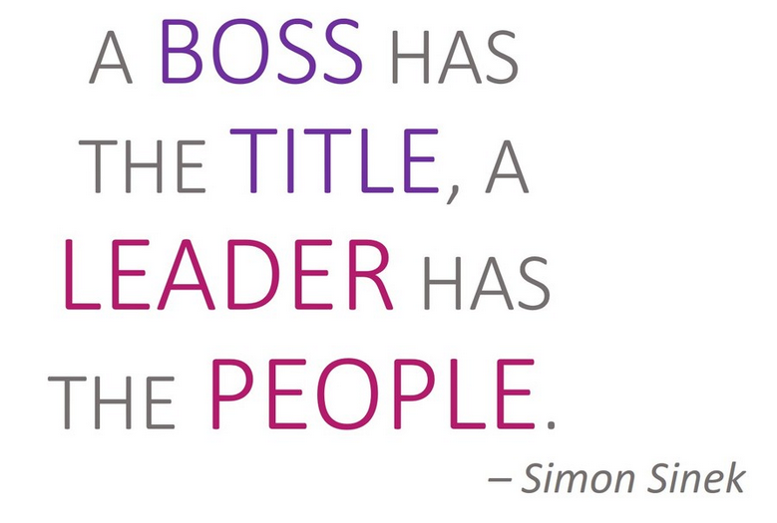
Notes:
https://mccormickcenter.nl.edu/wp-content/uploads/2018/03/Whole-Leadership-Framework.jpg

Slide 20
Center for Creative Leadership
Notes:
Center for Creative Leadership https://www.ccl.org/

Slide 21
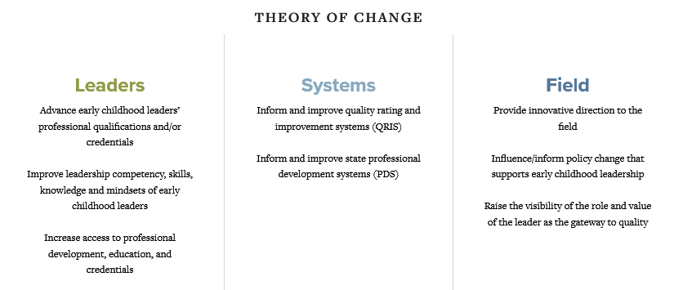

Slide 22
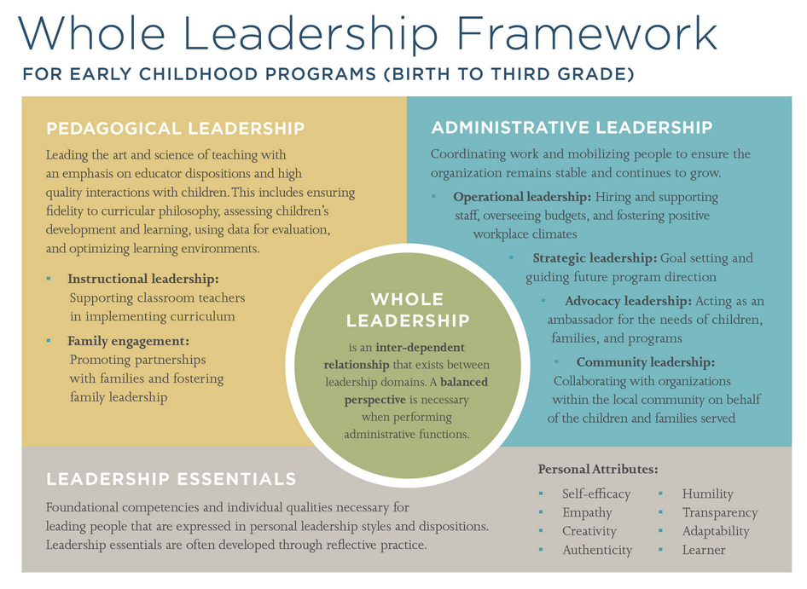
Notes:
Whole Leadership Framework
https://mccormickcenter.nl.edu/wp-content/uploads/2018/03/Whole-Leadership-Framework.jpg

Slide 23
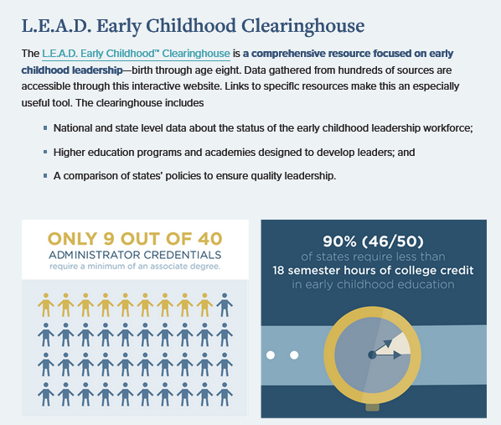

Slide 24
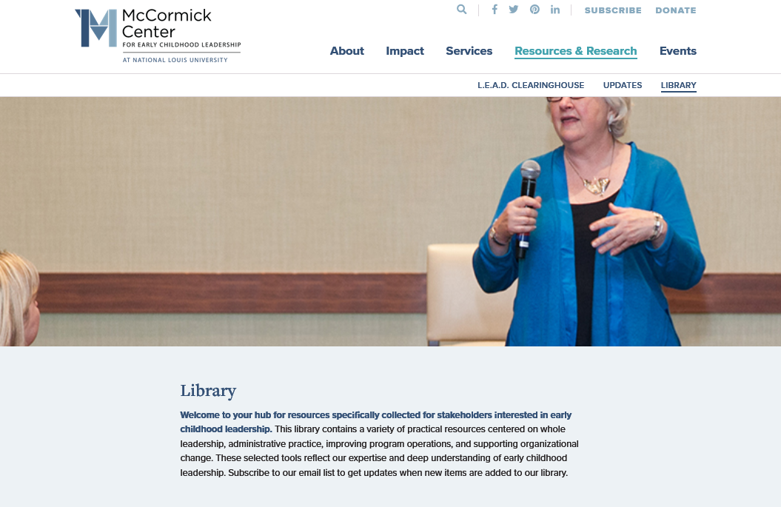

Slide 25
Notes:
Source: https://leadership.mchtraining.net/mchlc_docs/mch_leadership_comp_3-0.pdf

Slide 26
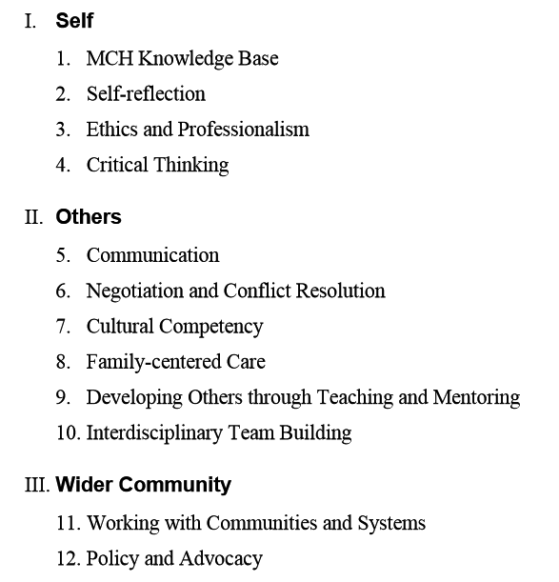
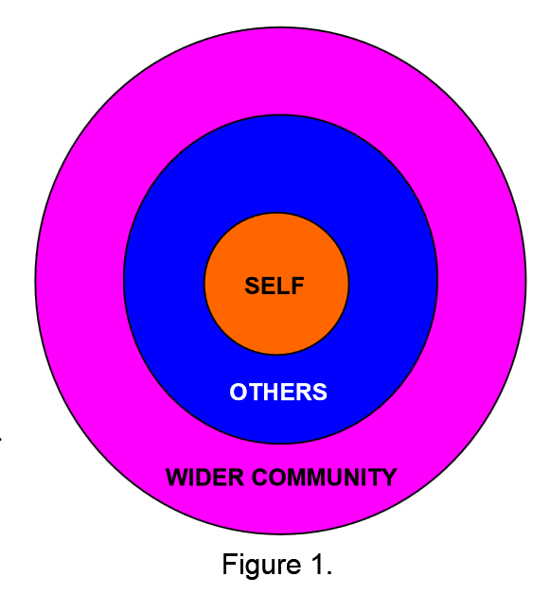
MCH Leadership Competencies
Notes:
Source: https://leadership.mchtraining.net/mchlc_docs/mch_leadership_comp_3-0.pdf

Slide 27
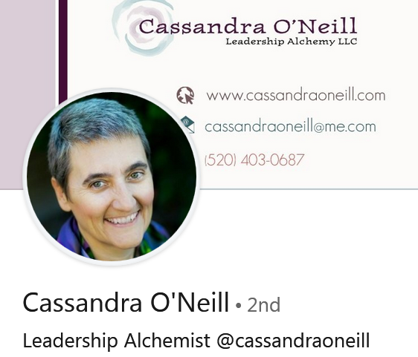

Slide 28
Five Elements of Collective Leadership
Element | Belief
1. Shared Vision and Re-envisioning | To achieve our fullest potential, we must co-create the condition we are working together to achieve.
2. Wholeness | When people are connected to mind, body, and spirit, the workplace, organization, and whole system benefit.
3. Collective Wisdom/ Intelligence | The whole is greater than the sum of its parts; collective wisdom and intelligence exists that is deeper than individual intelligence; one person cannot hold all the knowledge.
4. Coaction | Things are better when people are acting together instead of someone imposing on another.
5. Evolution/ Emergence | When complexity exists, the process of emergence, evolution, and adaptability are beneficial, and practices can help focus attention on growth and development.
Notes:
O’Neill, C., & Brinkerhoff, M. (2018). Five elements of collective leadership for early childhood professionals. St. Paul, MN: Redleaf Press.

Slide 29
Kouzes and Posner
Notes:
Kouzes and Posner – The Leadership Challenge
http://www.leadershipchallenge.com/About-section-Our-Approach.aspx

Slide 30
Kouzes and Posner
Notes:
Kouzes and Posner – The Leadership Challenge
http://www.leadershipchallenge.com/About-section-Our-Approach.aspx

Slide 31
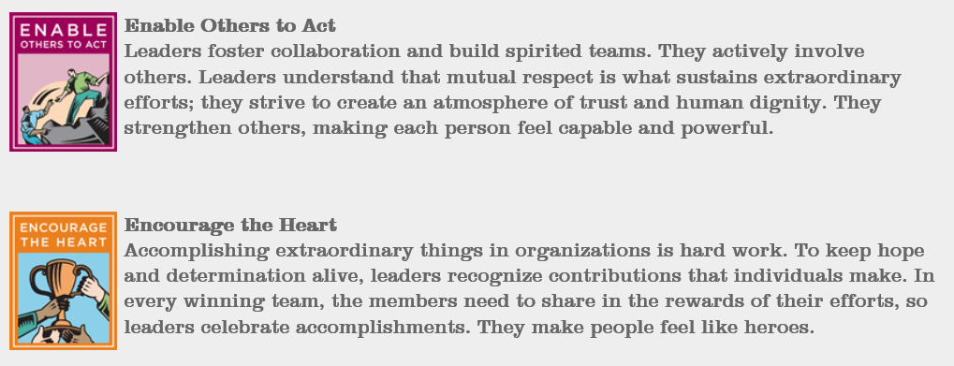
Kouzes and Posner
Notes:
Kouzes and Posner – The Leadership Challenge
http://www.leadershipchallenge.com/About-section-Our-Approach.aspx

Slide 32
Fish Philosophy

Slide 33
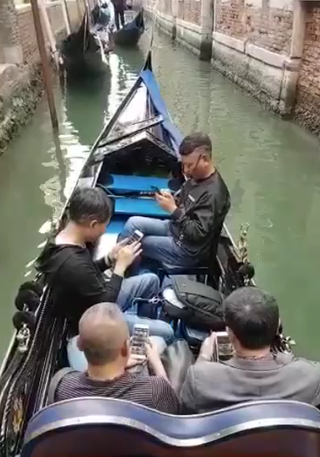

Slide 34
What 30 Years of Research Tells Us About the Effect of Leadership on Student Achievement
70 studies
2,894 schools
~ 1.1 million students
14,000 teachers
Notes:
Waters, J.T., Marzano, R.J., McNulty, B.A. (2003). Balanced leadership: What 30 years of research tells us about the effect of leadership on student achievement. Aurora, CO: Mid-continent Research for Education and Learning. https://www.claytonschools.net/cms/lib/MO01000419/Centricity/Domain/2/NSPRA2009/McREL_BalancedLeadership.pdf

Slide 35
What 30 Years of Research Tells Us About the Effect of Leadership on Student Achievement
There is, in fact, a substantial relationship between leadership and student achievement. [This study] found that the average effect size (expressed as a correlation) between leadership and student achievement is .25.

Slide 36
What dimension of leadership made the biggest difference?

Slide 37
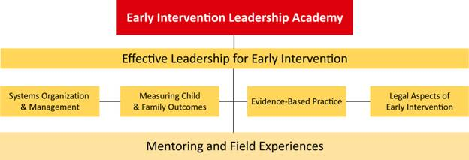
Program Sequence

Slide 38
Fellow Responses
I am more aware of leadership tools and resources to enhance my practices. I can use this information to influence others.
It has already created a ripple; people want to do this. I see good things in the future for our county--increased performance, better support for families.
EILA increased my confidence and ability to inspire others in my county.
I have more knowledge and ways to access knowledge so I can be a resource to others.

Slide 39
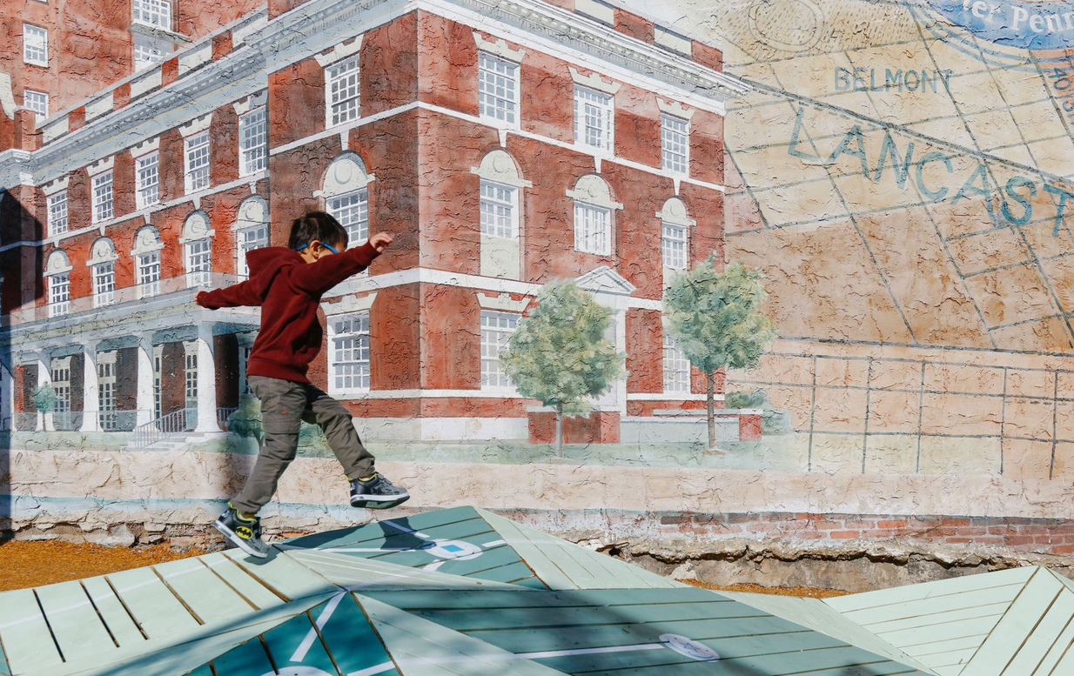
This urban design project is sneaking puzzles and hopscotch into abandoned lots

Slide 40
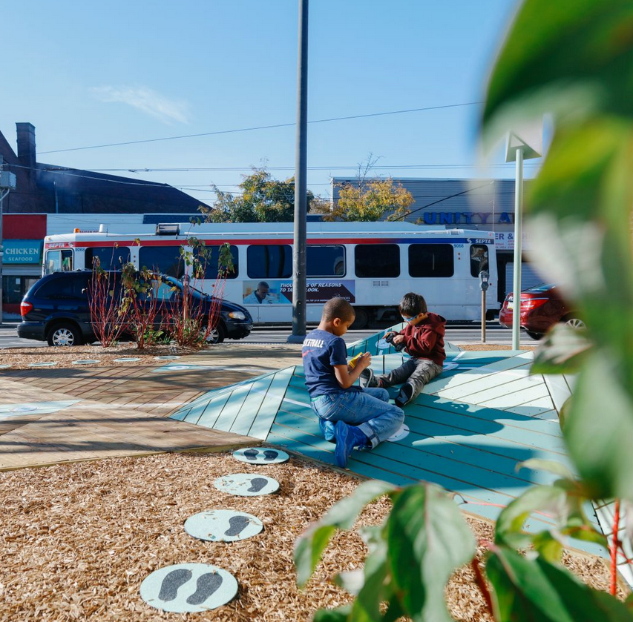
The games “increased adult-child interaction, increased language among adults and children, and the type of language used reflects greater use of spatial terms.”

Slide 41
Researchers turned supermarket aisles into games by putting up signs that encouraged conversations between parents and their children. Initial findings showed that in low-income neighborhoods, conversations between kids and parents grew by 33% when the signs were up.
Notes:
https://onlinelibrary.wiley.com/doi/full/10.1111/mbe.12081

Slide 42
Colorado needs leaders who use evidence-based practices to support each and every child

Slide 43
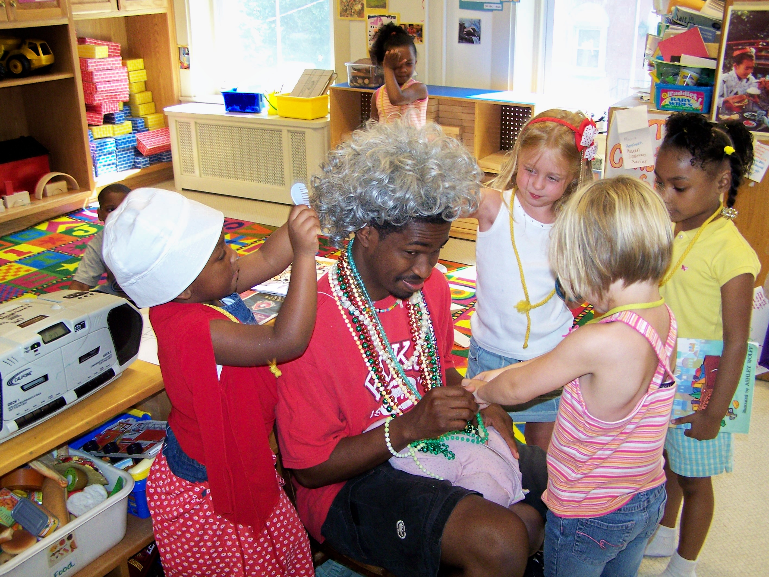
Colorado needs leaders who are committed to the full participation of each and every child

Slide 44
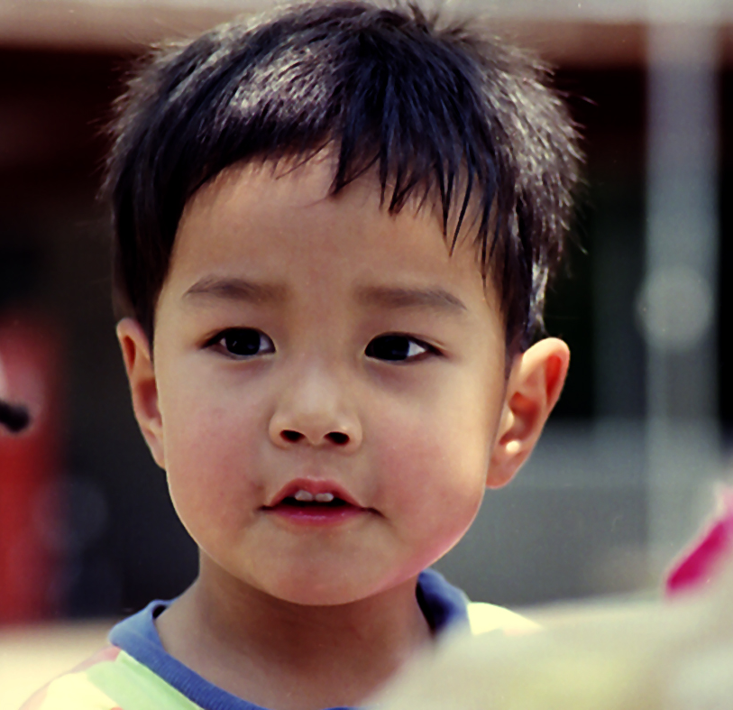
Colorado needs leaders who understand the difference their knowledge of and responses to culture, language, equity, and diversity will make for children and families

Slide 45
Colorado needs leaders who can support the shift from seeing children and families “at risk” to seeing them “at potential”

Slide 46
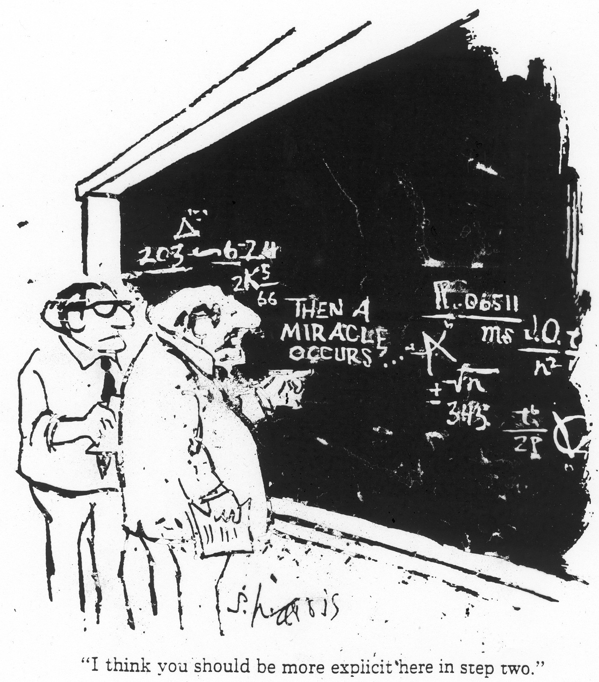
Colorado needs leaders who pursue, provide, and promote effective
professional development

Slide 47
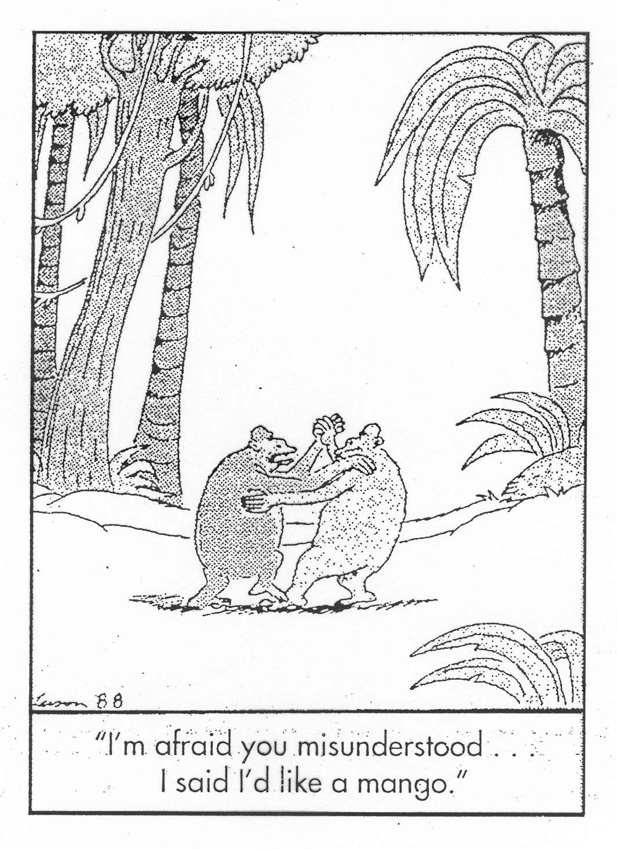
Colorado needs leaders who understand the importance of effective communication

Slide 48
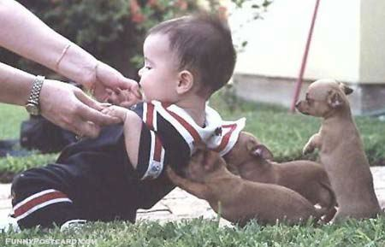
Colorado needs leaders who are effective collaborators

Slide 49
Colorado needs leaders who accept that conflict and change are not always bad things

Slide 50
If your actions inspire others to dream more, learn more, do more and become more, YOU ARE A LEADER. John Quincy Adams

