Slide 1


A World of Resources and
Some Thoughts on How to Use Them
Camille Catlett
SCRIPT-NC
Supporting Change and Reform in Preservice Teaching in North Carolina

Slide 2

Early Childhood Learning and Knowledge Center

Slide 3

National Center for Quality Teaching and Learning

Slide 4

Fred Rogers Center Early Learning Environment
Curriculum Toolkit

Slide 5
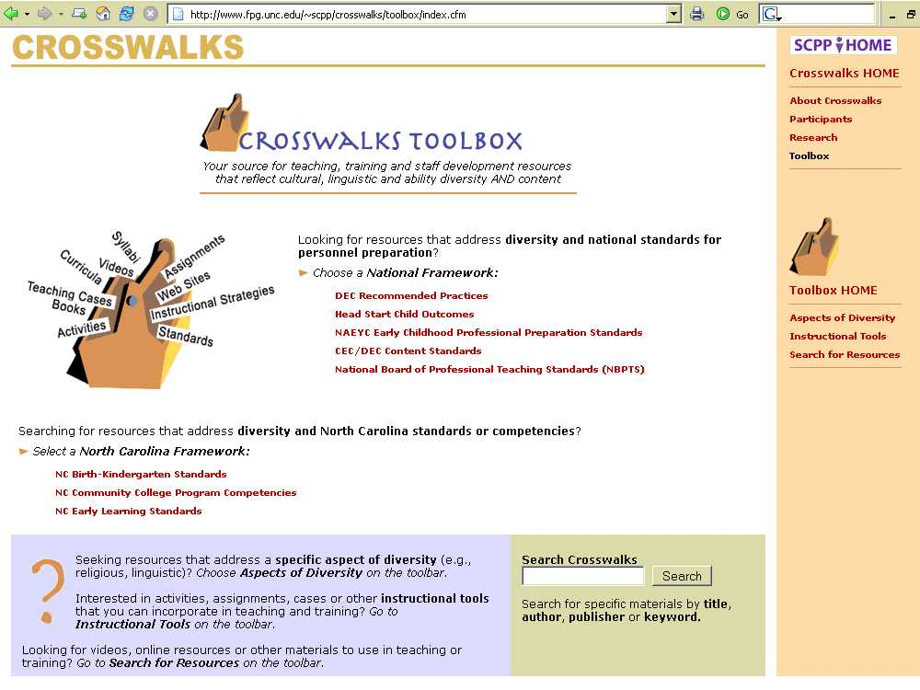
Crosswalks http://fpg.unc.edu/~crosswalks

Slide 6
Shifting Paradigms
Know &
be able to do
Evidence
Evidence-based practices

Slide 7
Shifting Paradigms
NAEYC standards
DEC standards
DEC recommended practices
Developmentally appropriate practices

Slide 8
Parts of a whole
Individually Appropriate
Developmentally Appropriate
Culturally Appropriate

Slide 9

How do you use DAP on an ongoing basis in your teaching/PD?

Slide 10
Use DEC Recommended Practices to . .
Promote discussion of intentional teaching practices (example: C2)
Guide observation (example: C1)
Promote reflection (example: C4)
Build rubrics (example: F6-7)

Slide 11
Ways of Making Shift Happen
Infusion – incorporate more than one perspective when discussing a particular topic
Example: What are the last sounds to develop for young English language learners? For young Spanish language learners?
Extension – expand consideration of a topic with a question
Example: How might this approach work with a young child with an attention deficit disorder? Or young dual language learner?
Stand Alone – focused content
Example: What are the early signs of autism? What are the stages of second language acquisition?

Slide 12
A World of Resources for
EDU 144
(Child Development & Learning Birth-36 months)
and
EDU 146
(Child Guidance)
Camille Catlett
SCRIPT-NC
Supporting Change and Reform in Preservice Teaching in North Carolina

Slide 13
Activities to Make EDU 144 Fun
Developmental Milestone Puzzle
 | 2-3 years | 3-4 years | 4-5 years | 5+ years
Large Motor Skills | Jumps in place on floor with 2 feet together | Hops on one foot | Walks up and down stairs, alone alternating feet | Skips using alternate feet
Fine Motor Skills | Strings several large beads on a string | Builds a tower of nine small blocks | Copies a square using a crayon | Prints numerals “1” to “5”
Language Skills | Makes negative statements | Repeats at least one nursery rhyme. Can sing a song. | Tells the content of a story but may confuse facts | Few differences from adults language
Social Skills | Plays house, imitating basic domestic activity | Joins in play with other children and begins to interact with them | Dramatic play is closer to reality, with attention paid to detail, time and space | Plays simple table games such as Candy Land

Slide 14
Activities to Make EDU 144 Fun
Developmental Milestone Puzzle
 | 2-3 years | 3-4 years | 4-5 years | 5+ years
Large Motor Skills
Fine Motor Skills
Language Skills
Social Skills

Slide 15
Activities to Make EDU 144 Fun
True-False Quiz: A great alternative to lecture
Answer each of the following questions about gross motor skills
Most two year olds can jump in place on the floor with both feet together. ◻ True ◻ False
Five year olds often master the art of skipping before they turn six. ◻ True ◻ False

Slide 16


Basics
Typical-Atypical Development (copy provided)
The World of Children: Developing Child Observation Skills

Slide 17

Basics
NC Division of Child Development and Early Education ( NC DCDEE)
The NC Infant-Toddler Program

Slide 18
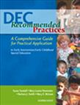

Just the Facts, Ma’am
Insights to how to support the development of young children with disabilities
Extend to discuss the other professionals who support young children with disabilities (e.g., occupational therapists)
Research on the many ways in which culture influences development

Slide 19
Just the Facts, Ma’am
Use the domains of learning to organize observations of child development
Emotional Social Development | Health and Physical Development
Language Development and Communication | Approaches to Learning

Slide 20
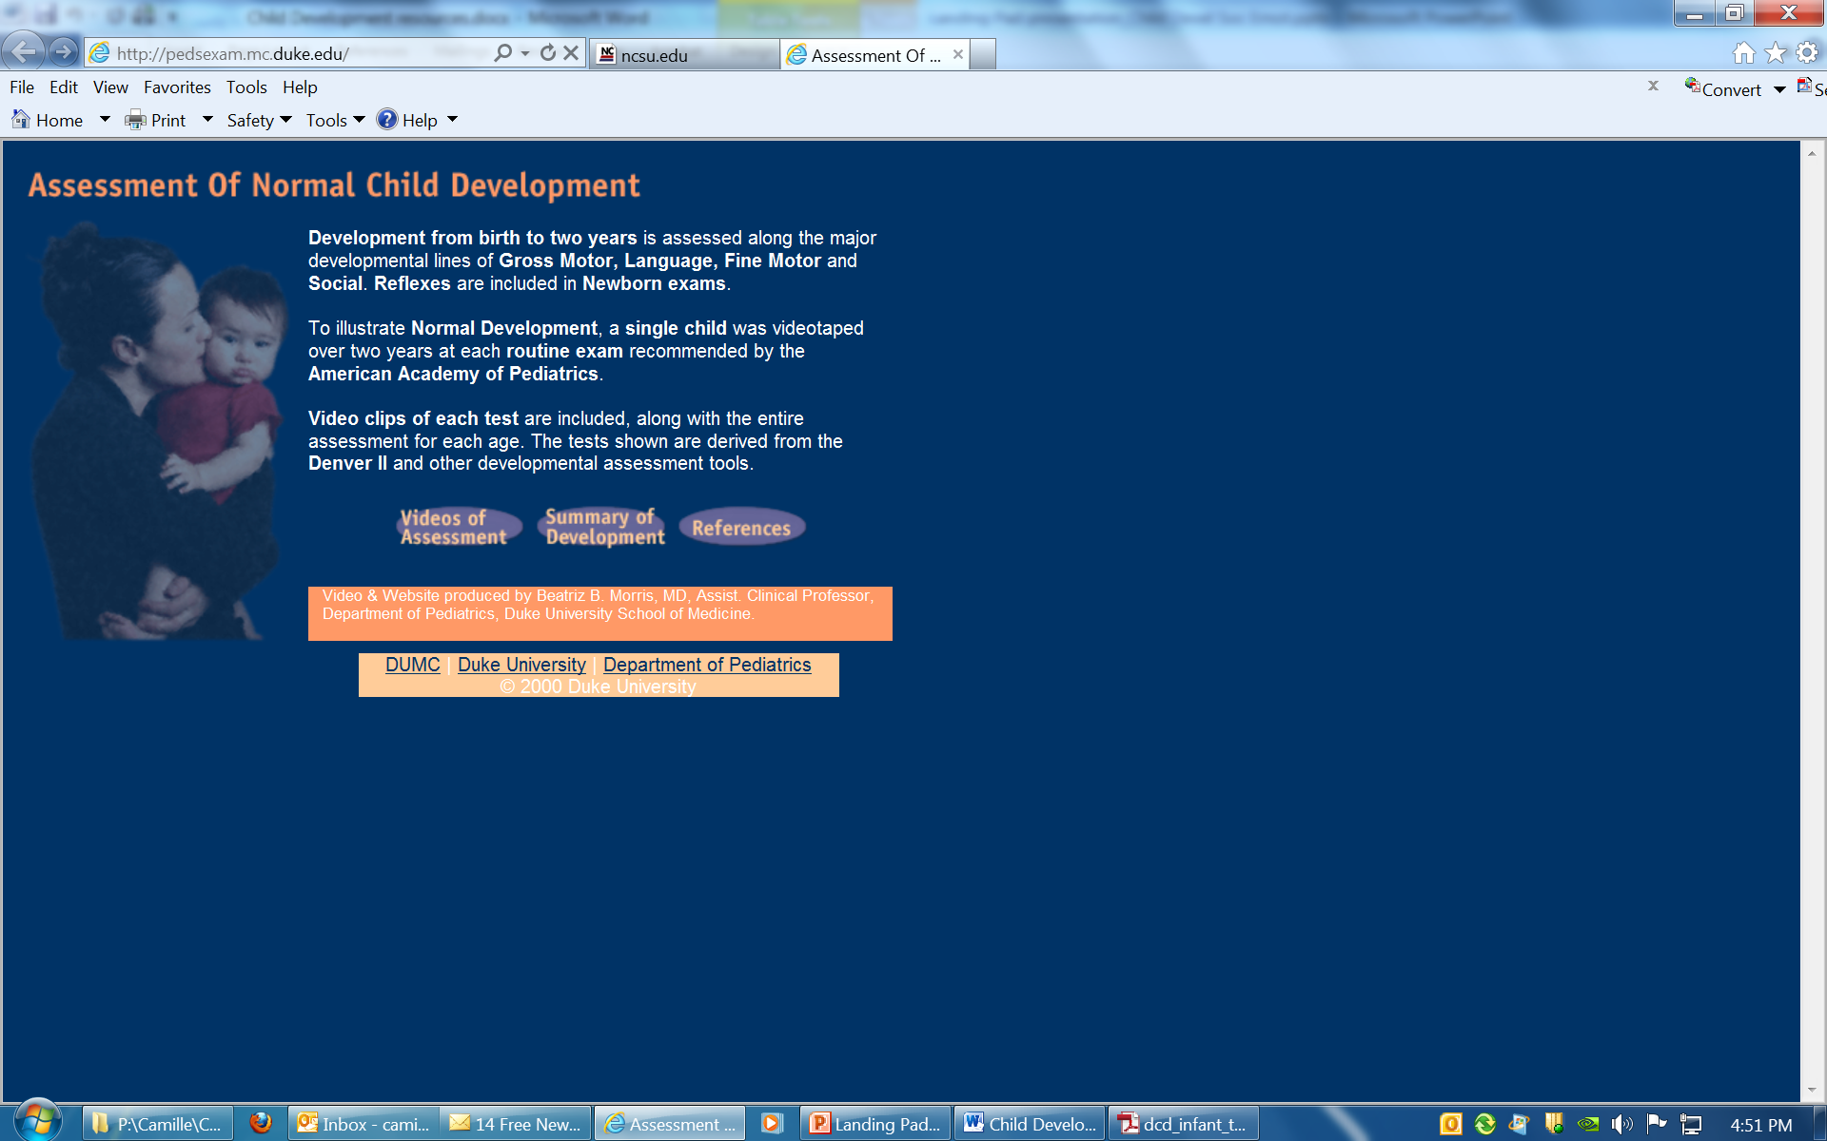
See For Yourself

Slide 21


See For Yourself
Videos on pregnancy, birth, newborn care
The Biology of Prenatal Development
Videos on pregnancy and prenatal development, infancy and toddlerhood, etc.

Slide 22
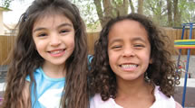
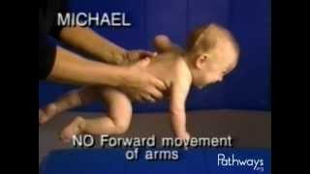
See For Yourself
Clips for Practicing Observation, Documentation, and Assessment Skills
Early Learning Brain Development and Lifelong Outcomes
Pathways Awareness Foundation videos

Slide 23


Find It Online
Ages and Stages for Caregivers
Games for Growing

Slide 24
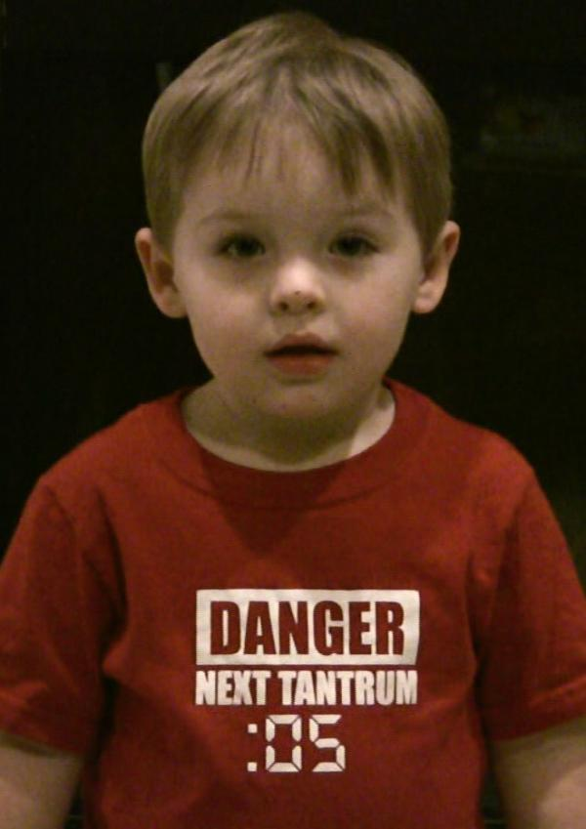
EDU 146 Social-Emotional Development/Child Guidance

Slide 25

All Around Resources
http://csefel.vanderbilt.edu/

Slide 26
Activities to Make EDU 146 Fun
Discover Book Nooks!

Slide 27

On Monday when it rained my mother said I couldn’t play outside.
I wanted to ride my new red bike with the blue horn to my friend Maggie’s house.
I was . . .

Slide 28
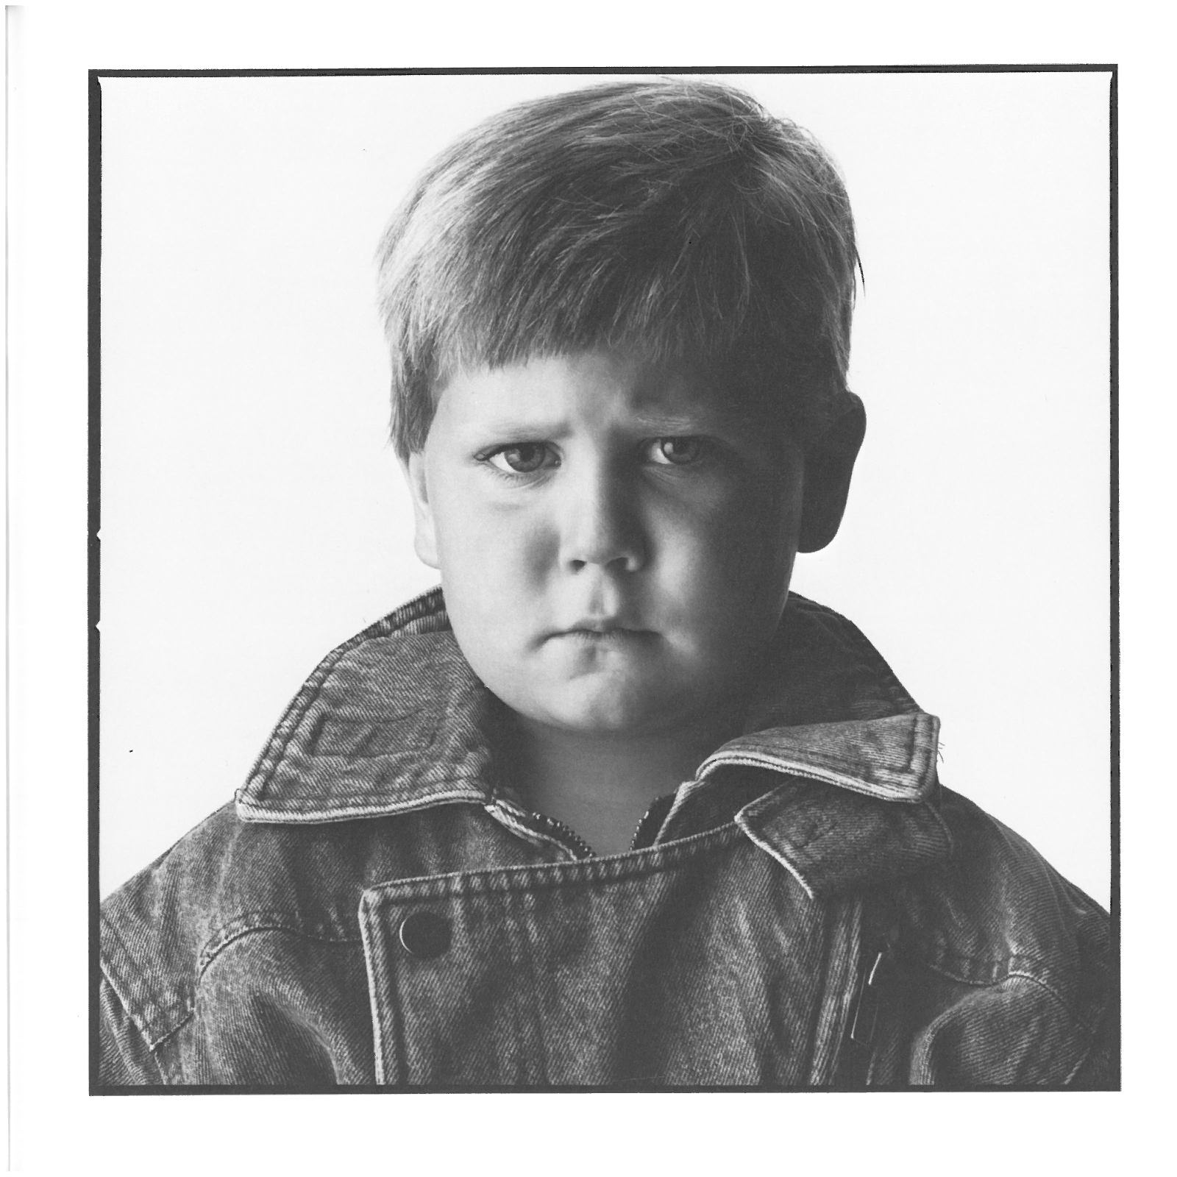

Slide 29
On Wednesday when I went to preschool we drew pictures of big animals in the zoo.
My teacher, Laura, said my elephant looked just like one she saw at the zoo last summer.
I was . . .

Slide 30
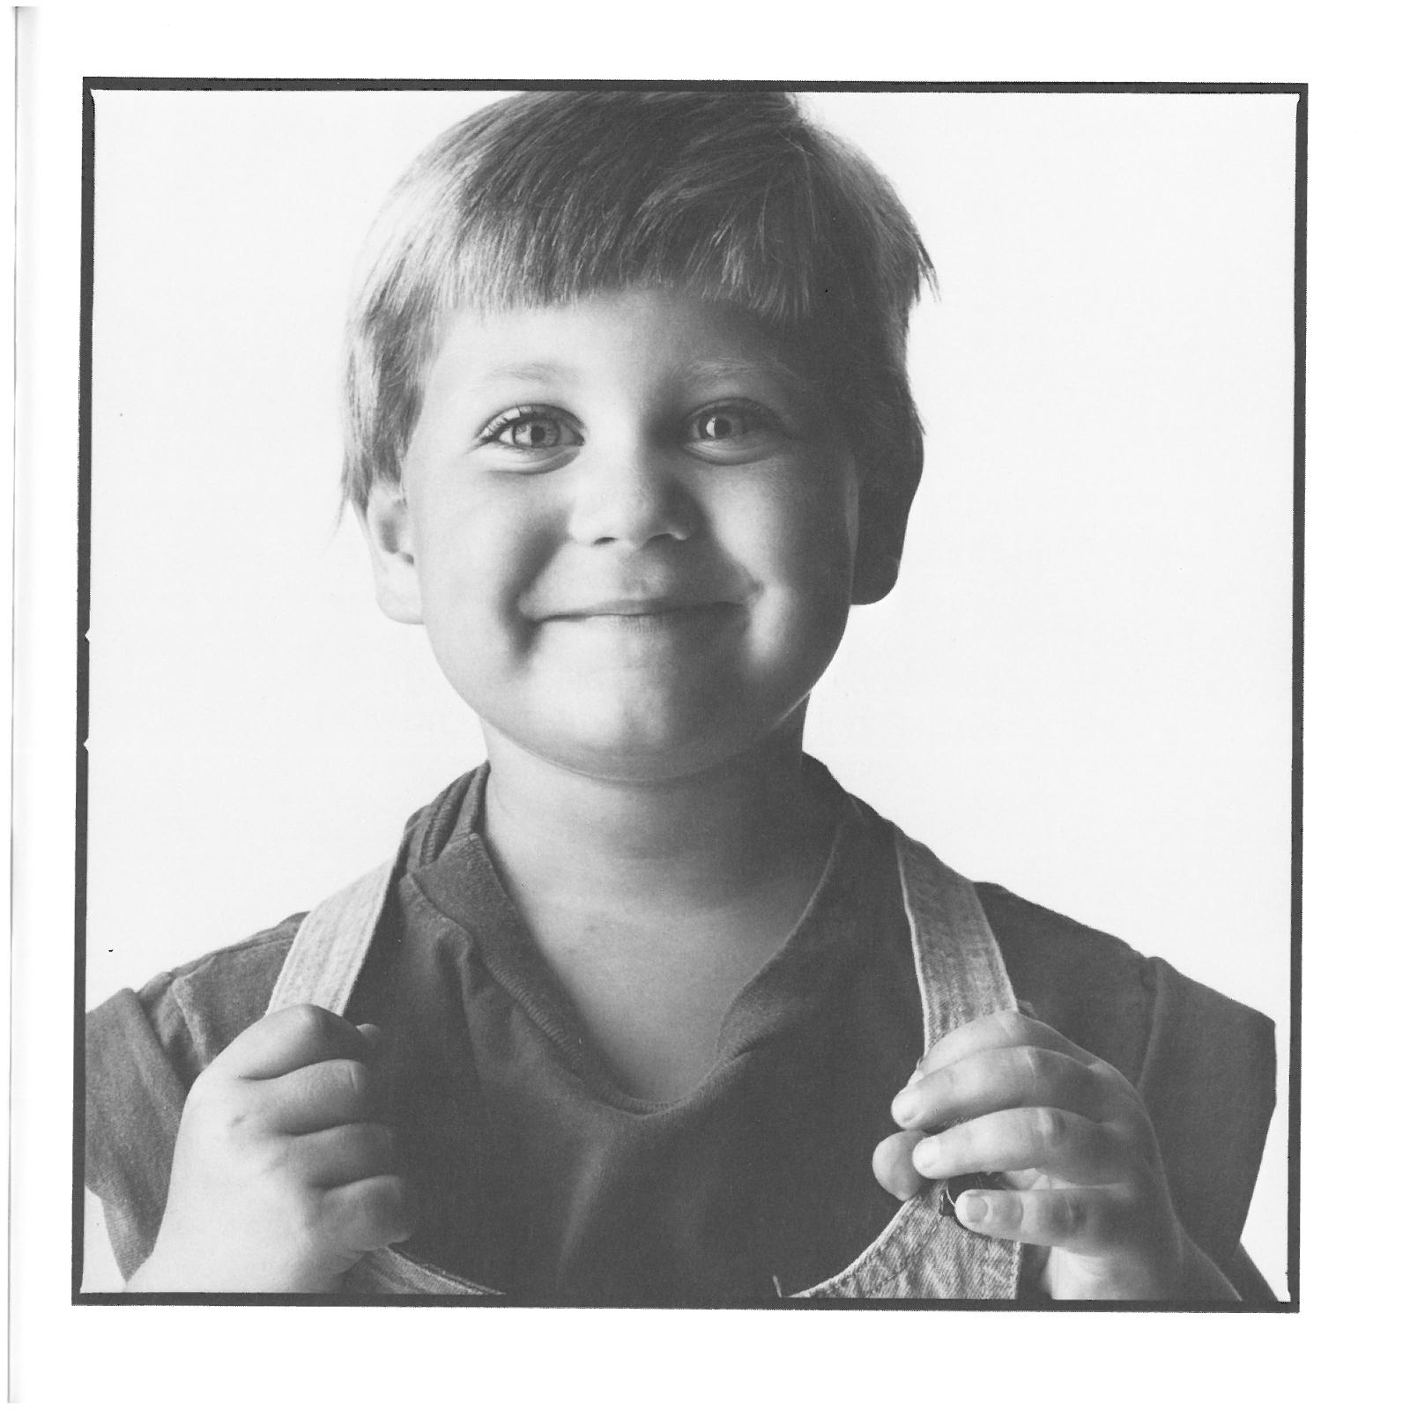

Slide 31
On Friday when I went to my cousin Janie’s she wouldn’t let me play with her new dump truck in the sandbox.
I always share my toys with her when she comes to my house and I have something new to play with.
I was . . .

Slide 32


Slide 33
All Around Resources
MODULES
Social and communication development
Determining the meaning of a challenging behavior
Positive behavior interventions and support
Intervention in everyday settings
Teaming to build a behavior support plan
Supporting families

Slide 34
Instructional Planning Form
What is the behavior? | Why is he/she doing it? (Function) | What could he/she do instead? (Realistic goal) | How will you teach him/her to do it? (Strategy) | Priority
Notes:
Be very specific
There is always a reason. He wouldn’t do if he wasn’t getting something out of it. Can’t sit still is a reason.
Again, be specific. Be good is not a replacement behavior.
This is the hard part. Be a teacher.
You need to prioritize

Slide 35

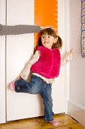
TECHNICAL ASSISTANCE CENTER ON SOCIAL EMOTIONAL INTERVENTION for young children
TACSEI Families Community

Slide 36
Just the Facts, Ma’am
What Works Briefs from CSEFEL

Slide 37
Read All About It

Slide 38
Read All About It

Slide 39

See For Yourself
Development of Social Emotional Skills
Most Popular Resources on Promoting Social Emotional Development

Slide 40
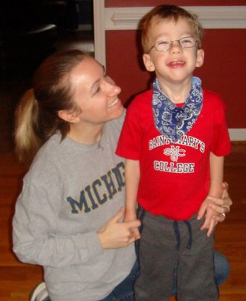
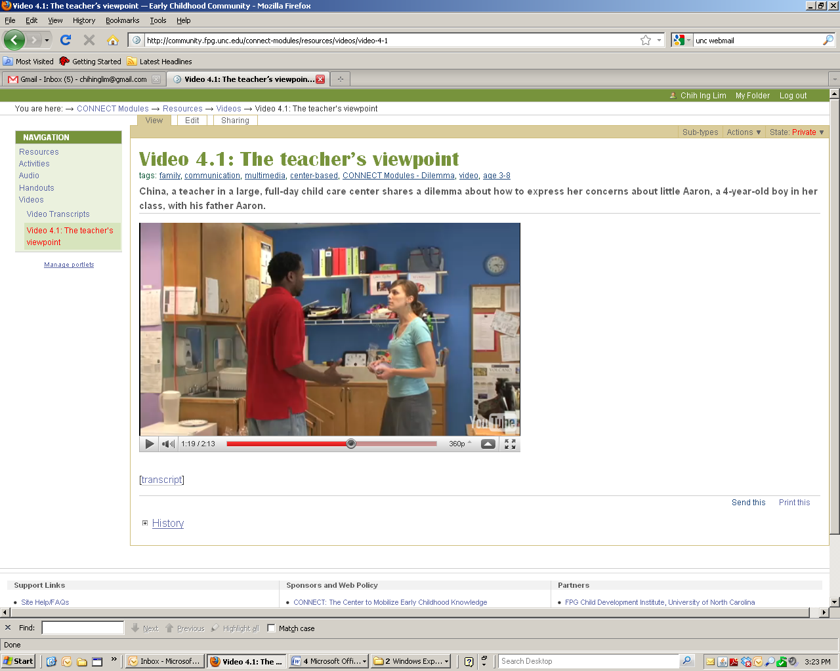
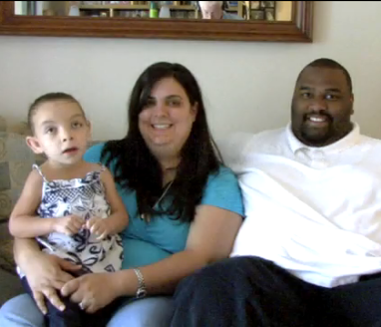
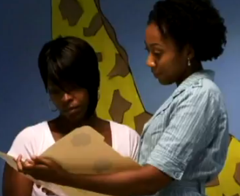
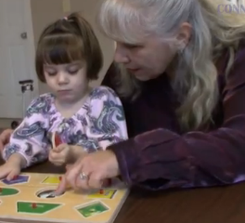
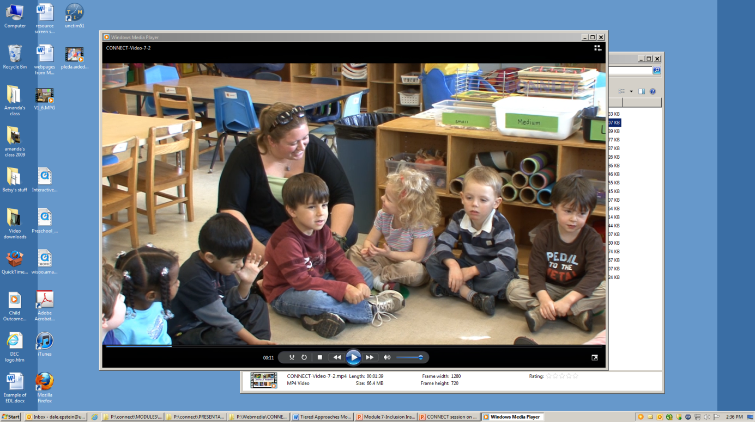
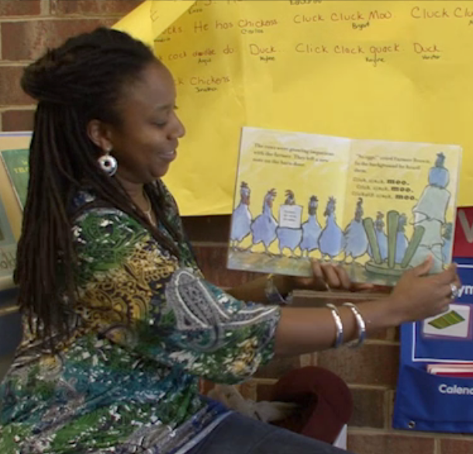
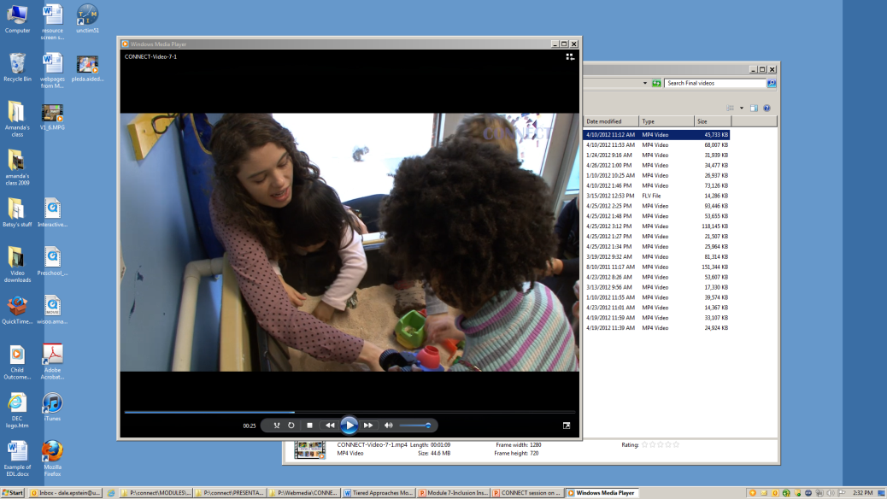
See For Yourself
Module 3: Communication for Collaboration
Module 4: Family-Professional Partnerships
Module 1: Embedded Interventions
Module 2: Transition
Module 7: Tiered Instruction (Social emotional development & Academic learning)
Module 5: Assistive Technology Interventions
Module 6: Dialogic Reading

Slide 41

Most Popular Resources on Promoting Social Emotional Development

Slide 42

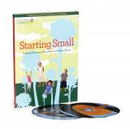
See for Yourself/Find it Online
http://www.tolerance.org

