Slide 1
Supporting Each and Every Young Child and Family’s Full and Equitable Participation: Guiding Principles
A presentation to the State Advisory Council
May 21, 2018

Slide 2
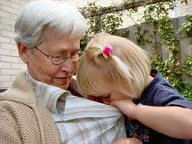
Work Group
Ben Allen Julie Cadwallader-Staub Linda Darrow Kathi Holsopple Kim Keiser Debbie Matthews Lori Erbrederis Meyer Jill Pearl Melissa Riegel-Garrett Jackie Sprague Mark Sustic Joanne Unruh | Sheri Boutin Sandra Cameron Cynthia Greene Danielle Howes Erin Maguire Pam McCarthy Cindy Moran Beth Peloquin Kate Rogers Nancy Sugarman Cindy Tabor Tierney O’Meara | Karen Burnell Jan Crow Breena Holmes Jennifer Hurley Anne Mason Katie McCarthy Reeva Murphy Andrea Racek Kate Ross Maureen Sullivan Beth Truzansky

Slide 3
Inclusion → Full participation
It is now widely acknowledged that culture has a profound influence on early development and learning, and that early care and education practices must reflect these influences . . . it is understood that children with disabilities and their families vary widely with respect to their racial/ethnic, economic, and linguistic backgrounds.
Joint position statement on inclusion, 2009

Slide 4
All → Each and every

Slide 5
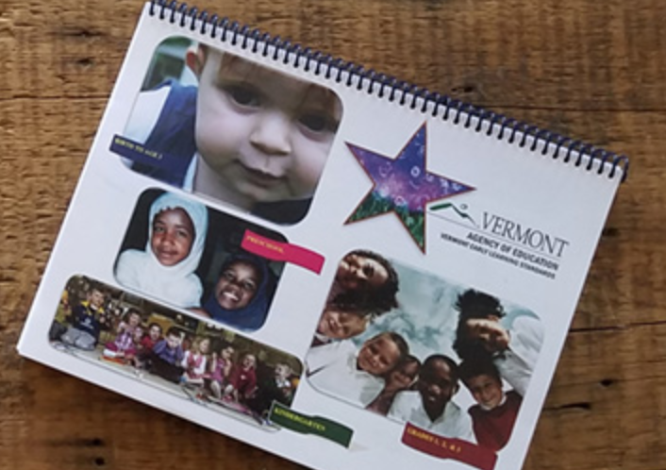
The principles were designed to align with and support Vermont’s quality frameworks

Slide 6
2015 – Federal policy statement on inclusion of children with disabilities in early childhood programs
2016 - Federal policy Statement on Expulsion and Suspension Policies in Early Childhood Settings
2016 – Federal policy statement on supporting the development of children who are dual language learners in early childhood programs
2016 – Federal policy statement on family engagement
2016 – The Individuals with Disabilities Education Act, including new regulations on promoting equity and reducing disproportionality
2016 – New Head Start Performance Standards
The principles were also designed to be aligned with and responsive to federal mandates, legislation, and frameworks
Notes:
The Guiding Principles also align with and support federal laws, policies and guidelines, including those you see listed on the screen.

Slide 7
Child Care Providers
Teachers
Administrators
Families
Foundations, Funders,
Organizations,
Colleges & Universities
Critical Conversation among Vermont early childhood partners
May 2016
Notes:
For the past year, a very diverse group representing these and other perspectives has been meeting to discuss the need for, and develop drafts of, a set of guiding principles. Now it’s time for your input.
A website has been created to gather input from as many as possible. The goal is to guarantee that the content of Vermont’s Guiding Principles reflects the thoughts and words of families, teachers, therapists, clinicians, leaders, faculty, and other representatives of early childhood programs, agencies and organizations. On the site, a draft of the Guiding Principles will be available in March and April 2017 for input from all of us.
So if you do just one thing, please provide your feedback.

Slide 8
“[I hope] that he will discover new interests, make good friends and have positive social experiences that challenge him and help him grow, and that his intellect will be fostered in many ways and appropriate for his developmental stage.”
Family member

Slide 9
Do you endorse the principles?
Do you endorse Vermont Guiding Principles for the Full Participation of Each and Every Young Child and Their Family?
YES
91.74%
8.26%
NO

Slide 11
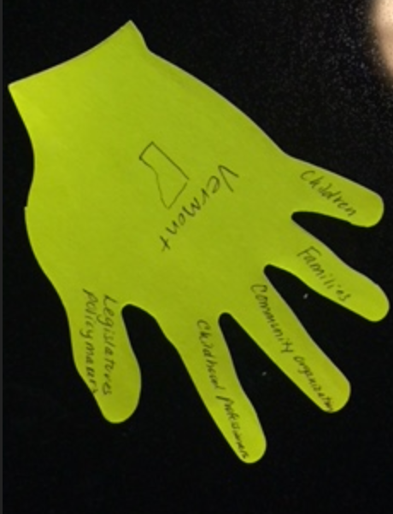

Slide 12
In other’s words
What is the importance of the principles?
How do you see building them into the work you do?

Slide 13
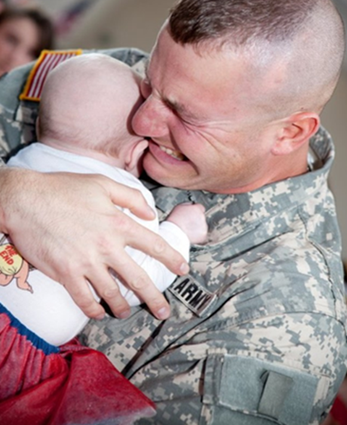
“More explicit Guiding Principles will describe how we are accountable to each child, family and community.”

Slide 15
Products to support the use of the principles

Slide 17
Imagine that you serve on the Board of a Vermont foundation at a point in the near future
The foundation’s philanthropic mission is to build quality in early childhood programs and practices
The Board has endorsed the principles and wants future decisions to be guided by them.

Slide 18
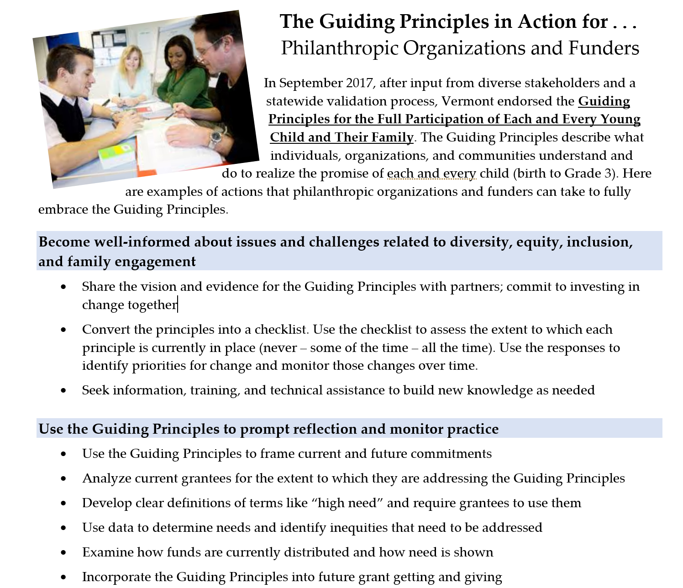
If the Board fully embraces the principles. . .
What should they do?
What expectations should they have for potential grantees?
What should you notice?

Slide 21
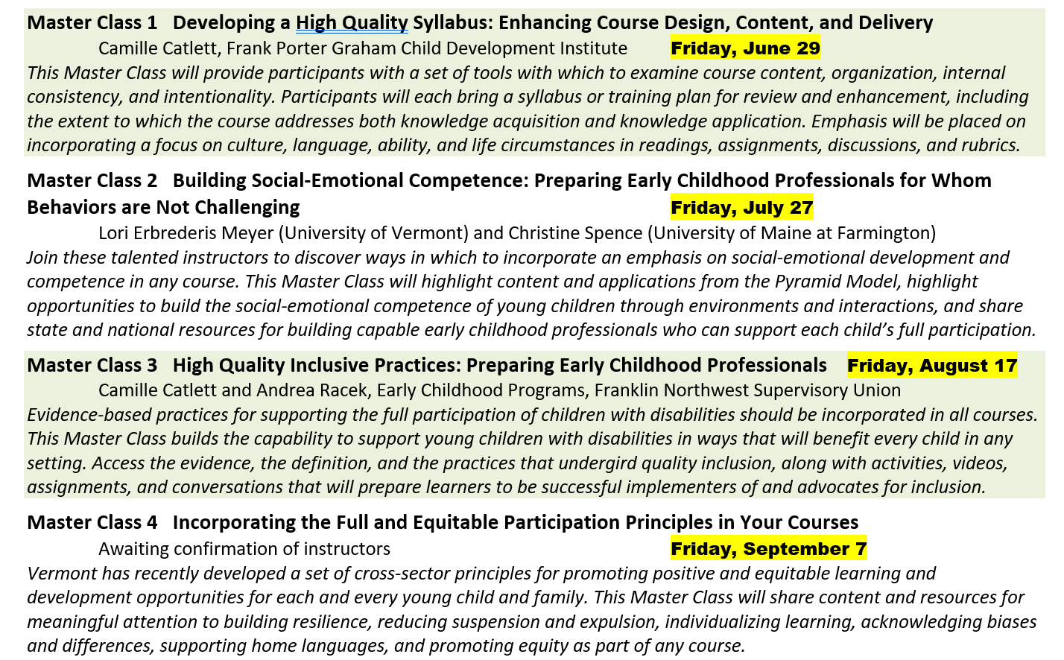
Master Classes

Slide 23
Activity
Reflection questions on the principles

Slide 24
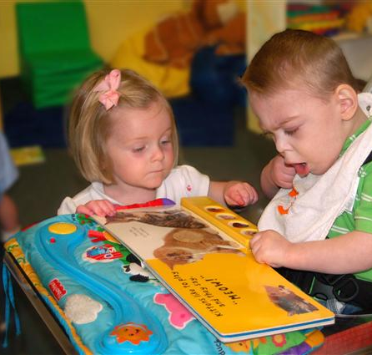
Future directions
Landing pad
Endorsement process
Recognition process for programs and entities

Slide 25
How might the principles be built into the work you do together?
Notes:
Do you still have questions? Your handout has information about who to call if you have questions about the Guiding Principles. The information is also included on the next slide.

Slide 26
Have the principles on the table at every meeting and refer to them as decisions are discussed and made

Slide 27
Use the principles to develop the roadmap for the Early Childhood Action Plan (ECAP)

Slide 28
Charge the Building Vermont’s Future Think Tank to use the principles to inform their work

Slide 29
Incorporate the principles into RFPs, asking applicants to speak to how they will address the principles in their scope of work

Slide 30
Endorse the principles as explicit concepts that will guide your work

Slide 31
How do you see incorporating the principles in the work of the SAC?
How will you use the principles in own professional efforts?

Slide 33
Questions?
Camille Catlett
camille.catlett@unc.edu
Kate Rogers
Kate.Rogers@vermont.gov

Slide 34
Notes:
Thank you for your commitment to quality for each and every young child and their family. We look forward to getting your input on the draft of the guiding principles and to sharing what we learn.

