Slide 1
An Overview of My Teaching Strategies GOLD

Slide 3
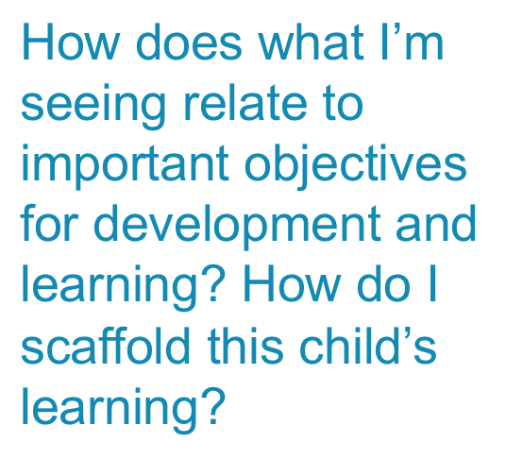
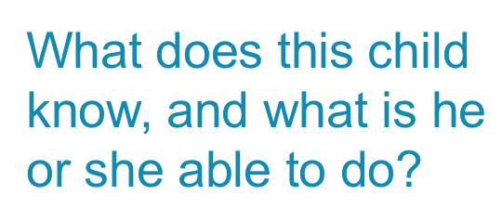
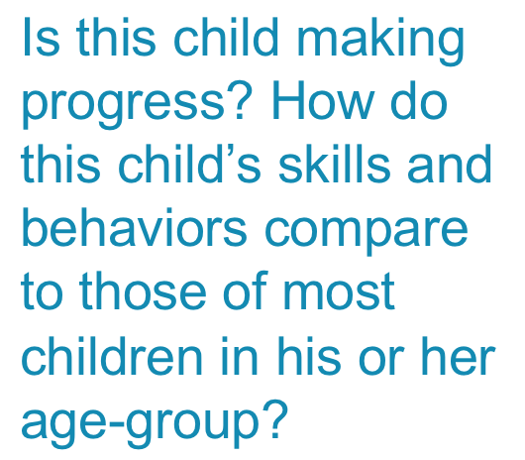
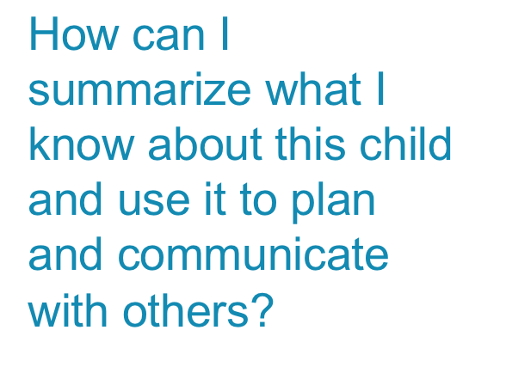
Notes:
Same as intro training

Slide 4
Notes:
Handout the One sheet Objective and Dimensions
Do the “Objectives and You” activity

Slide 5
Notes:
What do those color bands mean?
Note that at PreK 3, it changes from birthday to year in school. PreK 3 is two years before K based on the K cutoff date in the child’s home school district.

Slide 8
Structure of GOLD
Cognitive
Area
Objective
11. Demonstrates positive approaches to learning
Dimension
b. Persists
Plans and pursues a variety of appropriately
challenging tasks
Indicator
Example
Keeps looking through all of the magnetic letters
for those that are in her name

Slide 10
Notes:
This is how these look when you are online in MyTSG.

Slide 15
Notes:
Here is where we discuss how some indicators have many facets and that a child must be meeting all of the components of an indicator in a piece of documentation in order to give it an even-numbered level.
When writing notes, make sure you include information about consistency. You should note whether this is the first time you have seen the child do the skill, or if you have seen it several times over a couple of weeks, etc. That will help you know whether it is consistent.
Talk about the difference in how many pieces of documentation you may need for level 2 versus level 6 in Objective 20a.

Slide 16
Notes:
This is the home page now when you sign in online.
Point out the 5 areas at the Top – Teach, Assess, Develop, Report, Family…
The four buttons at the top of the home page were the four most-used tabs in TSG. In MYTSG they have been placed on the home page for quick access.
If you use the planning guide, your daily plans will show up on the right side of your home page
Any communication from MyTSG will be in the “Items that need your attention” area.

Slide 17
Notes:
Talk about the “Develop” area online. Let them know you’ll explore it further when we get online
How to find the online version of the ODL to download. It is in the ODL 10 hour free training.
Also, there are many courses you can take for free.

Slide 18
Notes:
Do activity where participants go through their version on the objectives and dimensions and put a mark next to all of the ones that are language independent – meaning you do not have to speak the language of the child and the child does not have to use words to show his/her knowledge, skills, and behavior.
I have them work in pairs and add them all up.
There are a total of 59 objectives and dimensions—between 30-34 of those end up being language independent

Slide 19
Notes:
On The Spot forms
Assessment Opportunity Cards. You find these in the Gold Question Mark area of the Assess Area.
Both are in the Assessment Area
Intentional Teaching Experiences are in the Teach Area

Slide 20
Questions

