Slide 1
Full Participation Building equitable state systems for children who are culturally, linguistically, and individually diverse and their families
Camille Catlett North Carolina | Robyn Lopez Melton Oregon | Tierney O’Meara Vermont | Kate Rogers Vermont
National QRIS Conference
Dallas TX June 27, 2017

Slide 2
VT
OR
T³

Slide 3
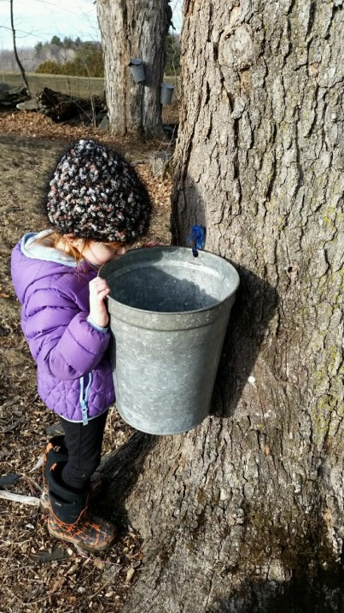
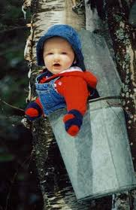
Making the Grade… even the maple syrup is diverse in Vermont!
The sap’s running!!
Just hanging out in VT!

Slide 4
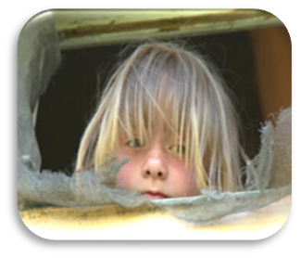
Vermont Guiding Principles for the Full Participation of Each and Every Young Child and their Family
Notes:
In March and April of this year, Vermont is asking individuals who work with, advocate for, and care about young children and their families to review and provide input to a new guiding principles document. The document is called the Vermont Guiding Principles for the Full Participation of Each and Every Young Child and their Family, or the Guiding Principles for short.
The purpose of this mini-webinar is to familiarize you with the Guiding Principles. Then, we will provide instructions on how to give feedback on the document. We will share a bit about the history and answer some questions. At the end, we hope you will feel well prepared to review a draft of the Guiding Principles and provide your input.

Slide 5
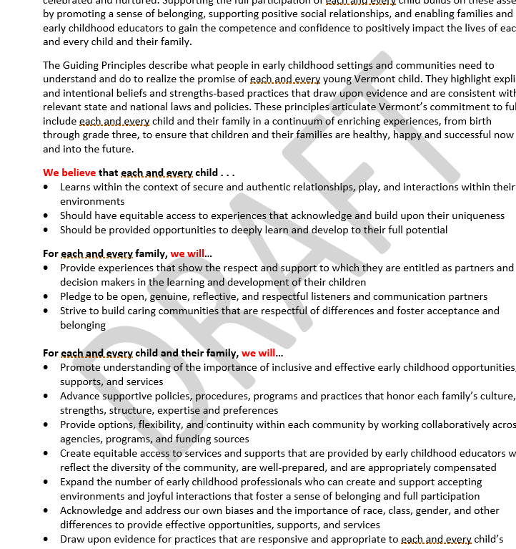
What are the Guiding Principles?
Notes:
The Guiding Principles are a set of explicit and intentional values and practices that can be used to support the successful, inclusive learning and development of children, birth through grade 3. This includes children with diverse cultures, languages, abilities, races, ethnicities, faiths, geographic settings, resources, and circumstances, and their families. As one member of the Guiding Principles Work Group said, “Guiding Principles describe how we are accountable to each child, family and community.”

Slide 6
Timeline for the Vermont Guiding Principles

Slide 8
What is early MTSS?
Practice
Systems Building
Multi-Tiered System of Supports
Notes:
VT Early MTSS is a balanced approach. Lessons learned from previous pd efforts resulted in a huge gap in systemic support to support the practice. Early MTSS is now a two prong approach with focus on systems building and evidence based practices.

Slide 9
Early Multi-Tiered System of Supports
To increase knowledge and use of EBPs to support social and emotional competence/confidence
To provide systems design to ensure program wide implementation and sustainability of EBPs
To increase school district capacity to offer a full continuum of educational placement options
To build a sustainable statewide system of high quality inclusive early childhood learning environments for each and every child

Slide 10
5 Key Components of Early MTSS
Strong System Support
Functioning Leadership Team
Staff Commitment
Supportive Systems
Partnership & Collaboration
Family Partnership
Early Childhood Community Based Partners
Transition (including K-3 transition)
Well-Designed Professional Development
Identification of Staff need
Provision of Professional Development Supports
Assessment of Learning and Implementation
Provision of High Quality & Responsive Learning Environments
Social and Emotional Confidence and Competence
Early Learning (Literacy) Confidence and Competence
Early Learning (Numeracy) Confidence and Competence
Comprehensive & Functional Assessment system
Effective Problem Solving Process
Data-Based Decision Making
Promotes Ongoing Improvement

Slide 11
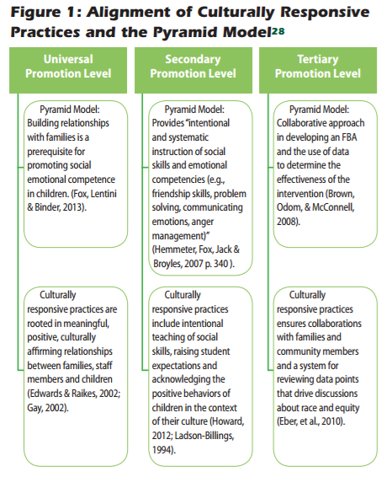
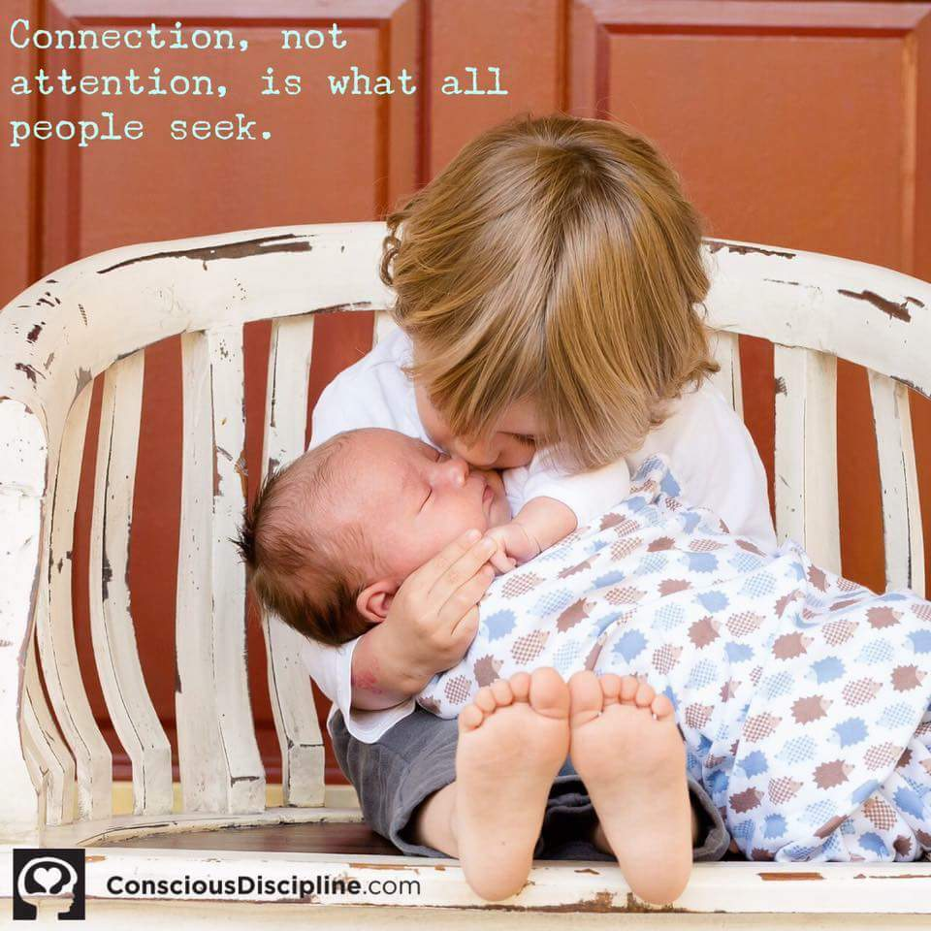
Connections to suspension-expulsion and equity??

Slide 12
Culturally Responsive Practices Incorporate Early MTSS systems building and content training into STARS/QRIS under leadership and program practice arenas

Slide 13
Instructor Survey
We were interested in . . .
What instructors knew
What they wanted to know more about
How much they were emphasizing each topic in their courses
Instructor priority for receiving free resources
We asked about . . .
Domains of development
Components of high quality teaching and learning for each and every child and their family
Components of supporting the full participation of each child
Vermont tools and quality frameworks

Slide 14
Areas of Highest Current Knowledge: Faculty and Instructors
Social-emotional development
Development of play and exploration
Development of literacy skills

Slide 15
Areas of Lowest Current Knowledge: Faculty and Instructors
Development of language and literacy for children who are dual language learners
DEC Recommended Practices for supporting children with disabilities
Newer Vermont assessment tools (CLASS, R4K!S, TPOT, TPITOS, ICP, SSIS)

Slide 16
Desire for Greater Knowledge
How a child’s racial/ethnic identity development impacts their learning and development
How a child’s cultural identity development impacts their learning and development
Supporting children who are dual language learners
Supporting children with disabilities

Slide 17
Current Level of Emphasis in Courses
Audience | High | Low
Faculty and Instructors | Social and emotional development | Supporting children who are dual language learners How to develop, implement, and evaluate experiences and practices to support the needs of young children who are culturally, racially, and ethnically diverse The DEC Recommended Practices for supporting children with disabilities Development of math and science concepts

Slide 18
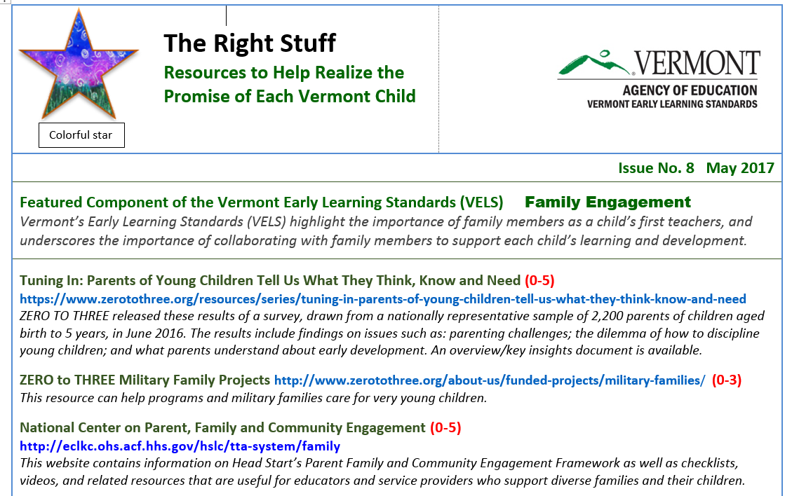
Responding to the Instructor Survey
Vermont Resource Collections
The Right Stuff

Slide 19
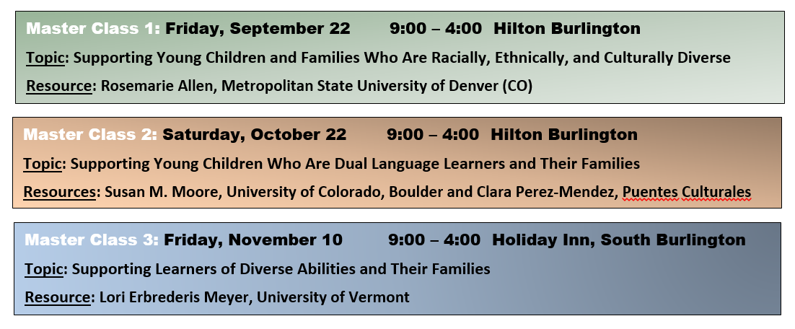
Responding to the Instructor Survey
Syllabus Review and Technical Assistance

Slide 20
Robyn Lopez Melton
meltonr@wou.edu
Notes:
Materials/Resources:
None
Presenters’ Notes:
Brief introduction for the participants, two minutes each.
Nate: 7 years experience at Head Start, 2 years at TRI, I feel passionate about getting people the materials they need to be successful in their material language

Slide 21
Oregon Spark Basics
2nd Round RTT State
Regional Field test 2013—Statewide Field Test 2014
5 Tiers—Building Block—Portfolio Based
Currently available in 3 Languages (Russian, Spanish, English)

Slide 22
Opportunity
Revision process gives us a chance to do right by Oregon’s children and families
Photo credit: Amy Rizo

Slide 23
New direction means a new vision…

Slide 24
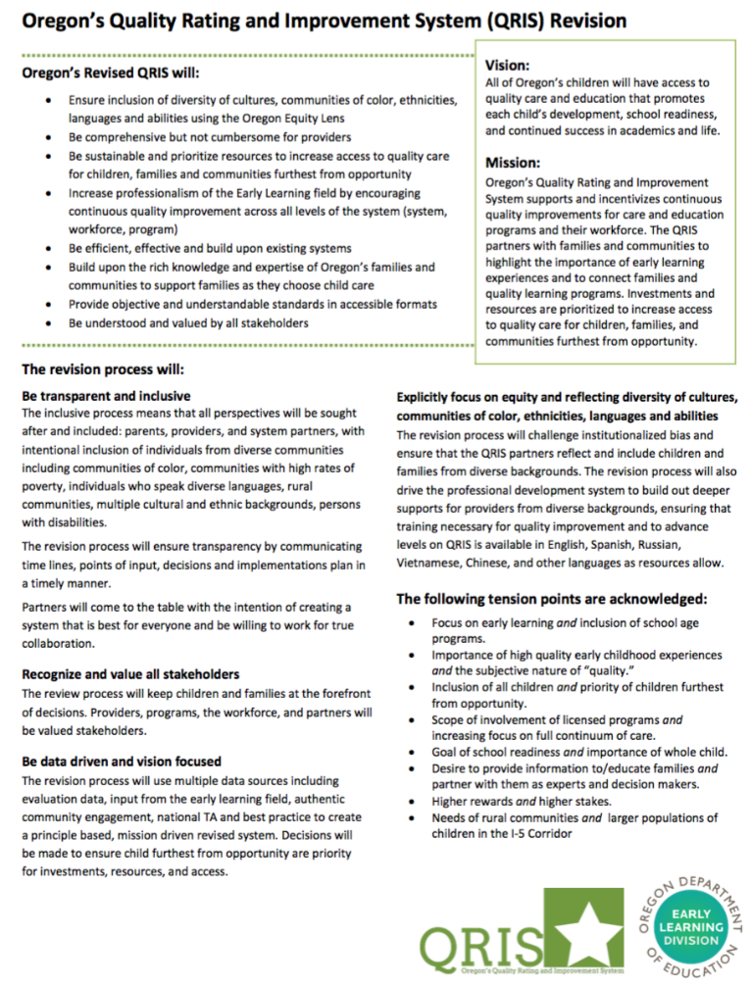
Our North Star

Slide 25
Vision: All of Oregon’s Children will have access to quality care and education that promotes each child’s development, school readiness and continued success in academics and in life.

Slide 26
Ensure inclusion of diversity of cultures, communities of color, ethnicities, languages and abilities using the Oregon Equity Lens
Explicitly focus on equity and reflecting diversity of cultures, communities of color, ethnicities, languages and abilities
The revision process will challenge institutionalized bias and ensure that QRIS partners reflect and include children and families from diverse backgrounds….

Slide 27
Tension points:
Inclusion of all children and priority of children furthest from opportunity
Scope of involvement of licensed programs and increasing focus on full continuum of care
Desire to provide information to families and partner with them as experts and decision makers
Needs of rural communities and larger populations of children in I-5 corridor

Slide 28
Values
Words
Action
Results

Slide 29
Words into action—Community Engagement
Multiple perspectives vital to revision process
Intentional outreach
Intentional facilitation
Multiple feedback loops

Slide 30
Words into action— Proposed Revisions
Award professional qualification score for speaking languages other than English
Prioritize TA and support dollars to programs serving children furthest from opportunity
Restructure the QRIS tiers
Allow full participation in CQI to all programs regardless of licensing status

Slide 31
Ongoing commitments
Multilingual newsletter and ongoing communications
Culturally responsive translation processes
Community engagement
Early Learning Division Ad Hoc Committee
Demographic data collection and analysis

Slide 32
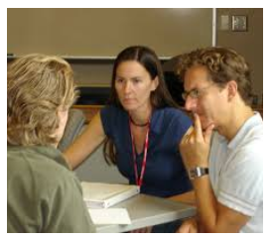
Table Top Time
1 – Guiding Principles with Tierney
2 – Early MTSS with Kate
3 – Higher Education Projects with Camille
4 – Oregon Projects with Robyn

Slide 33
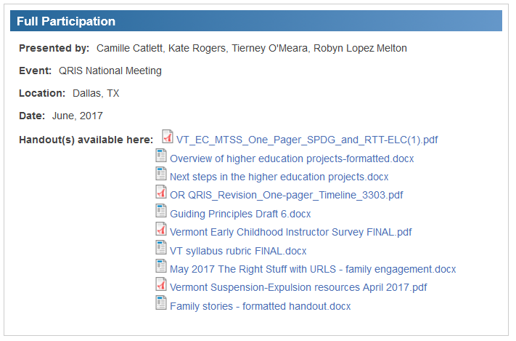

Slide 35
