Slide 1
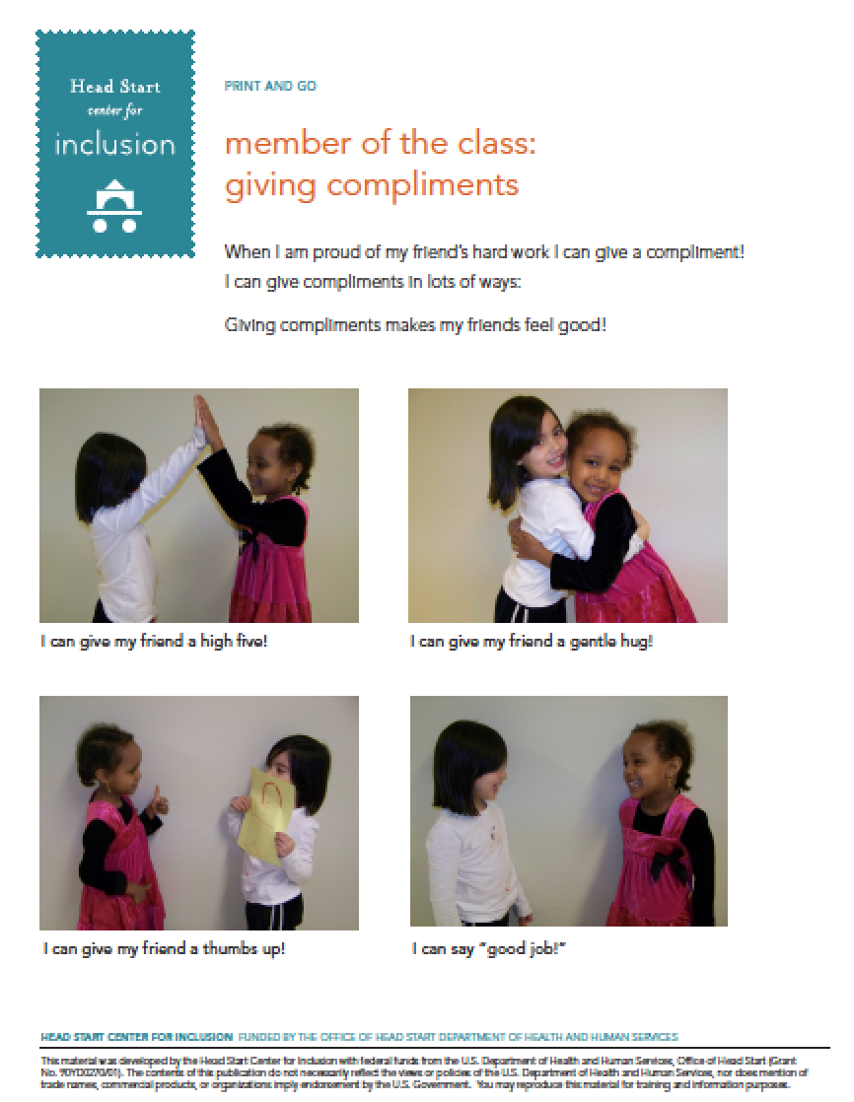
Facilitating Membership in the Classroom

Slide 2
Friendship Kit
Creating a classroom Friendship Kit is a great way to promote the idea of children helping each other. The Friendship Kit is an accessible container that holds all of the necessary items for providing support to a sad or lonely classmate. When children notice a classmate is feeling sad, they can be encouraged to go to the Friendship Kit for ideas to comfort their friend.

Slide 4
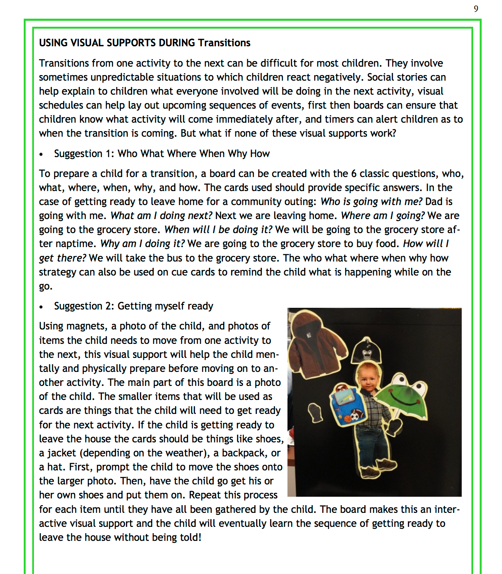

Slide 5
Need a Webinar on Preventing Challenging Behaviors During Transitions?
Notes:
Moving right along: Planning transitions to prevent challenging behavior
https://eclkc.ohs.acf.hhs.gov/video/planning-transitions-prevent-challenging-behavior

Slide 6
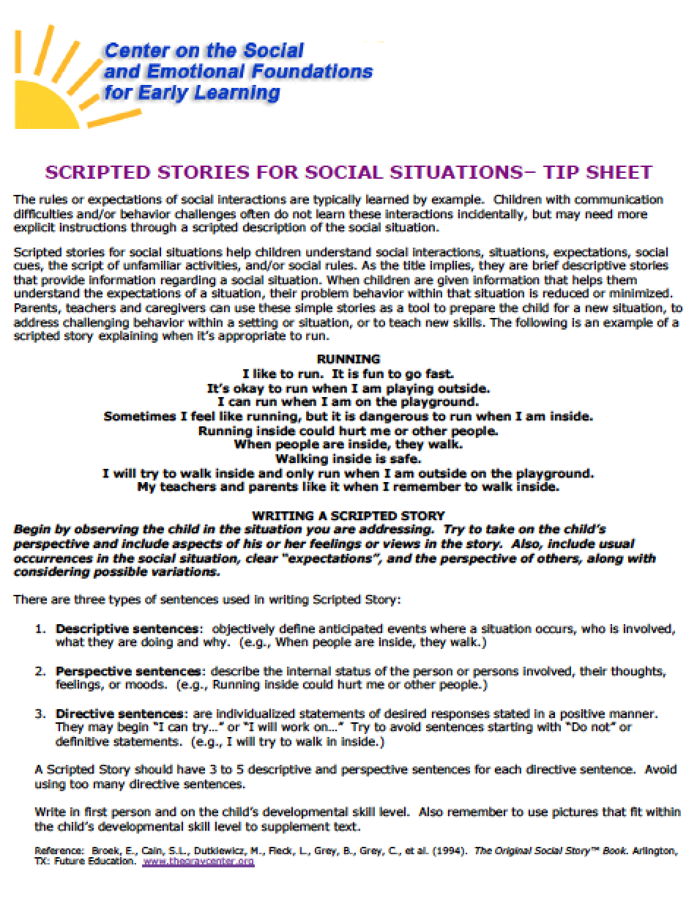
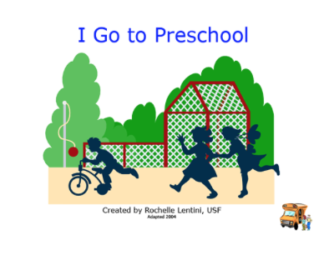
Resource Type: Scripted Social Story
Notes:
LEM
http://challengingbehavior.cbcs.usf.edu/resources/index.html

Slide 7
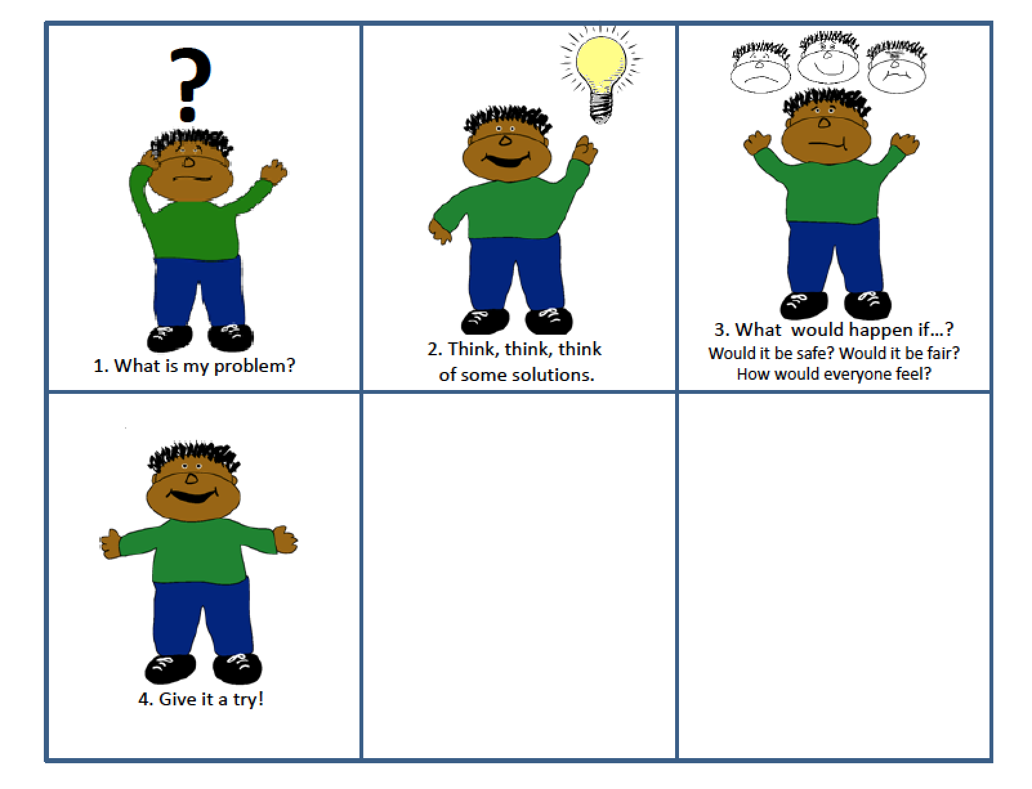
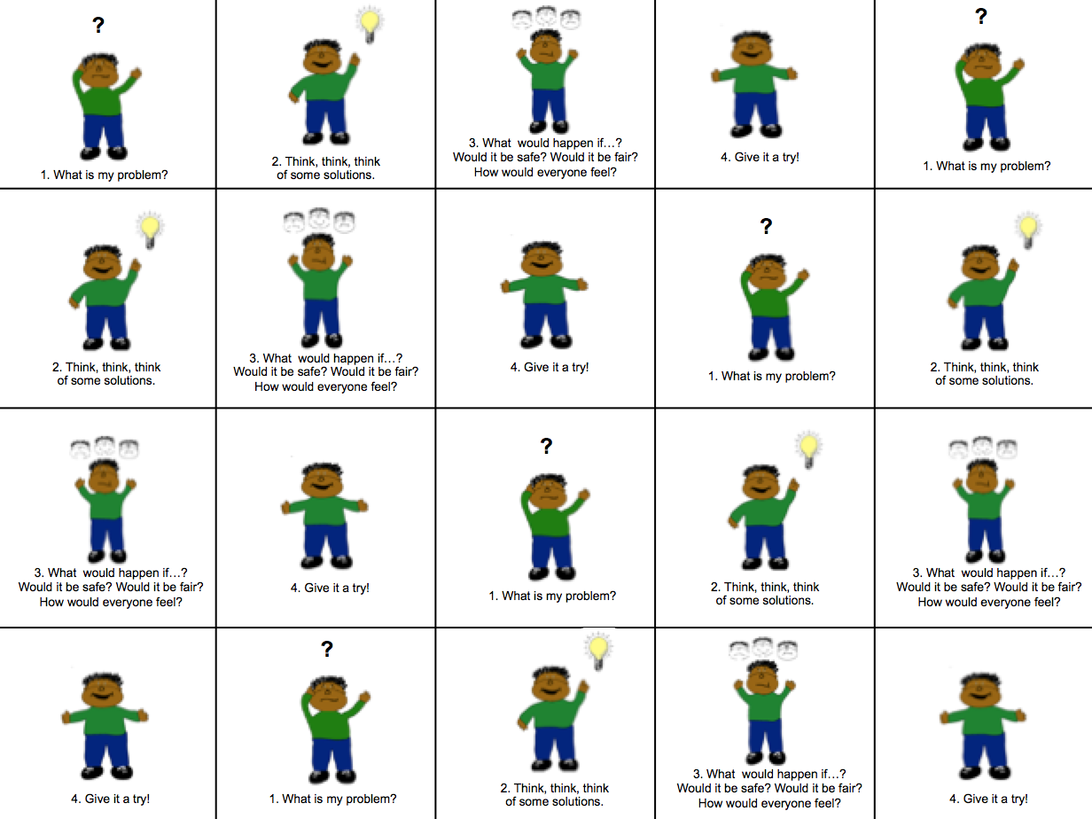
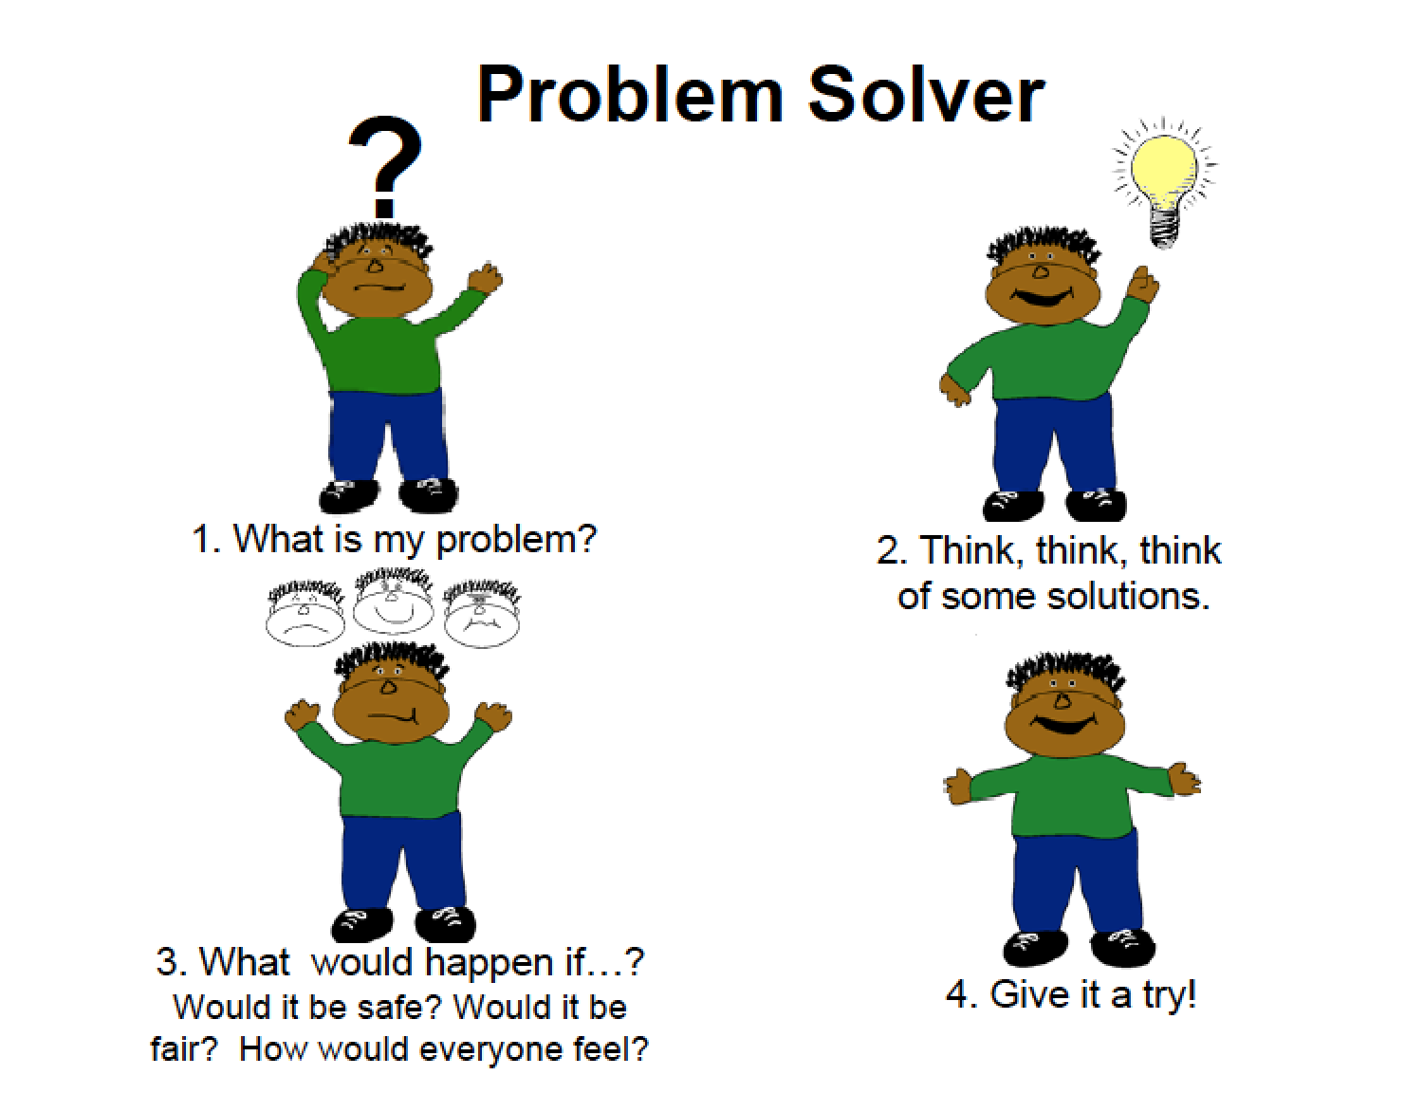
Problem-Solving Steps
Notes:
LEM

Slide 8
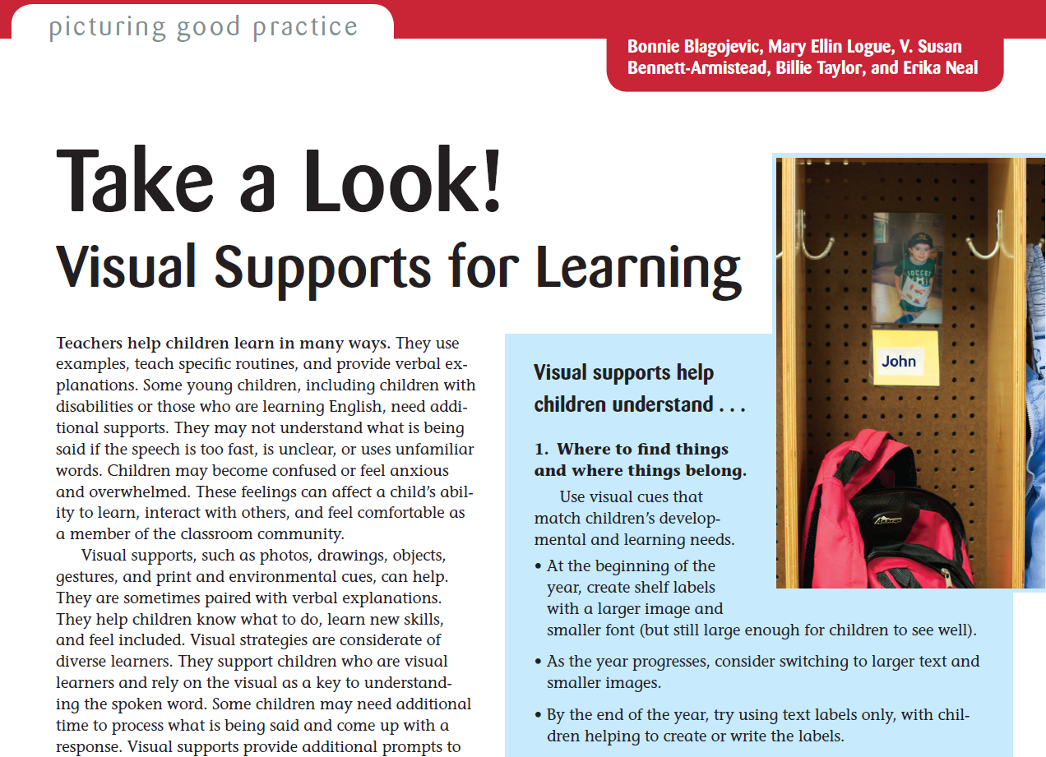

Slide 10
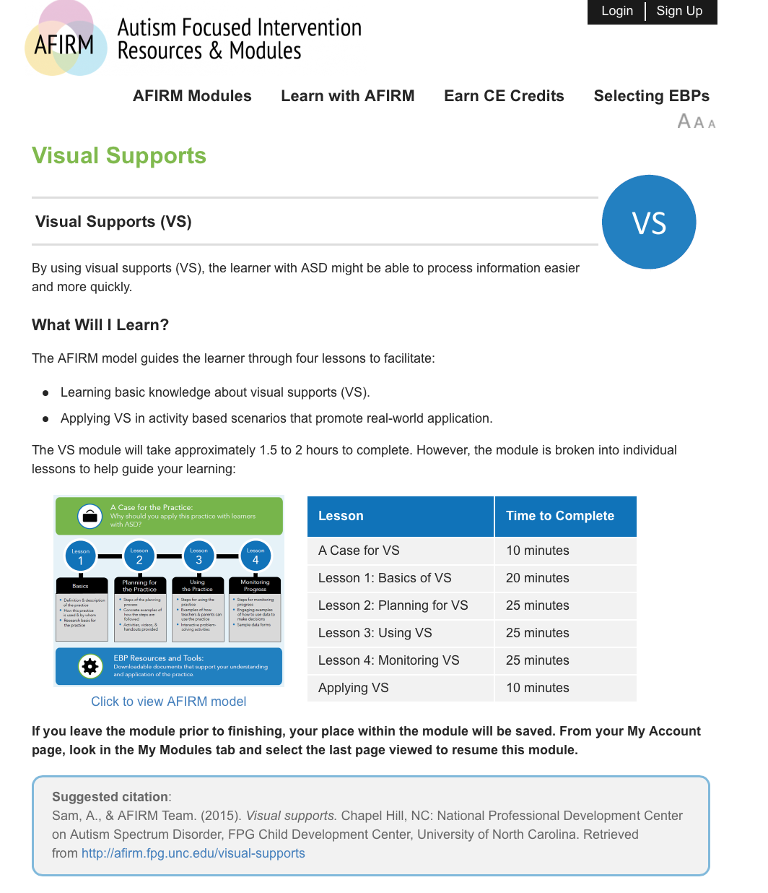
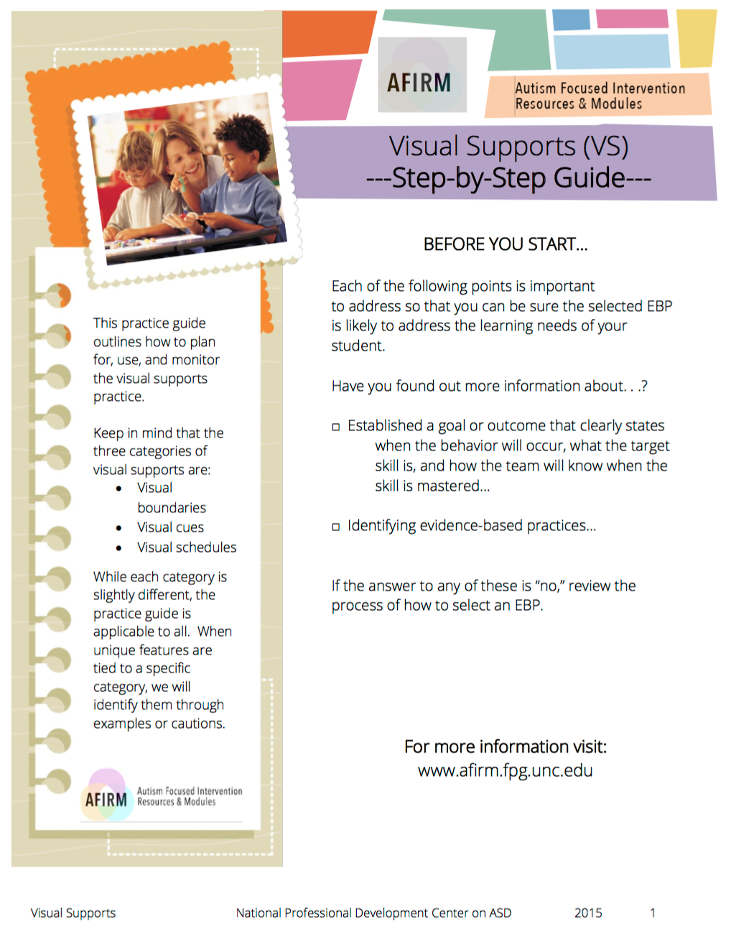

Slide 11
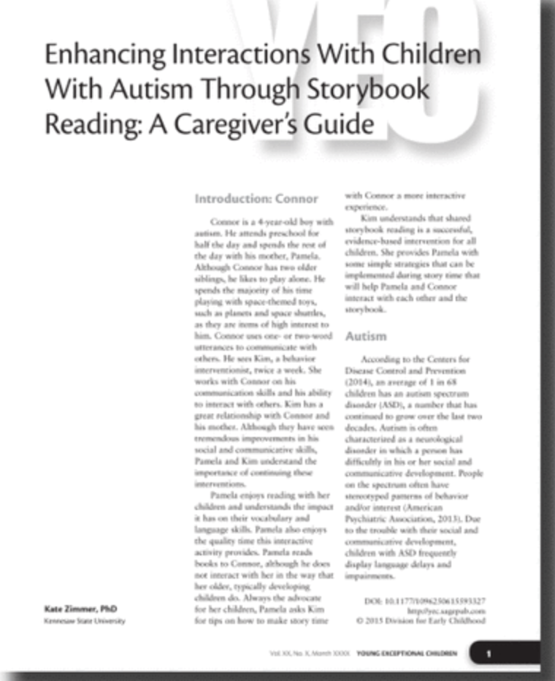
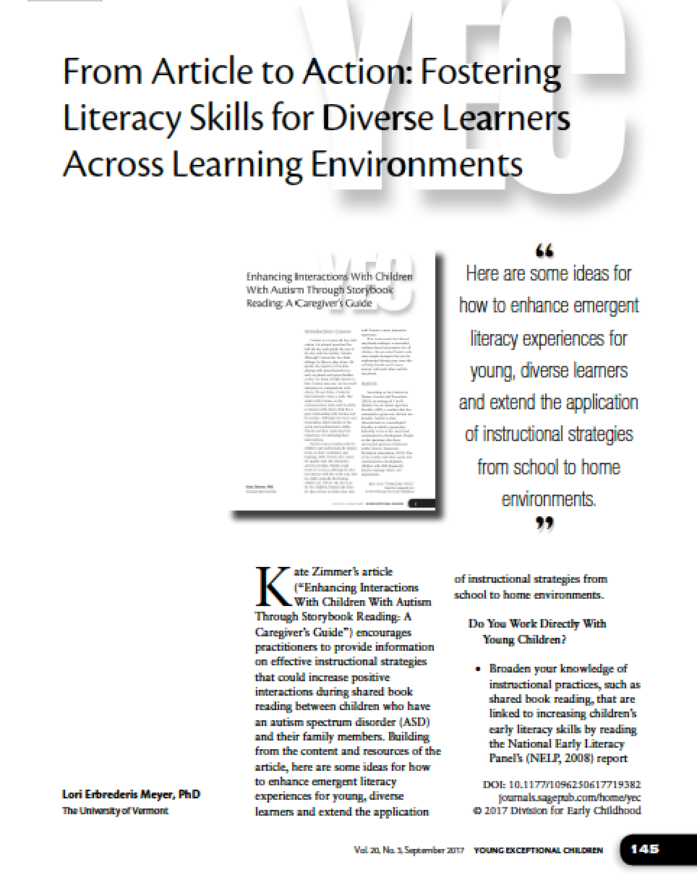
Notes:
LEM
A literacy and visuals connection

Slide 12
What does it mean to be literate?
Notes:
Note-taker
Talk at your table
Popcorn

Slide 13
VELS Institutes 2017
1. Communication & Expression
2. Learning About our World
3. Developing Self
Developing Self – Day 1
Developed by:
Lori Erbrederis Meyer
Carol McQuillen

Slide 14
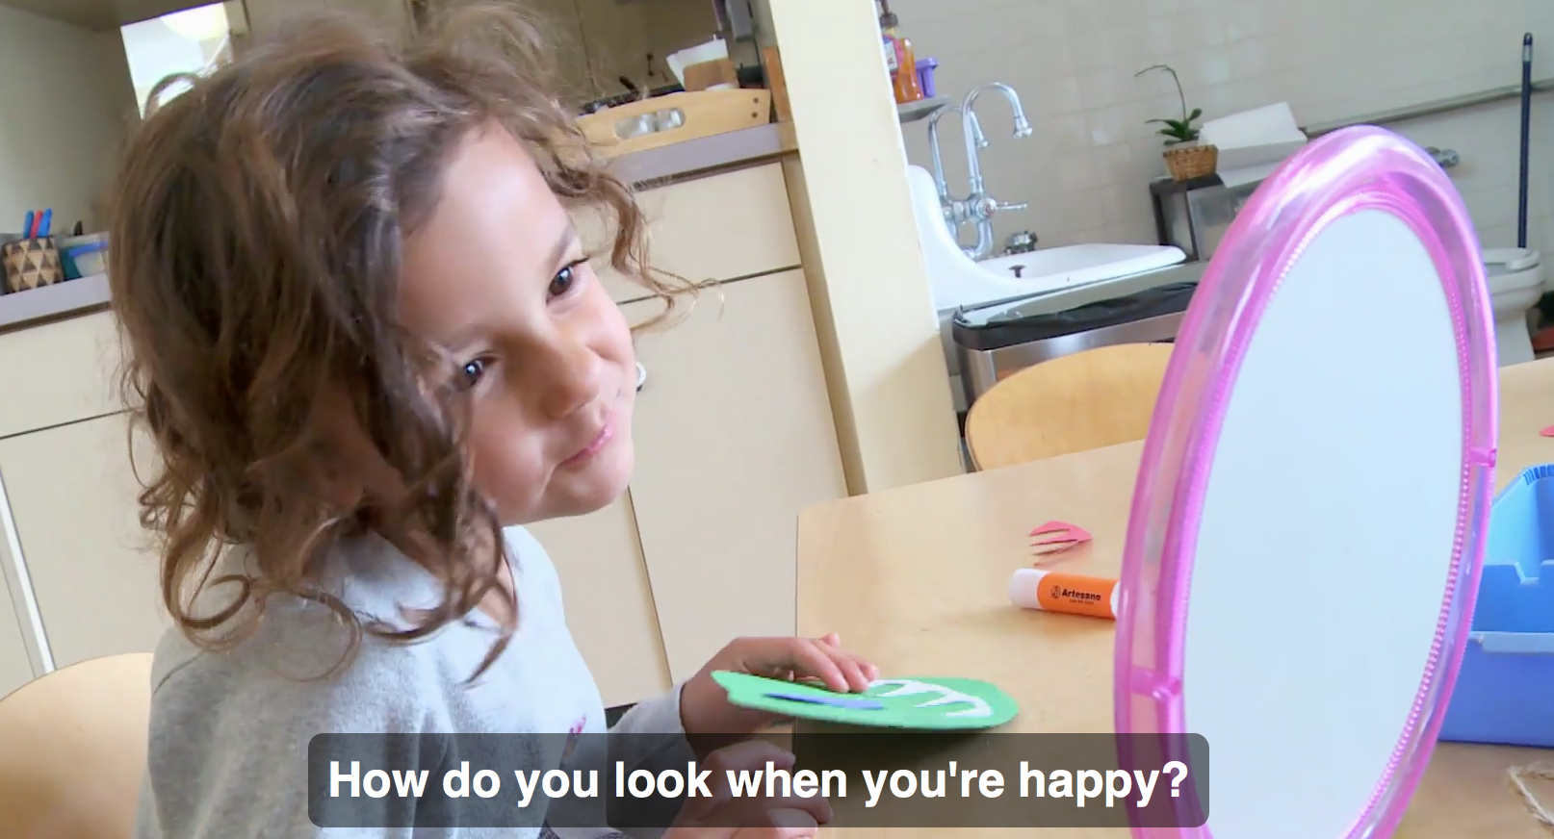
Building Emotional Literacy
Notes:
LEM
Building Emotional Literacy
https://www.teachingchannel.org/videos/pre-k-lesson-emotional-literacy
How does identifying feelings provide a foundation for developing empathy?
Why does Ms. Hawkins provide students with two options for the activity?
How does using mirrors enrich this lesson?

Slide 18
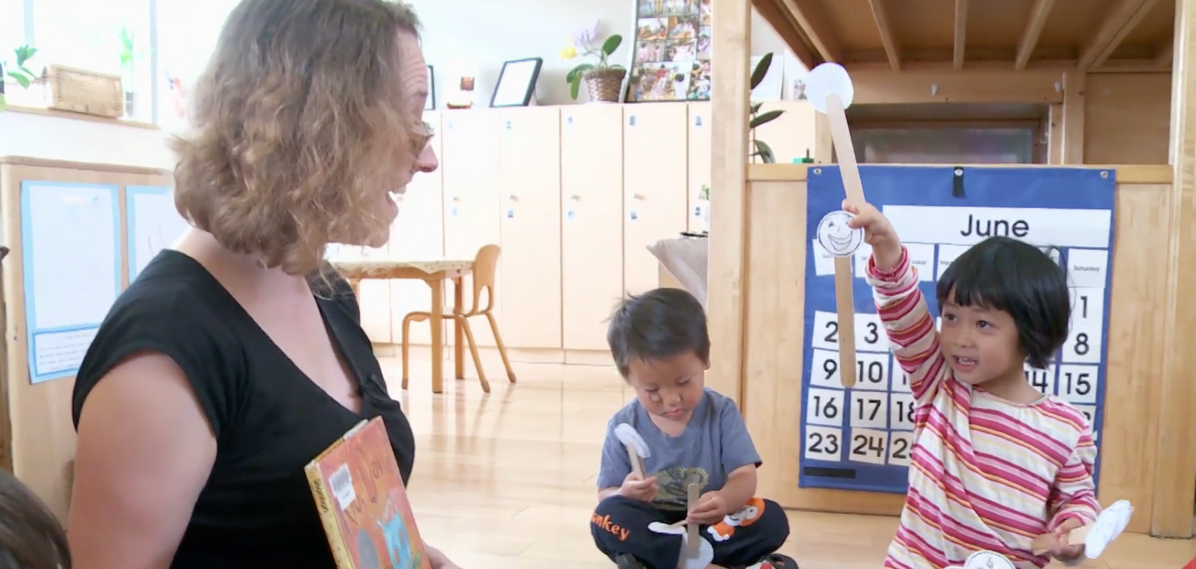
Identifying Feelings
Notes:
LEM
Identifying Feelings
https://www.teachingchannel.org/videos/pre-k-lesson-identifying-feelings

Slide 21
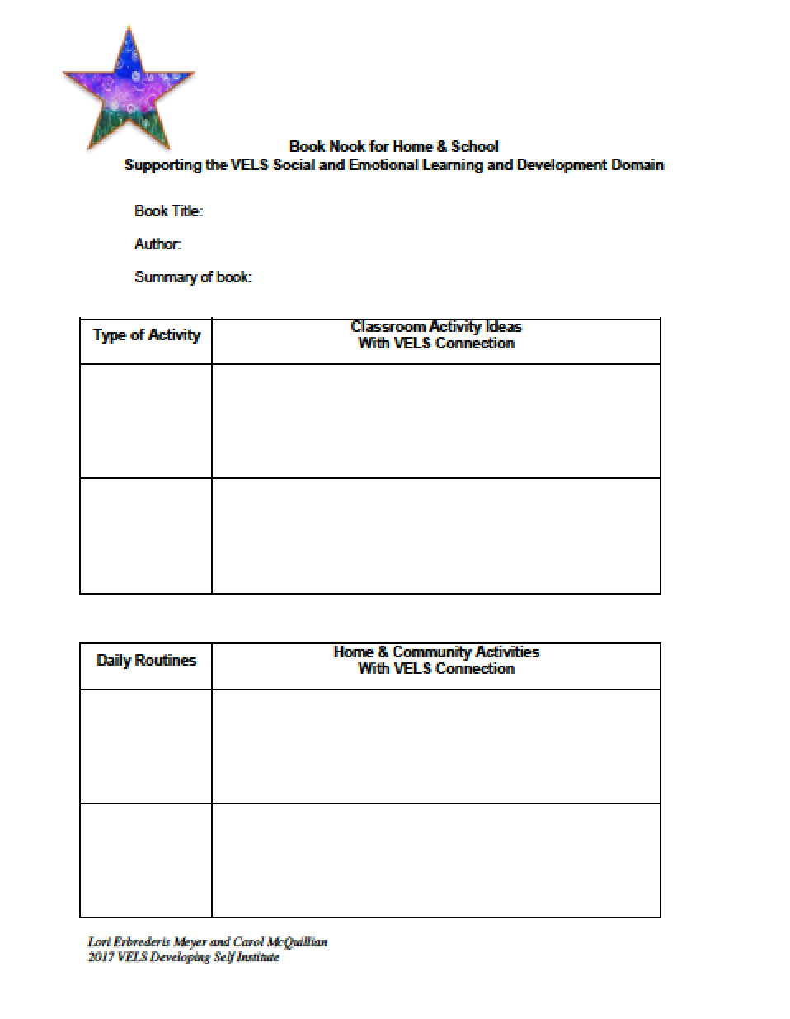

Slide 22
Current Events - Social-Emotional Impact
Childhood Trauma
Family Separation
Equity and Disproportionate Suspension
Military Families
Children in Foster Care or Adopted
Notes:
CHRISTINE
Suspension and Expulsion video - Rosemarie Allen - http://challengingbehavior.cbcs.usf.edu/Implementation/Equity/index.html
http://www.pyramidmodel.org/wp-content/uploads/2016/11/expelling_expulsion.pdf
http://challengingbehavior.cbcs.usf.edu/docs/PEP_Defining-Disproportionate-Discipline.pdf
Miltary - Reconnecting with your baby - https://www.zerotothree.org/resources/1101-home-again-re-connecting-with-your-baby
NAEYC blog on foster care - https://www.naeyc.org/resources/blog/when-foster-child-enters-care

Slide 23
Notes:
https://www.srcd.org
https://onlinelibrary.wiley.com/doi/toc/10.1111/(ISSN)1467-8624.the-science-of-childhood-trauma

Slide 24
Notes:
https://www.srcd.org
https://onlinelibrary.wiley.com/doi/toc/10.1111/(ISSN)1467-8624.the-science-of-childhood-trauma

Slide 25
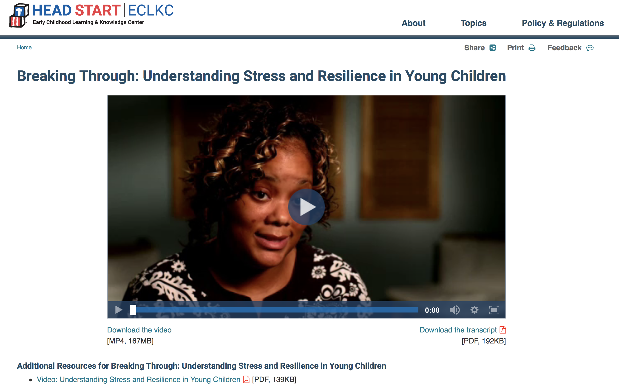
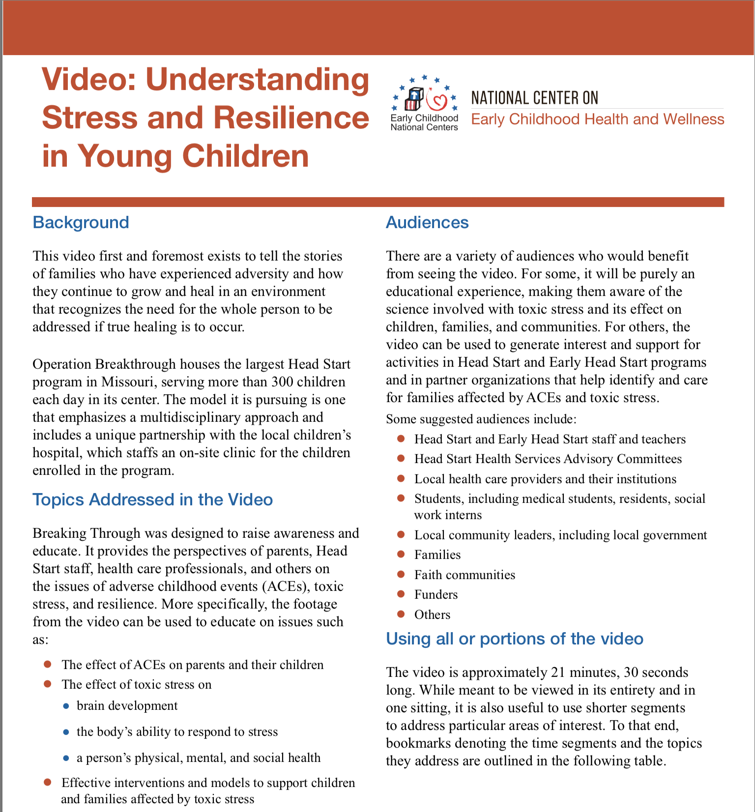
Notes:
https://eclkc.ohs.acf.hhs.gov/video/breaking-through-understanding-stress-resilience-young-children
https://eclkc.ohs.acf.hhs.gov/sites/default/files/pdf/understanding-stress-and-resilience-in-young-children.pdf

Slide 26
There is also an Early Childhood Toolkit for Child Welfare Professionals
Notes:
https://www.collaborative.org/sites/default/files/documents/SCSC-Toolkit_EC.pdf
https://www.collaborative.org/programs/early-childhood/system-change-successful-children/scsc-toolkits

